Slide 1
2021 Office Visit Evaluation and Management Changes January 2021
Provider Training
Rev. 12/9/2020
Julianne Tauscher, FNP
Dr. Steven Esrick, MD

Slide 2
Agenda
Overview of changes and why
Timeline and trainings
Billing on Time
Workflow changes
Billing on Medical Decision Making
Examples
Q & A

Slide 3
Timeline
1. Training Providers early Decembers 2020
2. Additional combined provider & staff training may be necessary- TBD
3. Changes go into effect on January 1, 2021 for all visits.
Throughout the year ongoing self-assessment and trainings may be offered
Peer review?
Videos and tables on the intranet

Slide 4
Objectives of changes
Decreased administrative burden of documentation/coding
Decrease the need for audits through expanding definitions and guidelines
Decrease unnecessary documentation not needed for patient care
Ensures resource-based payment, no direct goal for payment redistribution between specialties

Slide 5
Overview of changes
1. CPT codes that are affected – Office/outpatient E/M CPT codes 99202-99205 and 99211-99215
2. Deletion of CPT code 99201(kept 99211- mostly nursing use)
3. Components of E/M code selection
a) Total time on date of encounter or revised medical decision making (MDM)
b) Elimination of history and physical exam as key components of E/M code selection
4. Prolonged services add-on CPT codes
5. Primary care add-on code (GPC1X*)

Slide 6
Reducing administrative Burden -Revision summaries
Eliminate history & physical as elements of code selection
Providers should perform a “medically appropriate history and/or examination”
No need to re-record history & physical exam elements if collected by staff, only need to show evidence they were reviewed/updated.
Provider chooses if documentation is based on TOTAL TIME or MEDICAL DECISION MAKING (MDM)
Simplify code selection: more clinically relevant & intuitive

Slide 7
Reducing administrative Burden -Revision summaries
MDM Criteria Modified
Replaced “acute or chronic illness with systemic symptom” removed ambiguous terms such as “mild”
Defined terms such as “independent historian”
Data elements focus on tasks that impact patient management, such as independent interpretation of tests or consulting with external qualified healthcare provider
Created a shorter prolonged service code to add to 99205/99215 when time is used for coding

Slide 8
Overview of codes
CODE New/Established | TOTAL TIME New/Established | MDM: medically appropriate H&P plus:
99201/99211 | n/a | -
99202/99212 | 15-29 mins/ 10-19 mins | Straightforward Level of MDM
99203/99213 | 30-44 mins/ 20-29 mins | Low Level of MDM
99204/99214 | 45-59 mins/ 30-39 mins | Mod Level of MDM
99205/99215 | 60-74 mins/ 40-54 mins | High Level of MDM
Prolonged service code (99XXX) is over 74/54 mins if new/established patient.

Slide 9
Billing based on total time
The definition and calculation of total time have changed. It is important for providers and staff to understand what activities count toward total time, as well as any changes in practice workflows.
A. Updated definition of total time – The total time spent on the date of the encounter, including both face-to-face and non-face-to-face time spent personally by the physician and/or other qualified health care professional(s)

Slide 10
Can bill ON time when:
2020 | 2021
Counseling/coordination of care dominates (>50% of encounter) | Used to select an outpatient code whether or not counseling/coordination of care dominates
Only face to face time counts | Face-to-face and non-face-to-face time counts on date of service
Notes:
Can’t overlap, can’t double dip. Example if nurse and provider see patient together, can’t count it together.

Slide 11
Accounting for Provider /clinical time on date of encounter
Whose time counts?
a) Provider and “qualified healthcare providers” not otherwise billed for. Ex. IBH/ Integrated Nutrition
2. Examples of time that counts
a) Review of labs
b) Review of external records
c) Discussion with other health care professionals
d) Interpretation of tests or X-rays for which no additional code is being billed
3. Examples of time that does not count
a) Activities normally performed by clinical staff
b) Services reported separately
Notes:
Prepare to see patient, obtain/ review MA/ Clinical staff history
Perform Medically Necessary Exam/Eval
Order Meds, Tests, Procedures
Documentation in the EHR
Independent interpretation of results

Slide 12
Examples of time That Counts:
Prepare to see patient, review records/ review MA or Clinical staff history
Perform Medically Necessary Exam/Evaluation
Order Meds, Tests, Procedures
Documentation in the EHR on the date of service
Independent interpretation of results, ex. Review EKG/ Chest X-ray
Care coordination, Discussion with patient, family.

Slide 13
TIME (15-minute increments)
New Patient
CODE | TOTAL TIME
99201 | n/a
99202 | 15-29 mins
99203 | 30-44 mins
99204 | 45-59 mins
99205 | 60-74 mins
Established Patient
CODE | TOTAL TIME
99211 | Time removed
99212 | 10-19 mins
99213 | 20-29 mins
99214 | 30-39 mins
99215 | 40-54 mins

Slide 14
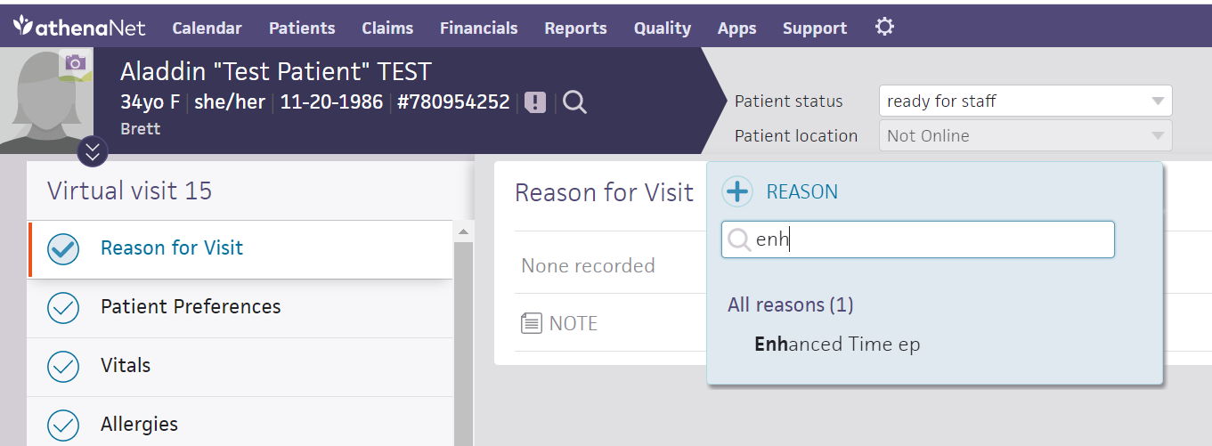
Workflow: Documentation by STaff
Encounter Plan Template Developed to capture language for time

Slide 15
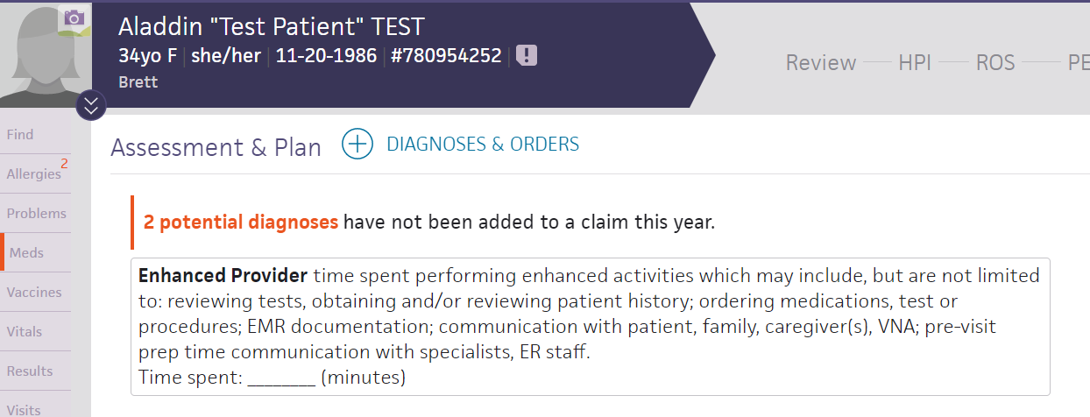
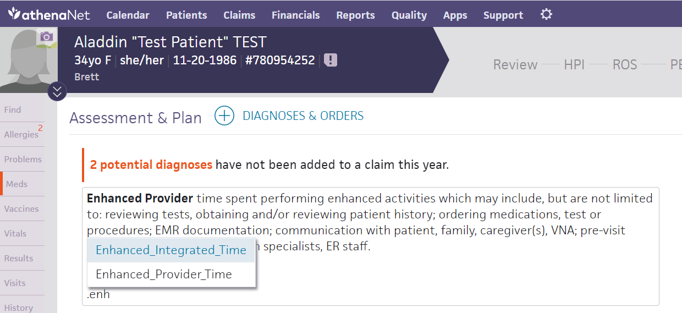
Macros in the A/P

Slide 16
Prolonged services add-on CPT codes
A. Prolonged services without direct patient contact (CPT codes 99358 and 99359)
B. Prolonged clinical staff services with supervision by physician or other qualified health care professional (CPT codes 99415 and 99416)
C. Prolonged services with or without direct patient contact on the date of an office or other outpatient service (99XXX**) NEW CODE
D. Payer coverage of prolonged services
1. Private payers
2. Medicare – As of January 1, 2021, Medicare does not cover CPT codes 99358 and 99359.
Notes:
To be clarified in the future, not as important but available possibly in the future

Slide 17
Prolonged Services: (99XXX)
Code only used with Level 5 codes (99205/99215)
Billed in 15 min increments
Prolonged time less than 15 mins is not reported
Face-to-face and non-face-to-face care
Can’t use with 99359, 99358,
99358 : non face to face prolonged service code may be used in conjunction with a prior recent service if more than 30 mins is spent (ex. Coordination of care or reviewing medical records)
Used if considerable time is spent reviewing a lot of work
Separate date, not typical patient

Slide 18
NEW Prolonged Service Code 99XXX
Total Duration of Established Office or Other Outpatient Services (use with 99215) | Code(s)
Less than 55 minutes | Not reported separately
55-69 minutes | 99215 X 1 and 99XXX X 1
70-84 minutes | 99215 X 1 and 99XXX X 2
85 or more | 99215 X 1 and 99XXX X 3 or more for each additional 15 minutes

Slide 19
Prolonged Service Timetable
TIMELINE
NEW | 1-14 | 15-29 | 30-44 | 45-59 | 60-74 | 75-89 | 90-104
 | Do not use time (99202 by MDM) | 99202 | 99203 | 99204 | 99205 | 99205+ 99XXX | 99205+ 2 units 99XXX
ESTABLISHED | 1-9 | 10-19 | 20-29 | 30-39 | 40-54 | 55-69 | 70-84
 | Do not use time (99212 by MDM) | 99212 | 99213 | 99214 | 99215 | 99215+ 99XXX | 99215+ 2 units 99XXX
From the AMA 2020 Presentation: CPT E/M Office Visit Changes: Using time to select a code level.

Slide 20
IV. Billing based on medical decision making
The MDM table has been updated.
Instead of a points system, the level of medical decision making is based on the types of tasks performed.
To qualify for a particular level of MDM, an E/M service must meet or exceed two out of the three elements for that level.
Be sure that providers and staff understand each element of MDM and what must be documented to support the level of service selected.

Slide 21
Additions and changes to the MDM table
A1. New/revised definitions
a) Independent historian – An individual (e.g., parent, guardian, surrogate, spouse, witness) who provides a history in addition to a history provided by the patient who is unable to provide a complete or reliable history (e.g., due to developmental stage, dementia, or psychosis) or because a confirmatory history is judged to be necessary. In the case where there may be conflict or poor communication between multiple historians and more than one historian(s) is needed, the independent historian(s) requirement is met.
b) Social determinants of health (SDoH) – Economic and social conditions that influence the health of people and communities (e.g., food or housing insecurity)
2. Based on types of tasks instead of number of tasks

Slide 22
Understanding the elements of MDM
1. Number and complexity of problems addressed
a) Minimal, low, moderate, or high
2. Amount and/or complexity of data to be reviewed and analyzed
a) Understanding categories of data
(1) Tests, documents, or independent historian(s)
(2) Independent interpretation of tests
(3) Discussion of management or test interpretation
b) Minimal/none, limited, moderate, or extensive
3. Risk of complications and/or morbidity or mortality of patient management
a) Minimal, low, moderate, or high risk of morbidity from additional diagnostic testing or treatment

Slide 24
#1 Number & Complexity of Problems Addressed at the Encounter
Must show that you review and analyzed a piece of data, not just copy & paste.
Cohesive encounter that can be documented in as few words as possible
#2 Amount and/or complexity of Data to be reviewed & analyzed
Straightforward
Minimal/None
Low (1 Category)
TWO documents/ or Independent Historian
Moderate (1 Category)
Count (3 items: documents or historian)
Interpret
Confer
High (2 Category)
Count (3 items: documents or historian)
Interpret
Confer
MDM TABLE ELEMENTS
#3 Risk of Complications and/or Morbidity or Mortality of Patient Management
Straightforward: Minimal Risk from Treatment/ no treatment or testing. (No risk essentially)
Low: low risk of any poor outcomes, minimal discussion/consent – Not a big deal, ex. such as an ACE may give you a cough.
Moderate: More risk we would review with patient, obtain consent, monitor labs, social factors may affect management
High: discuss risk for poor outcomes, required monitoring discussed, more serious discuss with or without treatment
Notes:
From AMA presentation CPT E/M Office Visit Changes: Using medical decision making to document an office visit

Slide 25
Selecting the level of MDM
1. Straightforward (CPT codes 99202 and 99212)
2. Low (CPT codes 99203 and 99213)
3. Moderate (CPT codes 99204 and 99214)
4. High (CPT codes 99205 and 99215)
5. MDM and CPT code 99211
6. Separately reported interpretation and/or report

Slide 26
Additional Info: Definitions
Term | Description | Examples
Acute, uncomplicated illness or injury | · The problem is recent and short-term. · There is a low risk of morbidity. · There is little to no risk of mortality with treatment. · Full recovery without functional impairment is expected. · The problem may be self-limited or minor, but it is not resolving in line with a definite and prescribed course. | · Cystitis · Allergic rhinitis · Simple sprain
Acute illness with systemic symptoms | · The illness causes systemic symptoms, which may be general or single system. · There is a high risk of morbidity without treatment. · For a minor illness with systemic symptoms like fever or fatigue, consider acute, uncomplicated or self-limited/minor instead. | · Pyelonephritis · Pneumonitis · Colitis
Acute, complicated injury | · Treatment requires evaluation of body systems that aren’t part of the injured organ, the injury is extensive, there are multiple treatment options, or there is a risk of morbidity with treatment. | · Head injury with brief loss of consciousness
Stable, chronic illness | · This type of problem is expected to last at least a year or until the patient’s death. · A change in stage or severity does not change whether a condition is chronic. · The patient’s treatment goals determine whether the illness is stable. A patient who hasn’t achieved their treatment goal is not stable, even if the condition hasn’t changed and there’s no short-term threat to life or function. · The risk of morbidity is significant without treatment. | · Well-controlled hypertension · Non-insulin dependent diabetes · Cataract · Benign prostatic hyperplasia · NOT stable: Asymptomatic but persistently poorly controlled blood pressure (pressures don’t change), with a treatment goal of better control
Chronic illness with exacerbation, progression, or side effects of treatment | · The chronic illness is getting worse, is not well controlled, or is progressing “with an intent to control progression.” · The condition requires additional care or treatment of the side effects. · Hospital level of care is not required. | · No examples given by CPT® guidelines
Chronic illness with severe exacerbation, progression, or side effects of treatment | · There is a significant risk of morbidity. · The patient may require hospital care. | · No examples given by CPT® guidelines
Acute or chronic illness or injury that poses a threat to life or bodily function | · There is a near-term threat to life or bodily function without treatment. · An acute illness with systemic symptoms, an acute complicated injury, or a chronic illness or injury with exacerbation and/or progression or side effects of treatment may be involved. | · Acute myocardial infarction · Pulmonary embolus · Severe respiratory distress · Progressive severe rheumatoid arthritis · Psychiatric illness with potential threat to self or others · Peritonitis · Acute renal failure · Abrupt change in neurologic status

Slide 27
For each of the levels: code based on either total time or medical decision making.
Visit level | Total time | Medical decision making | Example
Level 2 | <20 minutes (<30 minutes for new patients) | No medication prescribed | viral upper respiratory infection, or simple recheck for stable problem
Level 3 | 20-29 minutes (30-44 minutes for new patients) | One acute problem PLUS medication prescribed OR one test ordered and reviewed | strep screen, UTI w/ Urinalysis
Level 4 | 30-39 minutes (45-59 minutes for new patients) | At least one of the following: • One unstable chronic illness • Two stable chronic illnesses addressed • Acute complicated injury (e.g., concussion, fracture), • Acute illness with systemic symptoms (e.g., pyelonephritis or pneumonia), • New problem with uncertain prognosis (e.g., breast lump). PLUS at least one of the following: A. Prescription drug management, B. X-ray or ECG that is ordered and interpreted C. Total of three unique tests ordered or reviewed, external notes reviewed, or independent historians used (requires three “points” where each instance equals one point — e.g., three unique tests ordered or reviewed equals three points), D. Patient’s management or test discussed with external provider, E. Patient’s diagnosis and treatment limited by lack of money, food, or housing. OR: Prescription drug management plus at least one of the following: B, C, or D above. | Unstable=includes BP or A1C not to goal Chronic illness: HTN, DM, CKD
Level 5 | 40-54 minutes (60-74 minutes for new patients) | Severe acute illness or worsening chronic illness posing a threat to life or bodily function (e.g., myocardial infarction, pulmonary embolism, acute renal failure, severe respiratory distress, acute neurological change) PLUS at least one of the following: • Two of three from B, C, or D above, • Patient admitted by someone other than yourself, • Patient placed on warfarin, • Patient made DNR, care de-escalated.
From Millette, K. W. (2020) Countdown to the E/M Coding Changes. FPM. www.aafp.org/fpm.

Slide 28
Workflow
EHR changes/updates
1. Time will still be documented using macros
2. Provider documents MDM into A/P and medically appropriate appropriate history and physical exam
3. PROVIDER CHOICE: MDM or TIME

Slide 29
Primary care add-on code (GPC1X*) NEW CODE
A. Healthcare Common Procedure Coding System (HCPCS) code GPC1X* is an add-on code intended to reflect the resources associated with primary care visits.
B. Definition – Visit complexity inherent to evaluation and management associated with medical care services that serve as the continuing focal point for all needed health care services and/or with medical care services that are part of ongoing care related to a patient’s single, serious, or complex chronic condition
C. Payer coverage
1. Private payers
2. Medicare
Notes:
Save for later?

Slide 30
ExampleS(Time)
Medical staff completes vital signs, chief complaint
No, usual care
Medical Staff reviews PHQ9, Review med reconciliation, Social history, and review’s QM
No, Medical staff are not “qualified healthcare providers”
Patient with new onset diabetes meets with with nutrition for 20 mins for integrated visit
Yes, QHP, not billed for otherwise
Patient meets with Integrated behavioral health on date of PCP visit
Yes, IBH are QHP, service was not otherwise billed for
Triage nursing spends 10 mins on phone with patient collecting history and then after consult w/ provider patient is booked for same day visit
No, at this time we can’t count nursing time

Slide 31
Example 1 (MDM vs Time)
45 y/o pt w/ HTN seen for follow-up. No other concerns.
VS: 148/90, 148/98, 142/92 HR 68
Meds: Lisinopril 10 mg
NKDA
Document Medically appropriate H&P
Taking medication without side effects. On low salt, healthy diet. No alcohol. Exercise 2x/week. Denies headache, vision changes, chest pain, SOB, cough, edema.
Exam: Well appearing, NAD. Cardiac Normal S1, S2, RRR, No Murmurs. No edema. RESP: LSCTA
A/P Uncontrolled HTN, not at goal of 130/80. Reviewed recently normal BMP, Lipids. Plan to increase Lisinopril to 20 mg daily, reviewed med risks & side effects Follow-up in 4 weeks.
CODE is Provider choice
Time 5 mins(chart prep) + 10 mins (provider) + 5 mins(documentation) = 20 mins (99213)
MDM= Chronic illness problem, moderate risk due to medication management 99214

Slide 32
Example 2
58 y/o M w/ HTN, anxiety, and BPH seen for blood pressure follow-up and-oh-by-the-way his calf has been hurting for the last few weeks and there is some swelling in one leg that hurts. No injuries.
VS 152/100, 150/96 HR 78
NKDA/ Meds: HCTZ 25 mg, Metoprolol 25, hydroxyzine 25, finasteride 5mg
Medically appropriate exam & hx
A/P
1. HTN – uncontrolled, not at goal. Increase metoprolol to 50 mg and f/u in a week. Instruct to check heart rate.
2. Lower extremity edema with tenderness = DVT
Venous duplex same day, shows + DVT, start anti-coagulation, med risks and side effects reviewed. Medication information given. Discussed if chest pain, weakness, difficulty speaking, short of breath, bleeding to seek emergent medical care. Anti-coag nurses will follow up.
Labs for w/u of DVT
CODE 99215 , 1 acute or chronic illness that poses a threat to life/ body , high risk drug therapy that requires intensive monitoring for toxicity

Slide 33
Example 3
45 y/o M established patient w/ new onset diabetes. Seen for med management follow up.
Meds Metformin, Statin
VS 120/70, HR 80, WT 250, Height 5’4”
Labs HgA1C 9.0, Lipids elevated, MAU Panel normal, CMP normal,
Review ophthalmology consult neg for retinopathy.
Medically appropriate H&P
A/P Uncontrolled Type 2 Diabetic
-Reviewed labs. adjust medications, review diet, exercise, weight loss, foot exams, eye exams
-25 mins provider including review/exam/documentation/ordering
-Patient meets with 20 mins with nutrition and 15 mins with nursing for glucometer teaching
Time = 5(chart prep) + 20 (provider) + 20(nutrition) = 45 mins
= 99215 based on TIME

Slide 34
RVU Changes
Code(New) | Current RVU | New RVU
99202 | 0.93 | 0.93
99203 | 1.42 | 1.60
99204 | 2.43 | 2.60
99205 | 3.17 | 3.50
Code(Established) | Current RVU | New RVU
99211 | 0.18 | 0.18
99212 | 0.48 | 0.70
99213 | 0.97 | 1.30
99214 | 1.50 | 1.92
99215 | 2.11 | 2.80
99XXX | - | 0.61
Notes:
99XXX = 0.63

Slide 35
Conclusion
A. Summary of changes
B. Information on what has been communicated to patients
C. Resources
1. Staff contact for follow-up questions: Dr. Esrick, Julianne Tauscher, Martha
2. AMA – CPT® Evaluation and Management (E/M) Office or Other Outpatient (99202-99215) and Prolonged Services (99354, 99355, 99356, 99XXX) Code and Guideline Changes (available online at www.ama-assn.org/system/files/2019-06/cpt-office-prolonged-svs-code-changes.pdf)
3. AAFP – Coding for Evaluation and Management Services (available online at www.aafp.org/emcoding)
* HCPCS code GPC1X is a placeholder code. CMS will release the final code later this year.
** CPT code 99XXX represents a placeholder code. The AMA will release the final code later this year.

Slide 36
References
AMA. (2020). Implementing CPT Evaluation and Management (E/M) revisions. https://www.ama-assn.org/practice-management/cpt/implementing-cpt-evaluation-and-management-em-revisions
Millette, K. W. (2020, September). Countdown to the E/M Coding Changes. American Academy of Family Physicians: FPM. 29-36. www.aafp.org/fpm
AAFP. (2020). 2021 Office Visit Evaluation and Management Documentation Changes: Practice Training Outline.
AAPC. (2020). What’s Changing for E/M Codes 99201-99215 in 2021? Advancing the Business of Healthcare. https://www.aapc.com/evaluation-management/em-codes-changes-2021.aspx

Slide 37
Q & A
Disclaimer: We may not have all the answers but will work on getting them to you.

