Slide 1
Cocaine Use Disorder Treatment
Meaghan Foster MS4
University of Massachusetts Medical School

Slide 2
Efficacy of Topiramate in the Treatment of Crack Cocaine Dependence, A Double-Blind Randomized Placebo-Controlled Trial Leonardo Baldaçara, MD, PhDa,*; Hugo Cogo-Moreira, PhDb; Bruna Leal Parreira, MDa; Thaynne Almeida Diniz, MDa; Jaqueline Jerônimo Milhomem, MDa; Camila Campitelli Fernandes, MDa,c; and Acioly Luiz Tavares Lacerda, MD, PhDd Journal of Clinical Psychiatry, 2016
Primary End Points
Detection of benzoylecgonine, UDS x2/week
Retention (# patients completed study without data loss)
Frequency of cocaine smoking (mean # days/week)
Amount of cocaine (mean daily use, g)
Mean amount of money spent on cocaine per week
Secondary End Points
AE
# of dropouts
Notes:
Benzoylecgonine = cocaine metabolite, cutoff value ≥ 300 ng/mL
Toriramate – antieleptic and migraine prophylaxis, also has been used in alcohol dependence.
MOA is unknown but hypothesized… (1) voltage-gated sodium channels; (2) high-voltage-activated calcium channels; (3) GABA-A receptors; (4) AMPA/kainate receptors; and (5) carbonic anhydrase isoenzymes. - wiki

Slide 3
Methodology Double-blind, randomized, placebo-controlled trial Subjects: DSM-IV dx of cocaine dependence, used crack cocaine exclusively 91 assessed → 60 men randomized → 29 in each group completed the study Study Period: 2013-2014
Topirmate
Starting dose = 50mg daily
Increased weekly by 25-50mg depending on tolerability for the first 4 weeks
Max dose 200mg daily
Max tolerated dose continued daily throughout remaining 8 weeks
Placebo
Identically appearing capsules taken daily
Both
Motivational interviews & group therapy treatments

Slide 4
Results
Timeline:
4th week: 18 subjects in Topiramate group neg UDS vs 6 subjects in Placebo group (χ2 = 10.357, P = .002, absolute risk reduction [ARR] = 40.0%, NNT = 3)
10th week: 19 subjects in Topiramate group neg UDS vs 7 subjects in Placebo group (χ2 = 9.427, P =.002, ARR = 40.0%, NNT = 3)
12th week: 20 subjects in Topiramate group neg UDS vs 4 subjects in Placebo group (χ2 = 18.196, P < .001, ARR = 53.33%, NNT = 2)
Other Primary End Points:
Quantity of cocaine used (mean reduction = −3.108 g, P < .001)
Frequency of use (mean reduction = −0.784 times per week, P = .005)
Money spent on cocaine (mean reduction [US dollars] = −$25.38, P = .015)
Retention was not significant (odds ratio [OR] = 1.072, P = .908)
Overall:
Topiramate 8.68-fold chance (OR) of obtaining a negative UDS vs. those in the placebo group.
Notes:
Detection of benzoylecgonine, UDS x2/week
Retention (# patients completed study without data loss)
Frequency of cocaine smoking (mean # days/week)
Amount of cocaine (mean daily use, g)
Mean amount of money spent on cocaine per week
Mean reduction – mean difference compared to reference group
OR - What are the odds of disease in the people who were exposed vs odds of no disease in the people who were exposed

Slide 5
AEs
Side effects observed in 8 subjects (26%) in topiramate group vs 6 subjects (20%) in placebo group (χ2 = 0.373, P = .542, NNH = 15)
Topiramate group common AEs
Headache (n = 2)
Fatigue (n = 2)
Diarrhea (n = 1)
Dizziness (n = 2)
Nausea (n = 2).
Note: No subjects developed symptoms of renal lithiasis
Placebo group common AEs
Headache (n = 3)
Fatigue (n = 2)
Dizziness (n =2)
Notes:
Common AEs = tingling, loss of appetite, feeling tired, abdominal pain, hair loss, and trouble concentrating.^{[1][2]} Serious side effects may include suicide, increased ammonia levels resulting in encephalopathy, and kidney stones.^{[1]} Use in pregnancy may result in harm to the baby and use during breastfeeding is not recommended.^{[3]} - wiki

Slide 6
Study Limitations
Relatively small sample size
Only males study without Axis I (DSM IV) comorbidities were enrolled
Study was conducted within a single site – potentially limits generalizability of findings
Notes:
We observed that some subjects discontinued the use of cocaine early in the treatment (Table 3 and Figure 2), whereas others used the drug for a longer time period. In the latter group (those who did not stop using the drug), topiramate demonstrated the potential to reduce cocaine use in the first 4 weeks of treatment when the dose was increased to 200 mg. In subsequent weeks, this interaction over time was not present, suggesting that prolonged use of topiramate may not be beneficial or that the maximum dosage of 200 mg had a limited effect. We hypothesized that higher doses of topiramate could decrease the amount of cocaine used over time, and this possibility should be explored in future research.

Slide 7
Pharmacotherapy for Cocaine Use Disorder—a Systematic Review and Meta-analysis Brian Chan, MD MPH, Karli Kondo, PhD MA, Michele Freeman, MPH , Chelsea Ayers, BA , Jessica Montgomery, MPH, and Devan Kansagara, MD MCR Journal of General Internal Medicine, 2019
Outcomes:
Sustained abstinence (three or more weeks of negative UDS)
Cocaine Use
Lapse (first cocaine positive or missing UDS)
Relapse (two consecutive cocaine positive or missed UDS)
Treatment retention
Harm
SAEs
Treatment dropouts d/t AEs
Notes:
Lapse = first cocaine positive or missing UDS
Relapse = two consecutive cocaine positive or missed UDS

Slide 8
Methodology
Searches through MEDLINE, PsycINFO, and EBM Reviews Cochrane Database of Systematic Reviews through November 2017
5564 articles on stimulant use disorders → 7 systemic reviews + 48 RCTs included
66 different drugs considered

Slide 9
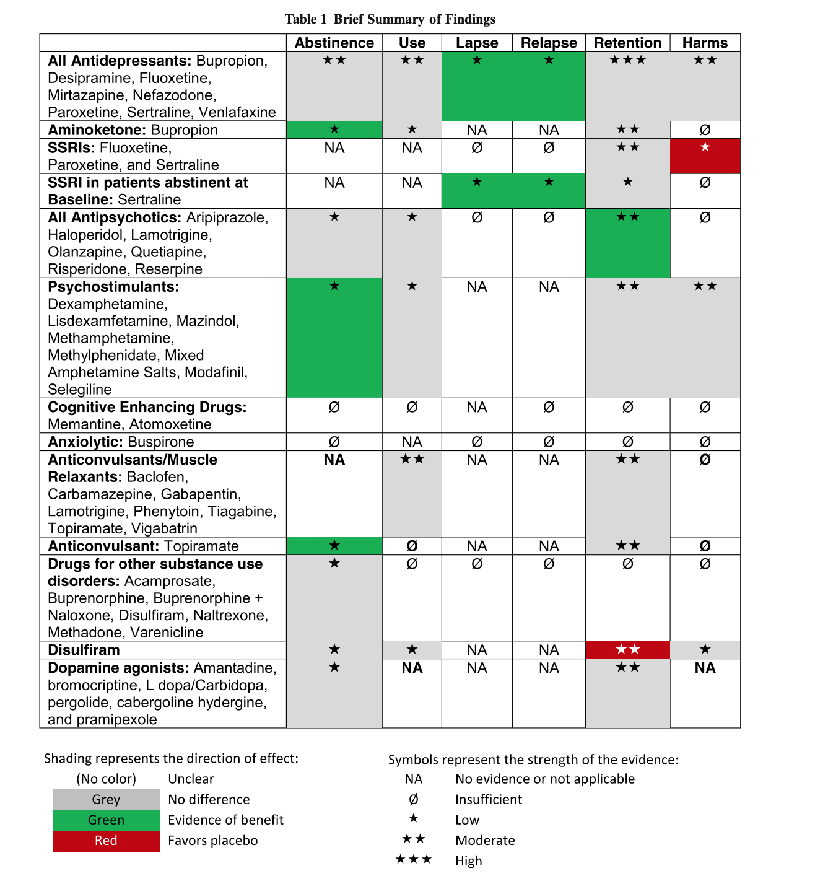
Summary of Findings
Low SOE bupropion, psychostimulants, and topiramate may improve abstinence
Bupropion esp for patients w/ co-morbid depression in conjunction w/ CM
Low SOE that sertraline may reduce relapse rates in abstinent patients
Moderate SOE that antipsychotics may improve treatment retention
Moderate SOE that disulfiram may worsen treatment retention
Low SOE that SSRIs assoc. w/ higher dropouts 2/2 AEs
Low SOE antidepressants + psychostimulants improved cocaine use outcomes in patients w/ comorbid opioid use disorder
Notes:
SOE determination - https://www.ncbi.nlm.nih.gov/pubmed/24404627 2013 AHRQ Systematic Reviews Original Methods Research Reports

Slide 10
Study Limitations
Definition of abstinence - didn’t include studies w/ differing definitions
This definition served as proxy for sustained abstinence…effects of treatment on long-term abstinence cannot be directly interpolated
Considered retention as an outcome since improving retention in treatment increases chances for successful recovery
However therefore could not consider study retention in SOE assessment
Overall low rates of retention may have affected assessment of treatment effectiveness in the majority of studies (attrition was greater than 20% in more than a third of the trials reporting retention rates)

