Slide 1
PrEP Update: Apretude
Sara Utzschneider NP-C, WHNP-BC
VMG LGBTQ+ Clinical Champion Lead
4/27/2023

Slide 2
Cabotegravir LA (Apretude)
FDA approved Dec 2021
IM gluteal injection q 2 months
Consider for:
Patients with renal dysfunction or bone dysfunction (osteoporosis)
Patients with difficulty adhering to daily oral medication
Patients who prefer injection every 2 months, able to come in to office every 2 months for labs and medical visit.

Slide 3
HPTN 083 trial Randomized, double-blind, double-dummy, non inferiority trial to eval the safety and efficacy of CAB-LA with that of TDF–FTC for the prevention of HIV infection
Population studied: MSM and transgender women who have sex with men, multicenter trial conducted in United States, Latin America, Asia, and Africa.
4,566 participants over 153 weeks
12.5% trans women, 49.8% identified Black, median age 26 years
Effect of study consistent across pre-specified sub-groups
HIV Incidence #52 cases (hazard ratio, 0.34; 95% confidence interval, 0.18 to 0.62)
13 cases on CAB LA (incidence, 0.41 per 100 person-years) (risk of HIV infection 66% lower thank TDF-FTC group
4 incident infections were observed despite on-time injections and expected cabotegravir concentrations in plasma
INSTI resistance was detected in 5 participants in the cabotegravir group (1 with baseline infection and 4 with incident infection
39 cases on TDF-FTC (incidence, 1.22 per 100 person-years)
Side effects
Injection-site reactions were reported in 81.4% of the participants in the cabotegravir group and in 31.3% of those in the TDF–FTC group. (2.4% chose not to continue injections)
In the participants in whom HIV infection was diagnosed after exposure to CAB-LA, INSTI resistance and delays in the detection of HIV infection were noted.
No safety concerns were identified.
(Landovitz et al., 2021)
Notes:
https://www.nejm.org/doi/full/10.1056/NEJMoa2101016

Slide 4
HPTN 084 trial Randomized, double-blind, placebo-controlled superiority trial to evaluate the safety and efficacy of cabotegravir LA compared to daily oral TDF/FTC for prevention of HIV.
Study conducted in sub-Saharan African with cis gender women at risk of HIV contraction
N=3224
Incidence of HIV infection 88% lower in CAB group compared to TDF/FTC
4 in CAB group (out of 1,592) ( 0.2 cases per 100 person-years [0.06–0.52])
36 in TDF/FTC group (out of 1,586) (1.85 cases per 100 person-years [1.3–2.57]
Side effects
Injection site irritation (CAB 38% vs TDF/FTC 10.7%), no cessation of injections
Confirmed pregnancy incidence was 1.3 per 100 person-years (0.9–1.7); no congenital birth anomalies were reported.
no INST resistance mutations were detected in HPTN 084
(Delany-Moretlwe et al., 2022)
Notes:
https://www.thelancet.com/journals/lancet/article/PIIS0140-6736(22)00538-4/fulltext

Slide 5
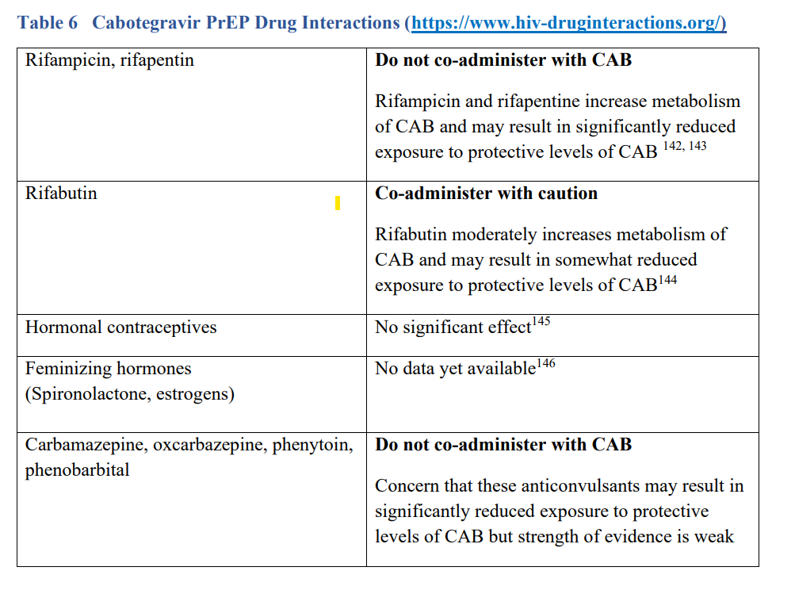
Cabotegravir Drug Interactions
(US Public Health Service, 2021, p. 48)
Notes:
CDC

Slide 6
Initiation Visit
Lead In
5 week lead in of oral cabotegravir (30mg PO daily) during clinical trials, no safety concerns during lead in or with injections. Is not necessary, but may be considered for patients concerned for side effects. Continued daily use NOT recommended or FDA approved.
If prescribing lead in oral cabotegravir, prescribe 4 weeks. Check HIV-1 RNA 1 week before scheduled initial injection. Can start Apretude on last day of lead-in or within 3 days after last oral dose.
Transitioning from F-TDF or F-TAF
Can initiate CAB injections as soon as HIV-1 RNA test results confirm that they remain HIV negative (negative HIV-1 RNA test within past week)
Initial Labs
HIV-1 RNA, HIV 4th gen ant/ag
Bacterial STI testing based on risk
Side effects (injection site irritation, diarrhea, nausea)
Time to protection – no data yet from clinical trials from time of initiation to maximal protection (per CDC). UpToDate advises minimum 1 week, conservative estimate 1 month
CAB PrEP has been associated with delayed seroconversion and detection of HIV acquisition
(US Public Health Service, 2021, p. 48-51)
(Krakower, 2023)
Notes:
CDC

Slide 7
VMG Clinical Policy and Procedure for Apretude Administration and Management
Provider patient visit to carefully discuss medication, counsel on possible side effects, importance of adherence, risk of development of resistance, dosing and testing schedule
If shared decision to initiate, PCP sends case to nursing (keep open)
Medication ordered through specialty pharmacy Walgreens in Florence
Order labs (HIV-1 RNA), must be done within 7 days of initial injection
Patient to notify clinical staff of expected med delivery and lab appointment dates.
Med delivered to health center, documented in case that has been received, forward case to assigned clinical staff for notification.
Med clearly labeled w patient information and stored appropriately
Lab results to provider, review, if neg for HIV provider sends case to clinical staff authorizing Apretude administration. Clinical staff documents in open case that med received, lab up to date, med authorized. Patient then contacted and appointment scheduled with nurse in treatment schedule and with provider.
Nursing to administer the medication.
Subsequent injections, patient to be scheduled with provider. Tickler report to be created by assigned clinical staff for 1 month and then every 2 months therafter. Med can be administered up to 7 days before or after scheduled date of injection.

Slide 8
Follow up visits
1 month after initial injection, and then every 2 months thereafter
Repeat HIV-1 RNA test and assess for signs or symptoms of acute infection
Administer CAB injection
Provide access to clean needles/syringes and drug treatment services for PWID
Respond to new questions and provide any new information about CAB PrEP
Discuss the benefits of persistent CAB PrEP use and adherence to scheduled injection visits
Bacterial STI testing q 4-6 months per risk
(Krakower, 2023)
(US Public Health Service, 2021, p. 52)
Notes:
CDC

Slide 9
Ambiguous test result?
Carefully assess with the patient their medication adherence since the last negative HIV test visit;
Draw a new blood specimen after a few days for repeat laboratory HIV testing including Ag/Ab and quantitative NAT testing
If results are still ambiguous, contact the PrEPline (855-448-7737) for further testing advice and identification of a laboratory that can do specialized testing. National Clinician Consultation Center: PrEP Guidelines & Resources ((855) 448-7737 or (855) HIV-PrEP; 9 a.m. to 8 p.m. ET, Monday to Friday)
While HIV status is being confirmed, clinicians should not administer a new CAB injection. During the 1-2 weeks needed for additional HIV testing to determine HIV status, CAB is likely to remain at protective levels. o If the final determination is that the patient has acquired HIV, treatment should be immediately started. Follow guidance in section on “Persons with Documented HIV Infection” o If determined not to have acquired HIV, CAB injections every 2 months should resume.
(US Public Health Service, 2021, p. 54-55)
Notes:
CDC

Slide 10
Planned missed injections
If a patient plans to miss a scheduled every-2-month continuation injection visit by >7 days, administer oral cabotegravir 30 mg once daily for up to 2 months to replace 1 missed scheduled every-2-month injection. The first dose of oral therapy should be administered ~2 months after the last injection dose
Restart injections on the day oral dosing is stopped or within 3 days after.
If oral cabotegravir is continued >2 months, an alternative oral PrEP regimen is recommended.
(Krakower, 2023)
Notes:
UpToDate

Slide 11
Unplanned missed injections
If a scheduled injection visit is missed or delayed by >7 days and oral therapy has not been administered in the interim, clinically reassess patient to determine appropriateness of resumption of injection dosing. If injection dosing will be continued, administer as follows:
Second injection missed:
≤2 months since first injection: Administer missed injection as soon as possible, then continue to follow the every-2-month injection dosing schedule.
>2 months since first injection: Restart with cabotegravir 600 mg IM, followed by a second 600 mg IM injection dose 1 month later. Then, continue to follow the every-2-month injection dosing schedule.
Third or subsequent injection missed:
≤3 months since last injection: Administer missed injection as soon as possible, then continue with every-2-month injection dosing schedule.
>3 months since last injection: Restart with cabotegravir 600 mg IM, followed by a second 600 mg IM injection dose 1 month later. Then, continue with the every-2-month injection dosing schedule.
(Krakower, 2023)

Slide 12
Discontinuing Apretude
Re-educate about “tail”, risks during declining CAB levels
Assess ongoing risk / infections
If PrEP is indicated, prescribe daily oral F/TDF or F/TAF beginning within 8 weeks after last injection
Educate about nPEP
Continue follow-up visits quarterly for 12 months
Conduct HIV-1 RNA testing at each quarterly visit after discontinuing CAB
(Krakower, 2023)
(US Public Health Service, 2021, p. 52-53)

Slide 13
Paying for PrEP
Most commercial drug plans are required to fully cover one form of PrEP. Unclear how easily will be covered, may need PA demonstrating side effect to other drugs, contraindications (thing renal or bone dysfunction), or issues with daily med adherence.
Not all Medicare plans cover PrEP, however Apretude is eligible under Medicare Part B but patient many need to pay part of the cost.
Does your patient need help paying for PrEP? Connect patient to the MA PrEP Drug Assistance Program via website at https://accesshealthma.org/prevention/prepdap/ or call (617) 502-1700, option 4.
Apretude savings program helps eligible patients with out of pocket costs (not for consumers eligible for Medicare or other government programs) https://apretudecopayprogram.com/

Slide 14
References
Cabotegravir: Drug information. (2023). UpToDate. Retrieved on April 27, 2023 from https://www.uptodate.com/contents/cabotegravir-drug-information?search=apretude&selectedTitle=1~22&usage_type=panel&display_rank=1&kp_tab=drug_general&source=panel_search_result
Delany-Moretlwe, S., Hughes, J. P., Bock, P., Ouma, S. G., Hunidzarira, P., Kalonji, D., Kayange, N., Makhema, J., Mandima, P., Mathew, C., Spooner, E., Mpendo, J., Mukwekwerere, P., Mgodi, N., Ntege, P. N., Nair, G., Nakabiito, C., Nuwagaba-Biribonwoha, H., Panchia, R., … Hosseinipour, M. C. (2022). Cabotegravir for the prevention of HIV-1 in women: results from HPTN 084, a phase 3, randomized clinical trial. The Lancet. 399(10337), 1779-1789. https://doi.org/10.1016/S0140-6736(22)00538-4
Krakower, D. & Mayer, K. (2023). HIV pre-exposure prophylaxis. UpToDate. Retrieved April 27, 2023 from https://www.uptodate.com/contents/hiv-pre-exposure-prophylaxis?search=prep%20&source=search_result&selectedTitle=1~124&usage_type=default&display_rank=
Landovitz, R.J., Donnell, D., Clement, M.E, Hanscom, B., Cottle, L., Coelho, L., Cabello, R., Chariyalertsak, S., Dunne, E. F., Frank, I., Gallardo-Cartagena, J. A., & Gaur, A. H. (2021). Cabotegravir for HIV Prevention in Cisgender Men and Transgender Women. The New England Journal of Medicine, 385:595-608. https://www.nejm.org/doi/full/10.1056/NEJMoa2101016
US Public Health Service. (2021). Preexposure prophylaxis for the prevention of HIV infection in the United States – 2021 update: A clinical practice guide. Centers for Disease Control and Prevention. https://www.cdc.gov/hiv/pdf/risk/prep/cdc-hiv-prep-guidelines-2021.pdf

