Slide 1
Pediatric and Maternal Screening Tools
Presented by:
David Slack, M.D.

Slide 2
SWYC
Developed at Tufts Medical Center by Ellen Perrin M.D. and Chris Sheldrick PHD, Zach Visco BA and Kathryn Mattern BA
Looks at early childhood development, and adverse childhood experiences, to screen for concerning issues
To be used for children under 5-1/2 years of age. Short , less than 10 minutes for parents to fill out

Slide 3
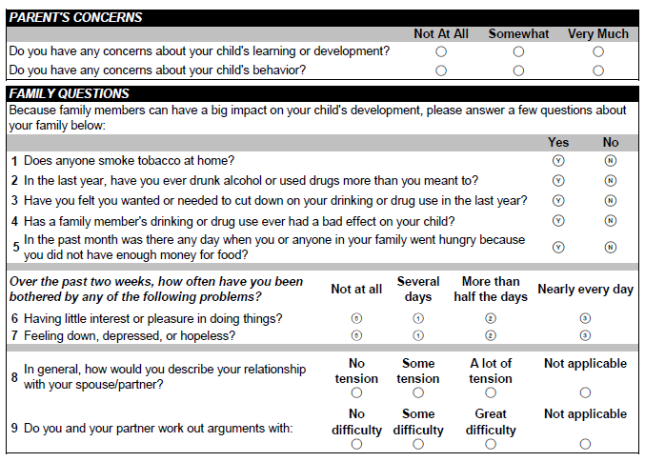
SWYC: Survey of Well-being of Young Children www.theSWYC.org

Slide 4
How to administer
#1 reception chooses the appropriate form for the child’s age , one for each WCC
(the first form, 2 month WCC, is not statistically significant, but can yield some important information)
#2.Parent or caregiver Fills out the form prior to the provider seeing the patient
#3 the medical assistant or LPN reviews the form for completeness prior to the visit and scores the developmental section only. ( provider scores the rest )
#4 scores are recorded under the vital signs, either a “Pass” score, or “needs attention”

Slide 5
Scoring the developmental portion
The top several milestones are the easy ones, the bottom several ones are more difficult. If a score shows that the child “needs attention” then doing a follow-up at the next visit would be appropriate. If child continues to not meet milestones , consider referral to Criterion ((REACH) , and may need other consultation
The score is obtained by totaling of the 0, 1, 2 point columns

Slide 6
SWYC Scoring

Slide 7
BPSC and PPSC
#1 BPSC-baby pediatric symptom checklist-
for ages : 2 months – 18 months
Any 3 points or more in any of the 3 sections- Child is “AT RISK”
#2 PPSC-preschool pediatric symptom checklist for ages 24 months – 5 years
Score of 9 or more _”AT RISK”

Slide 8
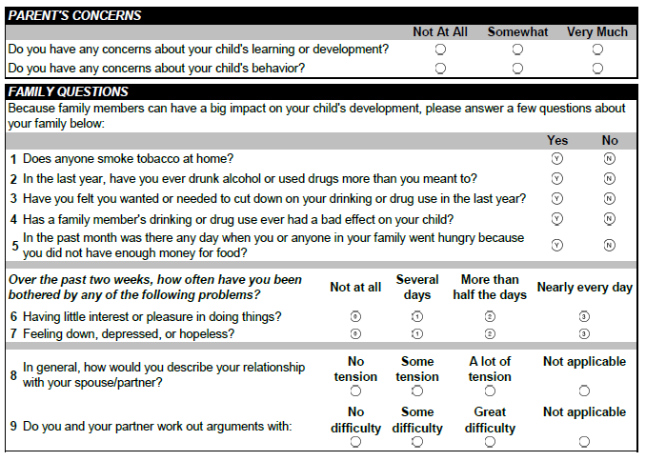
SWYC

Slide 9
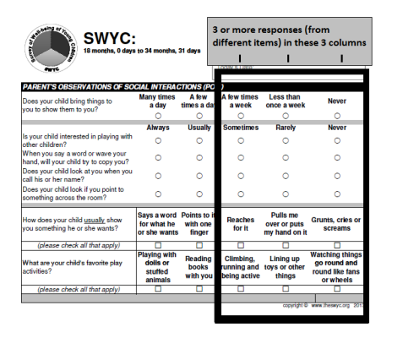
SWYC

Slide 10
POSI
Parents observation of social interactions
This is a developmental screen for autistic behavior. There are a total of 7 separate questions Each positive answer in the last 3 rows on the right, counts as 1point
Any score of 3 points or greater- “AT RISK”
You would then administer the MCHAT-R, this
questionnaire is in the EMR ( same place as the PHQ9)

Slide 11
MCHAT-R: Modified Checklist for Autism in Toddlers Revised

Slide 12
SWYC Scoring

Slide 13
PSC and Y PSC
These forms we are already doing,
Never – O points Sometimes – 1 point
Often – 2 points
PSC-pediatric symptom checklist, ages 6–11 years, over 28 points total- “psychological impairment”
YPSC-youth report-ages 11-18 years
Over 30 points total “psychological impairment”
If more than 4 blanks- invalid

Slide 14
Y-PSC: Pediatric Symptom Checklist- Youth Report

Slide 15
PSC: Pediatric Symptom Checklist

Slide 16
Postpartum depression screening
Using the Edinburgh questionnaire
Recommend using at the first newborn visit, 1 month, 2 months, 4 months
If positive this is a good place to use integrated behavioral health consultation

Slide 17
EPDS: Edinburgh Postnatal Depression Scale

Slide 18
billing
This is not the most important slide
CODE 96110
For every pediatric visit adding this code
May bring us extra money
We will try to attach it to the visits, but in the meantime please remember to code for the screening

Slide 19
Pediatric Vaccine Schedule

Slide 20
Pediatric immunizations
As a pediatric committee we have decided
to use PEDAIRIX ( DTP, Hep B, IPV) in all the health centers, the supply of PENTACEL ( DTP, HIB IPV) , has been quite undependable. We will now be required to carry only one or the other, and Pediarix seemed to be the most reliable
There are 2 new combination vaccines
Kinrex – DTaP and IPV
Proquad – MMR and Varicella
Both are only for the 4 or 5 year well-child check

Slide 21
HPV vaccination
For ages 11 through 14 years
Require only 2 vaccines, 6 months apart
For ages 15–26 years
Required 3 vaccines, baseline, 2 months, 6 months
Better to get it early and have less vaccines

Slide 22
Other recommendations
VISION-Recommended ages 4, 5, 6, 7, 8, 10, 12, 15
Hearing – ages 4, 5, 6, 8, 10 years
Flu vaccine, starting at 6 months of age, first dose needs a booster 1 month later, this is true up till age 9

Slide 23
Dr. Bob’s Alternative Vaccine Schedule

Slide 24
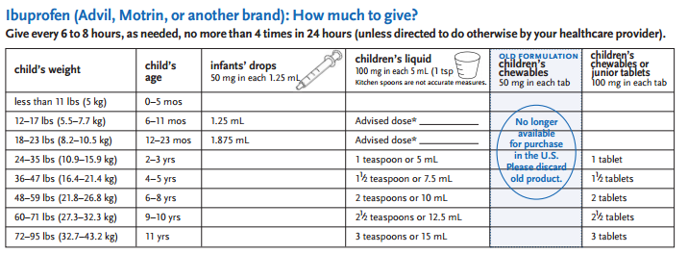
Pediatric OTC Medicines and Dosages

Slide 25
Most important
Be sure to laugh with your patients
Try not to get frustrated with the helicopter parents who only want to do one vaccine every 2 years
Remember that it is possible to breast-feed until age 10, and that’s a Valley thing

