Slide 1

Update on the Diagnosis and Treatment of Osteoporosis
Matthew Spitzer, MD
Valley Medical Group
Endocrinology
mspitzer@vmgma.com
(347) 463-8333

Slide 2
Objectives
Review the diagnosis and testing for osteoporosis
Discuss lifestyle and nutritional changes
Provide a practical approach to the medical treatment osteoporosis
Describe the pros and cons of osteoporosis medications
Discuss rare complications of meds and treatment of older persons

Slide 3
Diagnosis of Osteoporosis
Premenopause or Men Less than 50y
Low bone density for age (z-score ≤ -2) with fragility fracture and/or risk factors (glucocorticoid therapy, hypogonadism, hyperparathyroidism)
Postmenopause or Men Greater than 50y
Fragility fracture, especially of the spine, hip, wrist, humerus, rib and pelvis OR
T-score ≤ -2.5 after menopause or age 50y in men
Rosen 2019 Clinical manifestations, diagnosis and evaluation of osteoporosis in postmenopausal women, uptodate.com
Finkelstein 2019 Clinical manifestations, diagnosis, and evaluation of osteoporosis in men, uptodate.com
Cohen 2017 Premenopausal Osteoporosis

Slide 4
T-scores
A T-score is the difference between the patient’s bone mineral density and a young adult population divided by the standard deviation of the young adult population
-2.4< Low bone mass (Osteopenia) < -1
Osteoporosis ≤ -2.5
Lewiecki 2019 Overview of dual-energy x-ary absorptiometry, uptodate.com

Slide 5
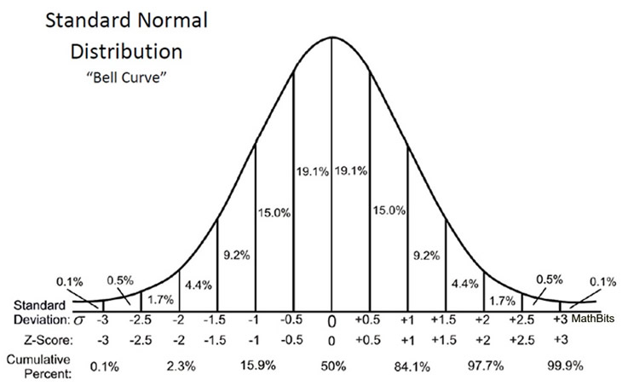
Z-scores
Z-score is the bone density standardized for age and sex
Z-score -2 = 2nd percentile for age
Z-score -2.5 = 6 / 1000
https://mathbitsnotebook.com/Algebra2/Statistics/STzScores.html

Slide 6
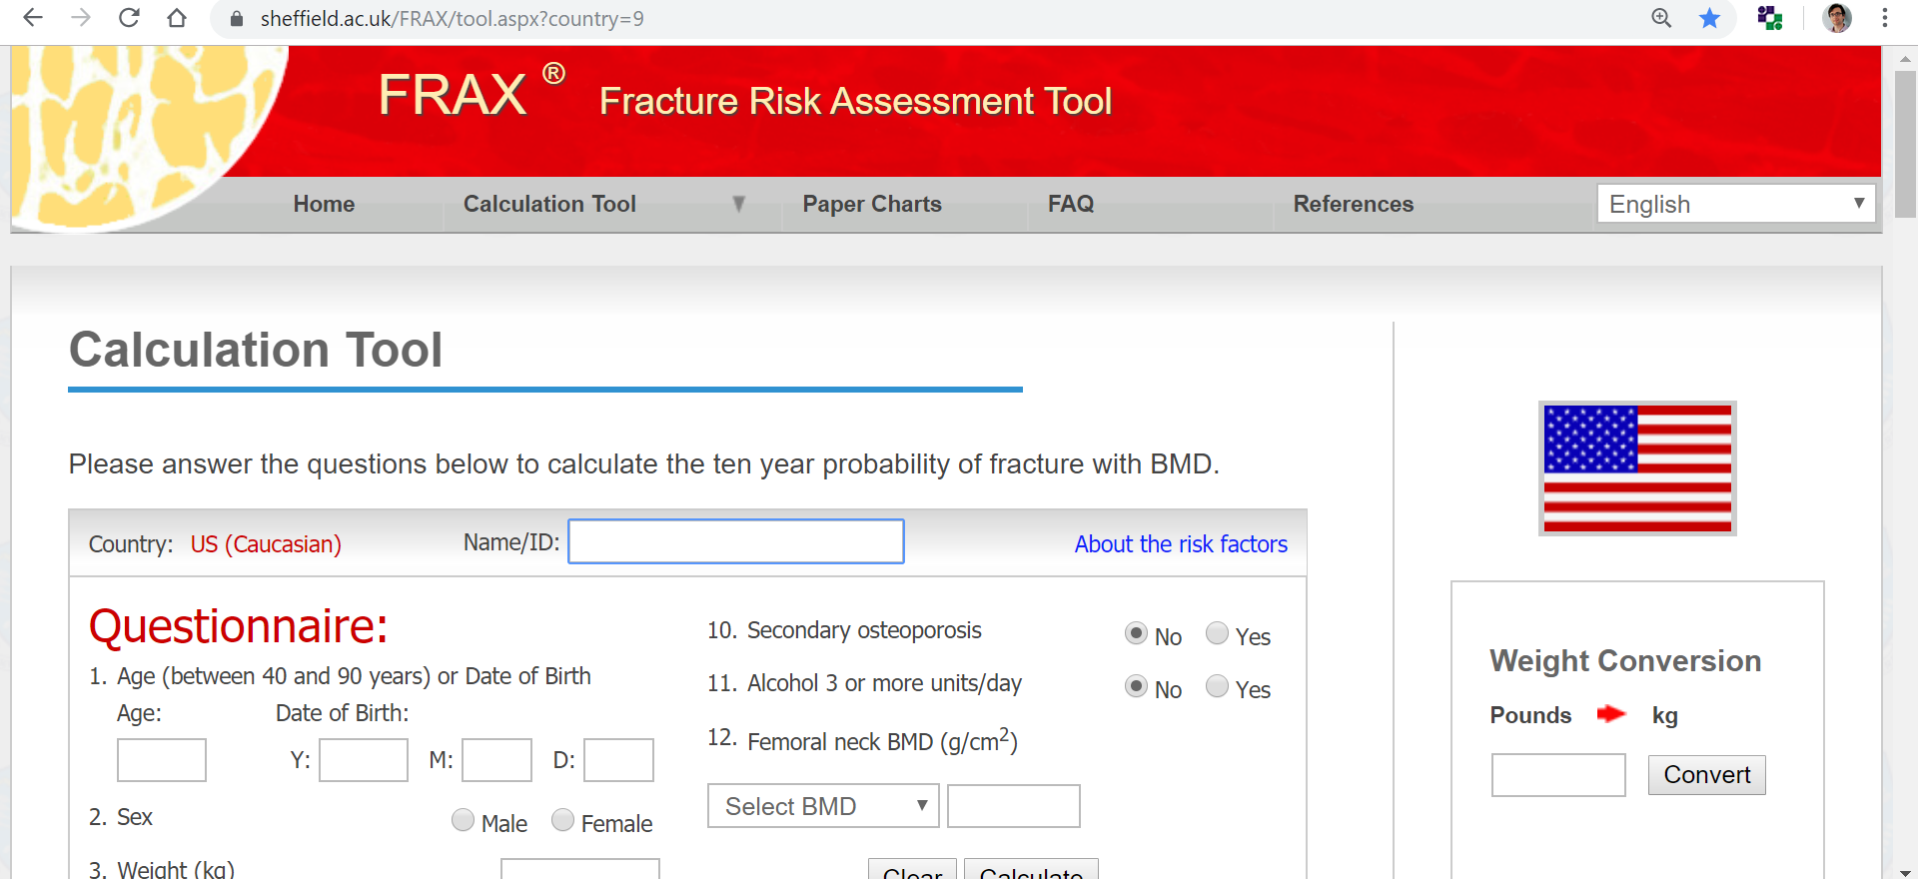
FRAX
FRAX may be used to estimate the risk of fracture prior to the use of a bone medicine, ie if >3% hip or 20% major fracture over 10y

Slide 7
Labs and Imaging
Basic tests
Complete metabolic panel
alkaline phosphatase
Phosphorus
25oh vitamin d
CBC
Additional Tests
Parathyroid hormone
TSH
SPEP/UPEP
24h urine calcium and creatinine
24h urine free cortisol
FSH, LH, prolactin, estradiol/testosterone
Magnesium
1,25 dihydroxyvitamin d
Tissue transglutaminase
Bone turnover markers
COL1A genetic testing for osteogenesis imperfect
Serum tryptase and histamine
Urinary N-telopeptide
Rosen 2019 Clinical manifestations, diagnosis and evaluation of osteoporosis in postmenopausal women, uptodate.com

Slide 8
Management of Postmenopausal Osteoporosis
Eastell 2019 Pharmacological Management of Osteoporosis in Postmenopausal Women: An Endocrine Society Clinical Practice Guideline

Slide 9
Calcium Supplements’ Uncertain Benefits in the Women’s Health Initiative
Jackson 2006 Calcium plus Vitamin D Supplementation and the Risk of Fractures

Slide 10
Calcium Supplements’ Uncertain Benefits in the Women’s Health Initiative
Hip fracture hazard ratio 0.88 for hip fracture (95 percent CI, 0.72 to 1.08), 0.90 for clinical spine fracture (0.74 to 1.10), and 0.96 for total fractures (0.91 to 1.02)
Risk of kidney stones increased (HR 1.17; 95% CI 1.02 to 1.34)
Removing women who did not adhere to the study medication reduced the hazard ratio for hip fracture to 0.71 (95 percent confidence interval, 0.52 to 0.97)
Jackson 2006 Calcium plus Vitamin D Supplementation and the Risk of Fractures

Slide 11
Calcium Supplement Harms
Gray 2015 Web of industry, advocacy, and academia in the management of osteoporosis

Slide 12
Calcium intake
Suggest 1000 to 1200mg of calcium via the diet if possible
High calcium foods include dairy, kale, bok choy, tofu, salmon, sardines, beans, almonds, beans, and supplemented cereals, juices and drinks
Rosen 2019 Overview of the management of osteoporosis in postmenopausal women, uptodate.com

Slide 13
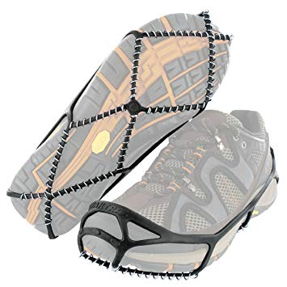
Lifestyle Changes
Light weight bearing
Physical therapy for balance
Walkers, canes
Cleats (yaktrax) for ice
Limit alcohol and reduce/stop smoking
Eastell 2019 Pharmacological Management of Osteoporosis in Postmenopausal Women: An Endocrine Society Clinical Practice Guideline

Slide 14
Lifestyle Changes
Gentle yoga and balance exercises or tai-chi
Sfeir 2018 Vertebral Compression fractures associated with yoga a case series

Slide 15
Risk Stratify
Low risk
No prior hip or spine fractures
T-score at the hip and spine both above -1.0 and a 10-year hip fracture risk <3% and 10-year risk of major osteoporotic fractures <20%
Moderate risk
No prior hip or spine fractures
T-score at the hip and spine both above -2.5 and a 10-year hip fracture risk <3% and 10-year risk of major osteoporotic fractures <20%
High risk
Prior hip or spine fracture
T-score at the hip and spine ≤-2.5 or a 10-year hip fracture risk ≥3% and 10-year risk of major osteoporotic fractures ≥20%
Very High Risk
Multiple spine fractures
T-score at the hip or spine ≤-2.5
Reassess fracture risk every 2 to 4y
Bisphosphonates
5 to 10y oral
3 to 6y IV
Denosumab
Teriparatide or Abaloparatide
2y
Eastell 2019 Pharmacological Management of Osteoporosis in Postmenopausal Women: An Endocrine Society Clinical Practice Guideline

Slide 16
Efficacy of Medications
Eastell 2019 Pharmacological Management of Osteoporosis in Postmenopausal Women: An Endocrine Society Clinical Practice Guideline

Slide 17
Efficacy of Medications
Eastell 2019 Pharmacological Management of Osteoporosis in Postmenopausal Women: An Endocrine Society Clinical Practice Guideline

Slide 18
Efficacy of Medications
Eastell 2019 Pharmacological Management of Osteoporosis in Postmenopausal Women: An Endocrine Society Clinical Practice Guideline

Slide 19
An Approach to Osteoporosis
5 vs 10y?
Fracture
T-score at the hip or spine ≤-3.5
Alendronate
Very High Risk
Fragility fractures
T-score at the hip or spine ≤-3.5
Ibandronate
(Boniva)
Zoledronate
(Reclast)
Denosumab
(Prolia)
Teriparatide (Forteo) or Abaloparatide (Tymlos)
Romosozumab (Evenity)
Rosen 2019 The use of bisphosphonates in postmenopausal women with osteoporosis, uptodate.com

Slide 20
First Line Treatment Options
Replete vitamin d and verify normal serum calcium prior to starting therapy
Provide supplemental calcium if dietary intake is inadequate
If GFR greater than 35mL/min, no active GERD, trouble swallowing, or hiatal hernia, oral bisphosphonates (alendronate or risedronate) are first-line therapy
Rosen 2019 Overview of the management of osteoporosis in postmenopausal women, uptodate.com
Eastell 2019 Pharmacological Management of Osteoporosis in Postmenopausal Women: An Endocrine Society Clinical Practice Guideline

Slide 21
Alendronate - Pros
Absolute Risk Reduction of any clinical fracture 4.6% with 3y of alendronate (13.6% for alendronate and 18.2% for placebo)
22 number needed to treat to prevent one fracture
Clinically apparent vertebral fractures reduced 2.7% with alendronate (2.3% had a fracture on alendronate vs. 5% on placebo)
Hip fracture risk reduced 1.1% (2.2% placebo vs. 1.1% alendronate)
Black 1996 Randomised trial of effect of alendronate on risk of fracture in women with existing vertebral fractures. Fracture Intervention Trial Research Group

Slide 22
Alendronate - Cons
7% develop heartburn symptoms due pill esophagitis on oral bisphosphonates
Osteonecrosis of the jaw occurs in less than 3 out of 10,000 people treated with bisphosphonates per year
Atypical femoral fractures occur rarely (2 out of 100,000women receiving bisphosphonates for less than 2y and more than 1 out of a 1,000 women receiving bisphosphonates for 8 years or more)
Generic retail cost is $1,061.32 annually
Crandall 2014 Comparative Effectiveness of Pharmacologic Treatments to Prevent Fractures

Slide 23
Zoledronate - Pros
Zoledronate once yearly IV reduces the risk of clinical fractures by 4.4% (from 12.8% for placebo to 8.4% with treatment
23 number needed to treat to prevent a fracture
Clinical vertebral fractures reduced from 2.6% in the placebo group to 0.5% in the treatment group
Black 2007 Once-Yearly Zoledronic Acid for Treatment of Postmenopausal Osteoporosis

Slide 24
Zoledronate - Cons
Adverse events are common: fever 9 to 22%, pain 2 to 24%, arthralgias 9 to 27%, myalgias 5 to 23%, headache 4 to 20%, chills 2 to 18%, fatigue 2 to 18%, hypocalcemia ≤ 3%
Acetaminophen may be given prophylactically to prevent many side effects
$270 to $1,004 per treatment
Requires IV placement
Uptodate.com
Black 2007 Once-Yearly Zoledronic Acid for Treatment of Postmenopausal Osteoporosis

Slide 25
Denosumab (Prolia) - Pros
Subcutaneous injection every 6mo is fast and simple
May be given if lower kidney function, but calcium should be monitored
Reduces risk of vertebral fractures from 7.2 to 2.3% and hip fracture 1.2 to 0.7%
Rosen 2019 Denosumab for osteoporosis, uptodate.com

Slide 26
Denosumab (Prolia) - Cons
Effects on bone remodeling reverse after 6mo if the drug is not taken on schedule
Another antiresorptive is recommended after stopping denosumab (e.g., bisphosphonate, hormone therapy, or selective estrogen receptor modular)
Cost $1,462.87 per 6mo dose or $2,925.74 yearly
Monitor calcium if kidney disease, hypoparathyroidism, malabsorption
Risk of osteonecrosis of the jaw, atypical femur fractures, and cellulitis
Little data on use in men without hypogonadism
Eastell 2019 Pharmacological Management of Osteoporosis in Postmenopausal Women: An Endocrine Society Clinical Practice Guideline
Uptodate.com

Slide 27
Teriparatide (Forteo) or Abaloparatide (Tymlos) - Pros
Builds bone and has greater gains in bone density than antiresorptive agents
Teriparatide has been available since 2002 and has a long safety and efficacy track record
Forteo patent expired 8/2019, so generic may be available in the future
Rosen 2019 Parathyroid hormone/parathyroid hormone-related protein analogs for osteoporosis, uptodate.com

Slide 28
Teriparatide (Forteo) or Abaloparatide (Tymlos) - Cons
Monthly cost for a pen $4,111.80 or yearly $49,341.60
Daily injection
Rare risk of osteosarcoma (therapy limited to 2y)
Hypercalcemia or nephrolithiasis are risks in practice
Teriparatide must be refrigerated
Contraindications include hyperparathyroidism, hypercalcemia, bone metastases or skeletal malignancies, Paget’s disease or unexplained alkaline phosphatase, prior radiation therapy involving the skeleton, young adult with open epiphyses
Not preferred if history of cancer, nephrolithiasis, or renal insufficiency
Rosen 2019 Parathyroid hormone/parathyroid hormone-related protein analogs for osteoporosis, uptodate.com

Slide 29
Romosozumab (Evenity) - Pros
Monoclonal anti-sclerostin antibody given for 12mo
Strongest bone therapy available
Monthly injection
One of 3 currently available anabolic agents
Rosen 2019 Overview of the management of osteoporosis in postmenopausal women, uptodate.com

Slide 30
Romosozumab (Evenity) - Pros
McClung 2014 Romosozumab in Postmenopausal Women with Low Bone Mineral Density

Slide 31
Romosozumab (Evenity) - Cons
0.6% increase in severe cardiac adverse events (from 1.9 for placebo to 2.5% with Evenity; (odds ratio, 1.31; 95% CI, 0.85 to 2.00)
Black box warning: “Evenity may increase the risk of myocardial infarction, stroke or cardiovascular death”
Little long term data available
Monthly cost $935.90 or $11,230.80 yearly
Saag 2017 Romosozumab or Alendronate for Fracture Prevention in Women with Osteoporosis
Evenity romosozumab drug insert
uptodate.com

Slide 32
Atypical Femoral Fractures and Osteonecrosis
Osteonecrosis occurs in less than 3 in 10,000 of people treated with bisphosphonates per year
Osteonecrosis generally been reported with IV therapy and/or malignancy
Atypical femoral fractures occur rarely too (2 in 100,000 of women receiving bisphosphonates for less than 2y and more than 1 in 1,000 women receiving bisphosphonates for 8 years or more)
Crandall 2014 Comparative Effectiveness of Pharmacologic Treatments to Prevent Fractures Annals

Slide 33
Use of Bone Medicines in Older Persons
All of us will have osteoporosis if we live long enough
There is an absence of consistent data supporting a benefit from bisphosphonate therapy above age 80 years in the absence of high risk factors or fractures
Bischoff-Ferrari 2014 Comparative Effectiveness of Pharmacologic Treatments to Prevent Fractures: Is This All We Need to Know?

Slide 34
Summary
Therapy for osteoporosis should start with reviewing lifestyle and dietary approaches
Alendronate and risedronate are first line treatments for osteoporosis
Consider zoledronate or denosumab as 2nd line agents after reviewing pros and cons
Teriparatide and abaloparatide may be used for severe osteoporosis and are costly

