Slide 1
Teaching patients about diabetes
What Patients Need to Know About Glucometers, Testing Blood Glucose and Common Diabetes Medications
Presented by:
Sarah Anderson, RN, BSN, CDCES
Bonnie Grenier, RN, BSN, CDCES
May 2022

Slide 2
Meeting the Patient
New diagnosis of diabetes can be very overwhelming
May have a lot of questions
One visit with nursing cannot cover everything; this is just about to get them started, basic survival skills
Make sure provider has referred to DM Education and Nutrition

Slide 3
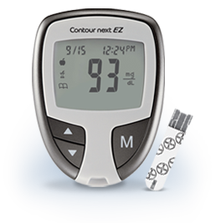
Glucose Meters
The screen on the meter will display the blood glucose number at that moment.
If patients ask, this differs from an A1c because the A1c is an average of their blood sugars over 3 months.
Tips for storing test strips:
Store strips at room temperature
Never store strips in a vehicle
Keep strips covered and dry in original packaging
Check the expiration date on the side of the container, and do not use test strips if expired

Slide 4
Freestyle Lite

Slide 5
How to set-up the Freestyle Lite
Push and hold the “M” button for 3 seconds until the word “SET” appears on the screen.
Press the “M” button to move through the settings. (Tell patients, “M” is to move, “C” is to change.)
Setting the Time
With the hour blinking, press the “C” button until the correct hour appears. The default for the meter is the 12-hour time format. The “P” displays for “PM” times.
Press the “M” button to move to the minute setting.
With the minutes blinking, press the “C” button until the correct minute appears.
Patients then have the option to set the clock to 12- or 24-hour time.
Press the “M” button to move to “Setting the Date” if needed. The date is usually correct when meters are turned on for the first time.
To exit set-up, press and hold “M” until the meter turns off.

Slide 6
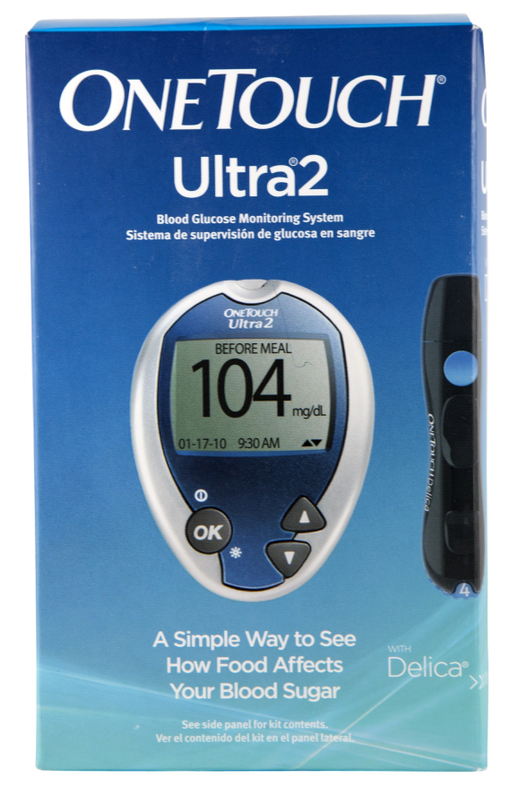
One Touch Ultra

Slide 7
How to set-up the One Touch Ultra
With the meter turned off, press and hold OK for two seconds to access MAIN MENU.
To set the date:
Navigate to “DATE FORMAT”.
Use the up or down arrows to set the correct date.
Use the OK button to move through the settings.
To set the time:
Navigate to “TIME FORMAT”.
Use the up or down arrows to set the correct time.
Use the OK button to move through the settings.

Slide 8
How to Check Your Glucose
Step 1:
Wash your hands with soap and warm water, or use an alcohol wipe. Dry your hands.
Note: Using hand sanitizer is not recommended

Slide 9
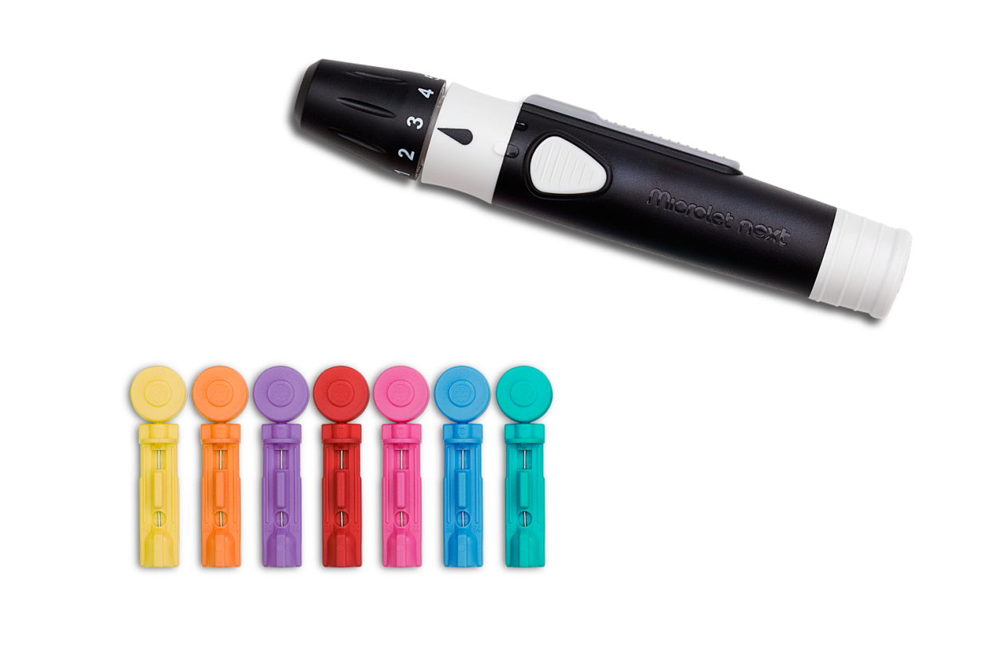
How to Check Your Glucose
Step 2:
Load the lancing device with a lancet. Use a new lancet each time you check your blood sugar.

Slide 10
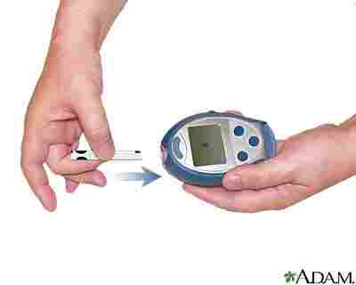
How to Check Your Glucose
Step 3:
Put a new test strip into your glucometer. The glucometer should turn on automatically. You will know it is ready when a picture of a blood drop appears on the screen.

Slide 11
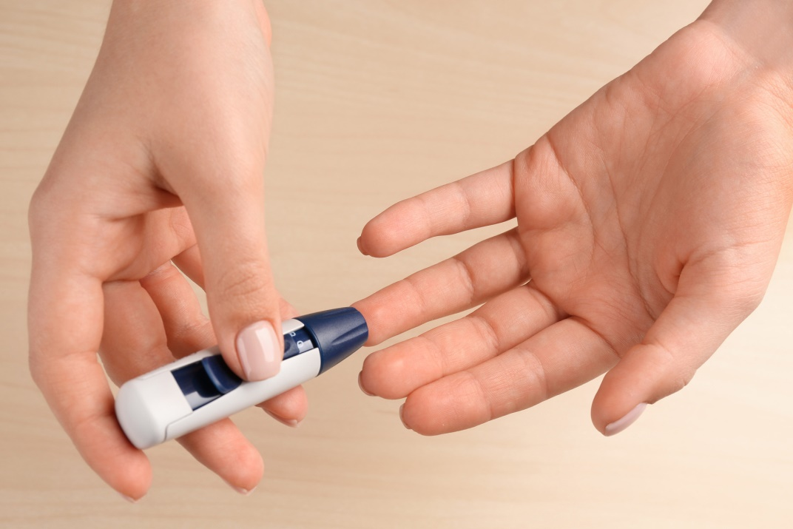
How to Check Your Glucose
Step 4:
Prick your finger with the lancing device. Use a different finger each time to prevent a callus from forming. Gently massage your fingertip until a small drop of blood appears.

Slide 12
How to Check Your Glucose
Step 5:
Apply the blood to the test strip and wait for the result to appear. Record the result in your log book.

Slide 13
When to Test and Glucose Targets
The most common times recommended to check blood glucose are fasting, before meals, and/or 2 hours after meals.
If patients are starting mealtime insulin, providers may also recommend testing at bedtime to reduce the risk for hypoglycemia.
Time to Check | Glucose Targets
Fasting or before a meal | 80 – 130 mg/dl
2 hours after the start of a meal | Less than 180 mg/dl
These target ranges may vary based on the patient’s individual healthcare needs.

Slide 14
Alternate Site Testing
Upper arm
Forearm
Palm of hand and base of thumb
Thigh
Calf
Avoid moles, veins, bones, and tendons. Do not use alternate site testing if testing for hypoglycemia, or for dosing insulin.

Slide 15
Medications you may be asked to teach
Incretins: Trulicity, Ozempic, Victoza, Rybelsus
Long acting insulin
Short acting insulin

Slide 16
Incretins (aka GLP-1 receptor agonists)
They are not insulin! They are a replacement of a hormone that people with type 2 diabetes don’t make enough of.
Work in 4 different ways to help control blood glucose:
Stimulate the pancreas to release more insulin in response to rising glucose levels (i.e. after eating)
Tell the liver to release less glucose
Slow down digestion
Help people feel full and satisfied on smaller portions
Precautions: pancreatitis, gastroparesis, family history of MTC (medullary thyroid cancer)

Slide 17
Incretins (aka GLP-1 receptor agonists)
Most common side effects: nausea, vomiting, diarrhea, abdominal pain and indigestion.
Teach patients:
Eat smaller, more frequent meals instead of large meals.
Avoid carbonated beverages.
Avoid greasy and fatty foods.
Call VMG if GI side effects are severe, disrupting daily life or do not go away.
Stop immediately if having severe abdominal pain and recommend patient go to the ED in case of pancreatitis.

Slide 18
Incretins (aka GLP-1 receptor agonists)
Trulicity – once weekly injection; starting dose 0.75mg weekly; single use injectors
Ozempic – once weekly injection; starting dose 0.25mg weekly x4 weeks, then increase to 0.5mg weekly; multi-dose pen
Victoza – once daily injection; starting dose 0.6mg daily; multi-dose pen
Rybelsus – once daily pill; starting dose 3mg daily for 30 days, then increase to 7mg daily

Slide 19
Long-acting insulin
Usually once daily injections.
Starts working in 2-4 hours, most last about 24 hours.
Take at the same time every day.
Recommend taking at bedtime, but ok to take at other times per patient preference.
Usual titration is to increase by 2 units every 3 days until fasting blood glucose is under 130 mg/dl (or per provider recommendation).
Teach identification and treatment of hypoglycemia.
Examples: Lantus, Basaglar, Tresiba, Toujeo, Levemir

Slide 20
Short-acting insulin
Most start working in 5-15 minutes, peak in 1-2 hours, and last about 4-5 hours total.
Recommend testing blood glucose and taking short-acting insulin 5-15 minutes before eating a meal.
Dose and titration determined by provider.
Teach identification and treatment of hypoglycemia.
Examples: Humalog, Novolog, Fiasp, Apidra

Slide 22
How to use an Insulin Pen

Slide 23
Subcutaneous Injection Sites

Slide 24
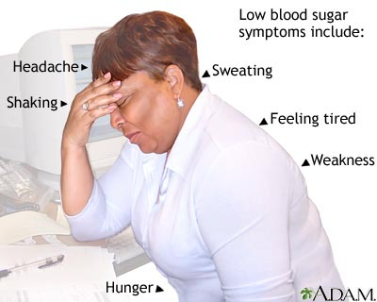
Symptoms of Low Glucose
Weak, shaky or lightheaded
Sweaty or clammy
Irritable
Confused
Hungry
Fast Heartbeat
Tingling lips

Slide 25
Treating Low Glucose
Use the “Rule of 15” to Treat Low Glucose Levels
1. When you feel symptoms of a low, check your glucose
2. If your glucose level is low, eat or drink 15 grams of carbohydrate
3. Wait 15 minutes then check your glucose again
4. If your glucose level is still low, eat or drink another 15 grams of carbohydrate
5. Wait 15 minutes and check again. If necessary, eat or drink another 15 grams of carbohydrate.
6. If your glucose level remains low after 3 treatments, call your primary care or 911
**Advise patients to contact VMG if they start having episodes of hypoglycemia**

Slide 26
What to treat lows with
Each of the following items has 15 grams of carbohydrate:
3-4 glucose tablets or hard candies
½ cup regular (not diet) juice or soda
1 cup of milk
5-6 saltine crackers
1 granola bar
1 popsicle (not sugar-free)
1 tablespoon honey or sugar

Slide 27
Virtual Diabetes Ed Classes
We offer virtual diabetes education classes on Zoom, taught by both a diabetes educator and a dietician.
New classes start every few months. Each series consists of four 2-hour sessions.
Appropriate for those newly diagnosed with diabetes, or any patient who has a lot of questions about diabetes.
If patients are interested, please send us a patient case and we can check on insurance coverage.
Flyer and more information about our program is on the website! Direct patients to vmgma.com, hover over Services, and click “Diabetes and Nutrition Education” tab.

Slide 28
How to Contact Us
Sarah Anderson, RN, BSN, CDCES
Amherst and Greenfield
sanderson@vmgma.com
(413) 256-4468
Bonnie Grenier, RN, BSN, CDCES
Northampton and Easthampton
bgrenier@vmgma.com
(413) 282-3846
We are also available by patient case or Athena message.

Slide 29
Questions? Thank you for attending!

