Slide 1
Difficult Interactions with Patients: Taking a Closer Look
Scott R. Meyers, PsyD
Primary Care Behavioral Health
Valley Medical Group
Florence, MA

Slide 2
As many as 15% of patient- provider interactions are rated as “difficult” by the provider.¹

Slide 3
What is a “difficult patient”?
Changing the language
There are no “difficult patients,” only difficult interactions.
Creates opportunities to influence our perception of that difficulty
Will make us more effective in the moment

Slide 4
What makes an interaction difficult
The more factors that come into play, the harder it is to manage the patient interaction effectively
Being aware of these factors and taking steps to reduce them could keep difficult interactions from escalating

Slide 5
Components of Difficult Interactions
Patient Factors
Provider Factors
System Factors

Slide 6
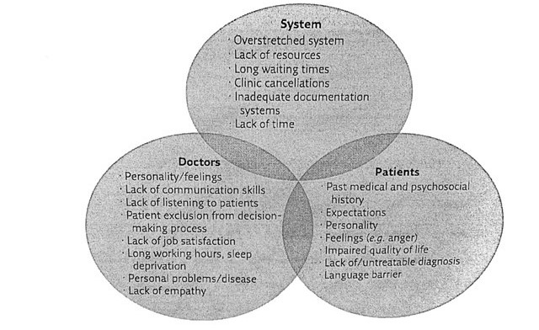
Components of Difficult Interactions

Slide 7
Components of Difficult Interactions
Patients
Past medical/psychosocial history
Expectations of care / provider
Personality traits
Impaired quality of life
Lack of or untreatable diagnosis
Language barrier
Other things they carry into the room

Slide 8
Components of Difficult Interactions
Providers
Personality traits
Lack of communication skills
Inappropriate word choices/phrases
Assumption about pts’ health literacy
Lack of listening to patients
Excluding patient from decision-making process
Lack of job satisfaction
Schedule overload / Long working hours
Other things they carry into the room

Slide 9
Components of Difficult Interactions
System
Dysfunctional healthcare systems can only add to provider-patient tensions
Lack of resources (i.e., staffing, availability)
Long wait times
Cancellations / rescheduling
Anything that has gone wrong in the patient pathway to treatment / finding support / answers

Slide 10
Components of Difficult Interactions
Where most difficult interactions occur

Slide 11
Potential Implications of Difficult Interactions
Patient
Heightened Anxiety
Heightened Concern / Fear
Increased Frustration
Dissatisfaction with quality of care
Increased feelings of vulnerability / not feeling safe
Eroded trust in patient-provider relationship

Slide 12
Potential Implications of Difficult Interactions
Provider
Increased stress, anxiety, anger
Feeling unable to help / Ineffective
Palpable dislike of the patient
Desire to move patient to another provider
Job dissatisfaction “I’m quitting”

Slide 13
Potential Implications of Difficult Interactions
System
Misuse of resources (i.e., doctor shopping)
Appointment with another provider for a second opinion
Increased ED visits
Looking for solutions for non-acute issues
More strain on the system

Slide 14
Managing Difficult Interactions
Solution-focused process
Demonstrates “working as a team” with patient
Searching for options
Searching for solutions acceptable to both patient and provider

Slide 15
Solution-focused Process
Top Tips:
Stay calm and professional
Try to see it from the patient’s perspective
Work together to find a solution in their best interest
Debrief with colleagues after a difficult interaction
Get feedback
What went well / what didn’t go well

Slide 16
Simple listening phrases
“Tell me more”
“I understand”
“Please continue”
“Tell me why this is important to you”

Slide 17
Acknowledging phrases
“This is what I’ve heard you say so far”
“What I’m hearing is”
“I appreciate you sharing this with me”
“That’s upsetting to hear”

Slide 18
Ending/Transition phrases
“I’m very sorry to interrupt, but I want to make sure I understand everything before it’s time to go”
“I feel like we’ve talked this out as much as it is productive to do so. So let’s wrap up.”
“I don’t think we can resolve this today and you’ve certainly given me a lot to think about. Can we follow-up?”

Slide 19
Why difficult interactions are bad for everyone
Drain on provider time, resources, emotional energy
Can increase provider stress, anxiety, anger
Higher burn-out risk
Dislike of the patient / avoidance strategies
Compromising good care

Slide 20
Why difficult interactions are bad for everyone
Decreased trust in patient-provider relationship
Patient more likely to ask to see another provider
Write a scathing review / patient complaint
Leave the practice / bad word of mouth

Slide 21
Primary references
Hardavella G, Aamli-Gaagnat A, Frille A, et al. Top tips to deal with challenging situations: doctor-patient interactions. Breathe 2017; 13: 129-135
Managing challenging interactions with patients. BMJ 2013; 347:f4673
1 Jackson JL, Kroenke K. Difficult patient encounters in the ambulatory clinic: clinical predictors and outcomes. Arch Intern Med. 1999; 159: 1069-1075

Slide 22
PCBH Team
Northampton
Scott R. Meyers, PsyD
Easthampton
Pamela Brigham, LICSW
Audra Winn, LICSW
Amherst
Marta M. Rodriguez, PsyD
Alexandra Reed, PhD
Greenfield
Rebecca Craven, LICSW
Whitney Robinson, LICSW

Slide 23
Let’s discuss…
Think about a difficult interaction you’ve had
What made it difficult?
Can you identify just when it became difficult for you?

