Slide 3
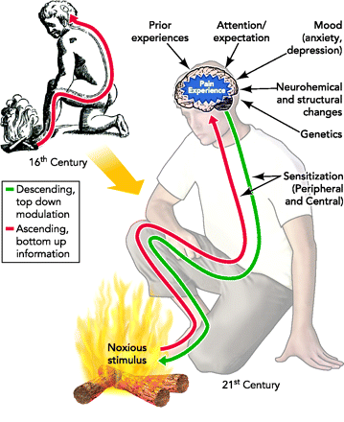

Slide 4
ACUTE pain
CHRONIC pain
ACUTE pain
CHRONIC pain
Related to an injury
Trauma (accident/surgery)
Infection (bacterial/viral)
Non-trauma internal injury (heart attack, artery rupture)
Intensity correlates with amount of tissue damage
Has a distinct warning and protective function
Soft tissue and bone heal in 3 months
No longer related to the acute injury
May be due to ongoing injury
May not be due to any injury
Central Pain Processing Disorders
Aging-related changes
Intensity no longer correlates with tissue damage
Has lost the warning and protective function
More complex biochemistry and brain areas involved
Becomes a diagnosis/condition in its own right (vicious cycle)

Slide 5
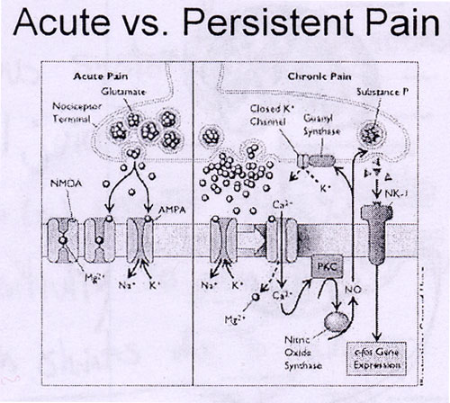

Slide 6
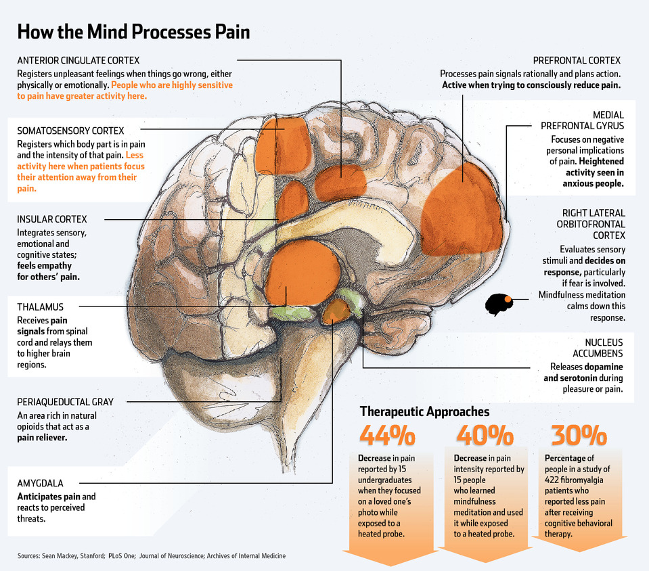

Slide 7
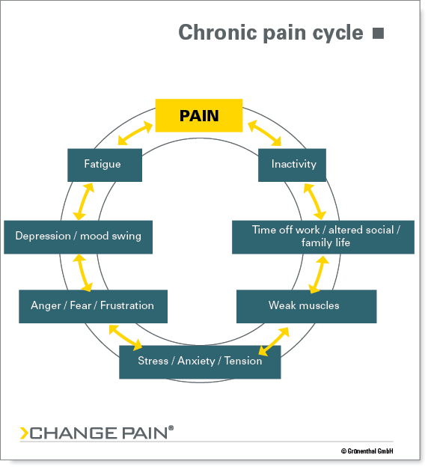

Slide 12
