Slide 1
Advance Care Planning
Primary Care Meeting
April 30, 2019

Slide 2
Disease is clinical Illness is personal
The Advance Care Planning (ACP) Committee will be presenting three inservices over the year to capture the progressive nature of advance care planning with patients
Notes:
Start with patient story demonstrating impact of ACP discussion on health care.

Slide 3
video
Excerpt taken from a program titled "How to Live When You Have to Die," featuring Atul Gawande, recorded in collaboration with the New Yorker Festival, October 2, 2010.
Atul Gawande Video

Slide 4
Serious illness conversation
A serious illness conversation is a discussion (or series of discussions) between a clinician and patient with serious illness that:
Focuses on values, goals, and/or care preferences
Offers an honest prognosis, according to patient preferences
Starts early in the course of serious illness
Provides a foundation for making decisions in the future or in the moment
Should be reviewed/revised over time
Notes:
Recent 4 year study by Ariadne Labs demonstrated that for patients with advanced cancer, earlier conversations (by oncologists) reduced the proportion of patients with moderate to severe anxiety and depression by half, and the anxiety improvements were sustained for at least 24 weeks.

Slide 5
Conversations are infrequent, late, and limited
Infrequent
Fewer than 1/3 of patients with end-stage diagnoses reported end-of-life discussion with clinicians
Late
In patients with advanced cancer, first end-of-life discussion 33 days before death
55% of initial end of life discussions occurred in the hospital
Limited
Conversations often fail to address key elements of quality discussions

Slide 6
Conversations are not documented well
When conversations take place, outcomes of discussions are often:
Not documented
Not documented accurately
Not easily retrievable in the EMR
Conflicting with other information in the EMR

Slide 7
Health Care Proxy (HCP)
Legal document, now one page
Introduce at age 18; assess for and review at all annual visits
Obtain form for EMR; do NOT check off in social history
Spanish version in print forms, other languages on webpage
Invoking the HCP
More definitive instructions in 3rd presentation
Where to document: Personal Info field
Notes:
HCP invoked- document only if permanent.
Mention VMG flyer available for giving out to patients.
Major points:
Tell the person they are now your agent
Have a conversation with the agent about what you want
Make sure the agent can do what you want
Spouses, children, special considerations

Slide 8
medical Order for life-sustaining treatment (MOLST)
Medical order, signed and dated by patient and provider
Introduce topic at age 65 wellness visit, or earlier with serious illness, or by patient request
VMG glossary
Obtain copy for EMR; do NOT add date in social history
Available in many languages from webpage link; must be completed in English
Notes:
Statement to discourage providers from signing and sending home incomplete MOLST form
The lay person’s understanding of:
1) procedure
2) outcome
3) situations in which a MOLST is used
- (collapse in restaurant leads to CPR)
- (questions are not asked until pt is thought to be dying)
- (difference between an MD’s ability to understand that someone is dying compared to family’s ability)

Slide 9
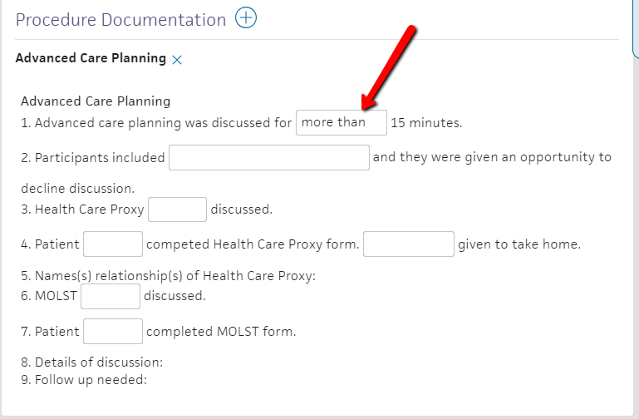
Documenting acp discussions in the chart
ACP template
Notes:
Emphasize need to complete #s 1 and 2 to meet insurance requirements
If MA is opening templates for Wellness Visits, but there is no discussion, delete the template.

Slide 10
Billing for ACP discussions
Don’t forget to check off the billing box for more than 15 minutes
Notes:
If “more than 15 minutes” is documented, must also check off billing box

Slide 11
HCP stats
Percentage of patients with HCP in the EMR, age 18+
AMC 10.80%
EHC 30.40%
GHC 10.70
NHC 8.50%
ALL 13.70%
Percentage of patients with HCP in the EMR, age 65+
AMC 19.40%
EHC 55.40%
GHC 23.10%
NHC 21.00%
ALL 26.20%
Notes:
This is 3/21/19 data.

Slide 12
MOLST STATS
Percentage of patients with MOLST in the EMR, age 80
AMC 23.60%
EHC 67.40%
GHC 36.10%
NHC 30.30%
ALL 36.50%
Notes:
This data also from 3/21/19
Age 80 chosen at random as age to reasonably think a non-critically ill patient might have a MOLST form completed

Slide 13
Acp billing stats
1st Quarter 2019
Claims Templates
AMC 17 18
EHC 43 132
GHC 26 37
NHC 39 46
Total 125 233
Notes:
Encourage using the template, even if not billable, to document discussion

Slide 14
More BILLING STATS
VMG ACP Claims Billed
2016 2017 2018 2019 (based on 1st Q)
AMC 53 72 81 17 x 4 = 68
EHC 6 89 141 43 x 4 = 172
GHC 41 125 113 26 x 4 = 104
NHC 62 122 126 39 x 4 = 156
Total 162 408 461 125 x 4 = 500

Slide 15
It’s always too soon until it’s too late
What’s next?
ACP Committee plans
Interactive lunch on Managing Chronic Illness
GHC: 5/28 EHC: 6/4 AMC: 6/11 NHC: 6/25
Fall lunch on Managing Serious Illness
Patient Informational Forums: 1 at each center

Slide 16
Your turn
Q & A
Discussion
Advance Care Planning Committee Members
Henry Simkin, chair
Laura Duffy
Shersten Killip
Scott Meyers
Ross Midler
Lauren Schwartz
Stephanie Pick
Notes:
Encourage providers to forward any questions, ideas, resources wanted

Slide 17
References
Ariadne Labs: A Joint Center for Health Systems Innovation between Brigham and Women’s Hospital and the Harvard T.H. Chan School of Public Health https://www.ariadnelabs.org/areas-of-work/serious-illness-care/
Ariadne Labs Videos
video of ACP discussion, 20 minutes: https://youtu.be/xLl1HlCcNYM
same video annotated by the MD, 34 minutes: https://youtu.be/RPQBukpyKAY
alternate video of ACP discussion, 12 minutes: https://youtu.be/fhwa9f5O_U4
Video shown during presentation, 3 minutes: https://youtu.be/45b2QZxDd_o
Honoring Choices Massachusetts https://www.honoringchoicesmass.com/
The Conversation Project https://theconversationproject.org/
Mass Coalition for Serious Illness Care http://www.maseriouscare.org/

