Slide 1

ORIENTATION

Slide 2
Message Taking Guidelines
Patient Cases (Inbox Management)
Standard Workflow

Slide 3
Message Taking Guidelines

Slide 4
Patient Cases
Where should they go?

Slide 5
What do you think?
Where does it go?
Pt’s mom called complaining of stomach ache x 2 days. Nothing helps (“tried everything”).

Slide 6
What do you think?
Where does it go?
Pt calling with headache x2 days, very bad. Wants to be seen ASAP. PCP and team n/a.

Slide 7
What do you think?
Where does it go?
calling to ask if drinking coffee is causing her to wet her pants.
This Photo by Unknown Author is licensed under CC BY-NC-SA

Slide 8
What do you think?
Where does it go?
Pt called requesting an xray order for her left wrist as its been sprained for a few weeks and she wants to make sure there is no fracture, pt has been doing PT as well. Pt is requesting the order be sent to BFMC. Pls contact pt. Thank you.

Slide 9
What do you think?
Where does it go?
calling to let us know he had a colonoscopy on 9/20/2010 at the Amherst VMG.

Slide 10
What do you think?
Where does it go?
Pt had a sleep apnea test a while back and it showed she has a mild case of it. Her insurance will not cover a test being at the hospital, so she is asking if she can have referral to do a sleep study again at her home.

Slide 11
What do you think?
Where does it go?
Pt called and is moving to San Francisco. Wants to take a copy of her medical records with her.

Slide 12
What do you think?
Where does it go?
Pt would like a refill on his oxycodone. He would like to go back to the 10 mg. He said the 20 mg makes him feel loopy. Any questions, call pt at above number.

Slide 13
What do you think?
Where does it go?
Pt would like cod 3 refill please. Let her know

Slide 14
What do you think?
Where does it go?
Pls call home # above with lab results.

Slide 15
What do you think?
Where does it go?
Patient had an apt today and was looking to pick up his oxycontin and oxycodone but it wasn’t in the drawer. Fill date was 2/21/20. Pt will be calling tomorrow to check on status of this. Please advise

Slide 16
Standard Workflow

Slide 17
CLINICAL CLERK
Prior Authorizations
  Cover my meds
Refills
Notes:
How important this is to our patients and our community – the spirit behind it.

Slide 18
Healthfinch Refill Requests
Healthfinch Determination | Why | Who | What
In Protocol |  | Clinical Clerk | Approve
In Protocol - provider no longer at VMG |  | Cllinical Clerk | Deny - New RX to follow. The queue up and approve new RX under appropriate provider.
Manual Review | Sig does not match | Clinical Clerk | Clarify and approve. If unable to clarify, route to provider staff for research.
Medication Status Problem | Med previously moved to Historical | Provider Staff | Clarify and approve. If unable to clarify, route to provider.
Off Protocol | Classes of meds for which no protocol exists (ex narcotics) | Provider | To approve or deny. If pt on CSRP, send to CSRP staff.
Out of Protocol | Lab not performed or Visit not in range | Provider Staff | Courtesy refill for 30 (or 90 days) and message patient. If they have a scheduled lab appointment, notify patient they must attend. If no appointment, schedule lab visit for 1 week and notify patient. *
*Language for Staff: I'm calling from Dr. Smith's office about your Lisinopril refill request. It looks like your're overdue for some lab work so I've put in a 30 (90) day courtesey refill and scheduled you for an appointment at our Greenfield lab at 9am on April 12. This lab work is important as it helps Dr. Smith manage your medication. If you're unable to attend this appointment, please call out office. Thank you.
*Language for Staff: I'm calling from Dr. Smith's office about your Lisinopril refill request. It looks like your're overdue for an office visit so I've put in a 30 (90) day courtesey refill. Please call our Greenfield office at 413-774-6301 to schedule an appointment. This is important as it helps Dr. Smith manage your medication. Thank you.

Slide 19
CSRP
Contracts
Fill Dates
Refills
Notes:
How important this is to our patients and our community – the spirit behind it.

Slide 23
CSRP Guidelines Grid
MEDICATIONS | CONTRACT | ENROLLED IN CSRP | VISIT FREQUENCY | URINE TESTING | PILL COUNTS
ALL OPIOIDS | YES | YES | 3 months Annual Wellness visit Patients 80 years and older – Annual visit - appointment. UDS done at annual wellness visit | Twice yearly minimum | As Indicated
TRAMADOL >200 PILLS/MONTH TRAMADOL < 200 PILLS/MONTH | YES YES | YES PROVIDER DISCRETION Refills ok Electronic RX ok | 3 months Annual Wellness visit 6 months Annual Wellness visit | Twice yearly minimum PCP discretion – no minimum testing | As Indicated As Indicated
STIMULANTS | YES | YES | 6 months Annual Wellness visit | PCP discretion – no minimum testing | As Indicated
BENZOS with Opioids or Stimulants) | YES | YES | 3 months Annual Wellness Visit | Twice yearly | As Indicated
BENZOS ONLY | NO | PROVIDER DISCRETION | 6 months Annual Wellness visit | PCP discretion – no minimum testing | As Indicated
Virtual | YES | NO | No visits – for patients in nursing homes or severely homebound | No | None

Slide 24
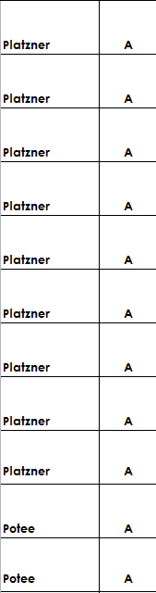
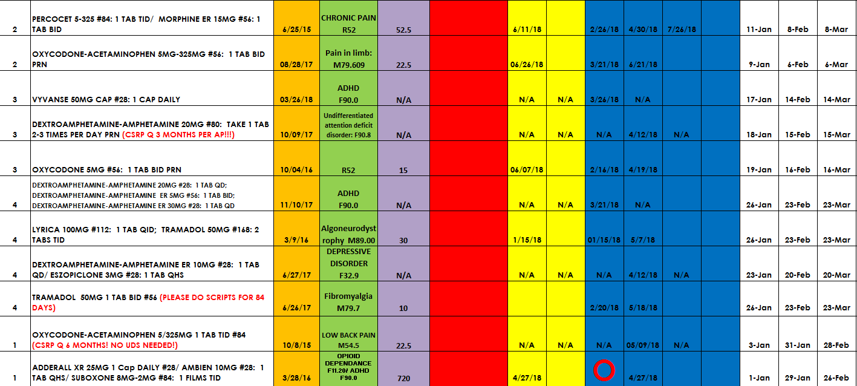
Sample Registry

Slide 25
CLINICAL SKILLS
All nursing staff

Slide 26
Blood Pressure Measurement
Staff should wait at least 5 minutes before taking BP
Patient’s legs should be uncrossed and they should be sitting on a chair with their feet on the floor
Staff should ensure proper cuff size is used
Stethoscope should be placed on a bare arm (not over any clothing)
If rolling up patient’s sleeve, it should not be tight around their upper arm, if it is then they need to remove their arm out of the sleeve.
If BP is ≥140/90 it must be retaken at least 5 minutes later using the automated machine to obtain three BPs for an average and provider must be informed
To ensure correct and accurate blood pressure measurement results.

Slide 27
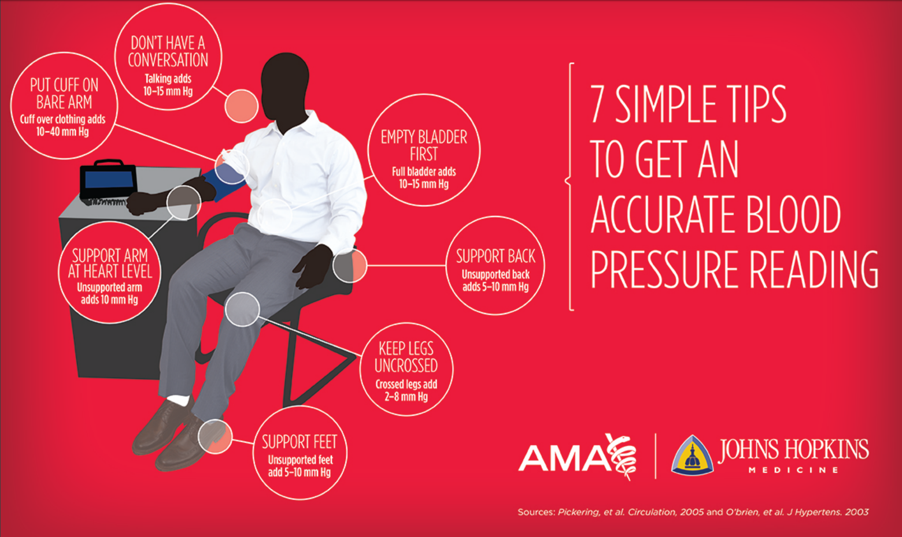

Slide 28
Medication Reconciliation
Verification
  The collection of the med history
Clarification
  Ensuring the meds & doses are accurate
Reconciliation
  Documenting changes in the orders
To maintain an accurate list of medications that includes those prescribed by the PCP, by a specialist or during a hospitalization.
Notes:
Involves four steps

Slide 29
Medication Reconciliation
VERIFICATION
CLARIFICATION
Staff will verify patient pharmacy
Staff will collect history including all meds; prescription, over the counter, herbal supplements and vitamins
Staff will verify if patient is taking the medication as prescribed
Staff will review each medication on the list with patient and confirm dosage, frequency, route and reason
It is NOT acceptable to ask the patient “has anything changed”
Notes:
All entries including otc and supplements must include name, dosage, route & frequency

Slide 30
Medication Reconciliation
RECONCILIATION
Staff will document any changes to the med list
Staff will document any new prescriptions a patient has been prescribed by a specialist
Clinical staff will stop all short term meds, such as antibiotics
If a patient has stopped a medication per order of the provider, the med will be stopped and notification put in the chief complaint of the encounter
If patient has stopped prescribed meds without an order to d/c, the staff will NOT stop the med, but will record the reason the patient stopped, and when, in the chief complaint.
The practitioner will stop the med if they feel it is appropriate
PRN meds will stay on the active med list with an internal note stating “PRN”
Notes:
Patient care summary will be printed at check out or patient can obtain it on the portal

Slide 31
Peak Flow Monitoring
https://youtu.be/055fSYXgNKU?t=15
https://youtu.be/FS2yKgPExCc
To measure a patient’s peak expiratory flow rate during for patients with Asthma.
Spirometry Testing
To measure pulmonary function to aid in the evaluation and management of patients with known or suspected respiratory disorders such as COPD and asthma.

Slide 32
Carbon Monoxide Testing
Attach a breath sampling D-piece and new steribreath mouth piece.
Patient may be seated or standing.
Have patient take a deep breath in and hold breath for the 15 second countdown.
Once the countdown reaches zero, exhale slowly into the mouth piece. The aim is to empty the lungs as much as possible. If patient is unable to hold their breath for the full 15 seconds, they should commence exhalation at a comfortable point, but exhale completely into the mouth piece.
The display will show a rising CO ppm and the equivalent % COHb level reading. The colors on the screen will change accordingly. You will only need to record the CO ppm reading in the patient’s chart.
The sounder will beep at an increasing rate, according to the concentration of CO measured.
The highest level detected during the exhalation will remain on the display.
Remove the D-piece with gloves between tests to purge the sensor with fresh air and wash your hands or use included alcohol free hand sanitizer.
Document in Vital Signs note section.
To measure the amount of CO in the lungs and on the breath and measure the percentage of vital oxygen that has been replaced in the bloodstream for all patients identified as smokers.

Slide 33
Pack Years
Calculation:
  Number of cigarettes per day
  Divide by 20
  Multiply by the number of years smoked
    Example 1:
    Patient smokes 7 cigarettes a day for 15 years
    Pack years = 5.25
    Example 2:
    Patient smoked 20 cigarettes per day for 5 years, quit for 2 years, now smokes 10 cigarettes per day for the last 10 years
    Pack years =10
Completed and entered into social history for every new patient and then once per year at the wellness visit.
It doesn’t have to be exact –there are only 4 categories on the drop down list:
  <10
  10-19
  20-29
  30+
A term used to express the amount of smoking exposure a person has had over time. It can determine the risk level for smoking related illnesses.

Slide 34
Waived Testing
Testing is performed by all nursing staff.
These are tests that can be performed by the lab, but can also be done in the clinic area:
  Clinitek – Urinalysis
  Coagucheck – INR
  Sofia – Urine Pregnancy
  Sofia – Influenza A & B
  Sofia – Group A Streptococcus
  A1C
  Glucometer
The lab overseas all tests and equipment.
There is a competency that all staff need to complete yearly.
To provide Point of Care testing allowing for the immediate diagnoses of certain Medical Conditions.

Slide 35
Specimen Collection
Staff are responsible for ensuring all specimens are labeled accurately and are sent to the correct lab.
Label must include the following:
  Patient Name
  Source of Specimen
  Site of Specimen
  Date of collection
  Time of collection
Staff must check the expiration on the lab specimen transport materials.
Each center has a board in the lab area showing what containers should be used for what specimens and what lab to send them to.
Examples of Specimens collected:
  Urine – clean catch
  Urine – UDS
  Skin Biopsy
  Paps
  Nasal Swabs
  Nasopharyngeal Swabs
  Throat Swabs
To provide a process for collecting specimens accurately to obtain diagnoses.

Slide 36
Specimen Collection
Expected Specimen Collection
  Print label from print forms
  When specimen is collected, attach the pre-printed label. Write the source on the label and initial label.
  Create order, or go into order; entering the source & site in the “note to lab” section*****
  Print second label from order within 30 minutes of specimen collection
  Attach second label on top of first label, confirming source/site is on the label and initial label
  Put specimen in designated bag and bring to designated collection box
Unexpected Specimen Collection
  Provider performs specimen collection and attaches a generic label (located in exam room) and writes patient name, source and site on label
  Provider should communicate to staff that specimen was collected
  Proceed as above by creating or going into order and printing second label*****
To provide a process for collecting specimens accurately to obtain diagnoses.

Slide 37
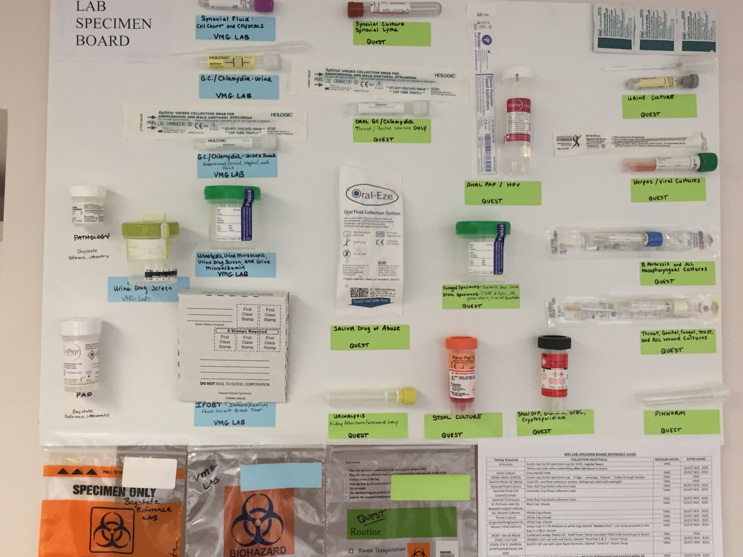

Slide 38
Patient Visit Preparation
Well Visits | Clothing* | Vitals | Special Procedures / Measurements | Other
Child | Johnny* | Ht, Wt, BP ≥ 4yrs, Pulse | Head Circumference every visit to age 2yrs
 |  |  | Vision Screen - Ages 5,6,7,8,10,12,15 yrs
 |  |  | Hearing Screen - Ages 5,6,8,10 yrs
Adult | Johnny* | Ht, Wt, BP, Pulse
Medical Management
Diabetes | Shoes & Socks off | Wt, BP, Pulse | Download glucometer
Asthma | n/a | Wt, BP, Pulse | Peak Flow, Spirometry (once per year)
COPD | n/a | Wt, BP, Pulse, O2 sat
HTN | n/a | Wt, BP, Pulse | EKG (once per year)
Same Day
Abdominal / Pelvic Pain | Female - Johnny* | Wt, BP, Pulse | HCG
 |  |  | U/A
Musculskeletal | Johnny* | Wt, BP, Pulse
URI | n/a | Wt, BP, Pulse, Temp, O2 Sat | Strep if sore throat, >3yrs, with no cough or runny nose, unless requested by practitioner.
 |  |  | Flu during flu season with flulike symptons.
UTI | n/a | Wt, BP, Pulse, Temp | U/A
Eye Complaints | n/a | Wt, BP, Pulse | Visual Acuity test | Eye tray in room
Chest Pain | Johnny* | Wt, BP, Pulse | EKG
Shortness of Breath |  | Wt, BP, Pulse, O2 sat
Skin issues (e.g. wart removals) |  | Wt, BP, Pulse |  | Liquid Nitrogen in room
* Refer to Provider preference regarding clothing
**All visits must get at least 3 vital signs
**CO Monitor to be performed on all smokers
To ensure appropriate preparation of the patient to allow the provider to efficiently address their needs.

Slide 39
Mandated Reporting
Child Abuse/Neglect:
  VMG medical personnel who suspect or observe the neglect/abuse of a minor will report such activity as mandated by Massachusetts General Laws C. 119 51-A
  All reports of suspected child abuse or neglect must be phoned in to DCF. Please call immediately if you know of, or suspect, an incident of child abuse or neglect.
  Complete the 51A form. This can be completed online at www.mass.gov/dcf or you can print a copy from the website and fax or mail the completed form. This must be done within 48 hours of the oral report.
  Scan the 51A form into the patient’s chart under “Admin Signed forms and letters” labeled as “confidential” and document in the patient encounter or patient case the observed or suspected abuse/neglect and any interventions/treatment provided.
  The Greenfield office is the office for Greenfield, Northampton, Easthampton, and Amherst Areas.
Under Massachusetts General Laws, chapter 119 any Physician, Nurse, Medical Intern, Psychologist, or person engaged in the examination, care or treatment of persons, is mandated to report any suspected or observed abuse or neglect of persons under the age of 18.
Under Massachusetts General Laws, Chapter 19A healthcare workers are mandated to report any suspected or observed abuse or neglect of persons age of 60 and over.
HOURS | WHOM TO CALL
During regular business hours (8:45 a.m.-5 p.m. M-F) | Department of Families and Children’s Services Greenfield Office 413-775-5000
Nights, weekends, and holidays | Child-at-Risk Hotline at 800-792-5200
Fax Form | 413-773-5773
Mail Form | Screening Unit Department of Families and Children’s Services Greenfield Office 143 Munson St., Unit 4 Greenfield, MA 01301

Slide 40
Mandated Reporting
Elder Abuse/Neglect:
  VMG medical personnel who suspect or observe the neglect/abuse of an elder will report such activity as mandated by Massachusetts General Law 19A.
  When neglect or abuse is suspected or observed, calls are made to:
  Complete the Elder Abuse Mandated Reporter form which must be sent to the Elder Care Services Agency within 48hrs of oral report.
  Scan a copy of the Elder Abuse Mandated Reporter Form into the patient’s chart under “Admin Signed forms and letters” and label “confidential” and document in patient encounter or patient case the observed or suspected abuse/neglect and any interventions/treatment provided.
Under Massachusetts General Laws, chapter 119 any Physician, Nurse, Medical Intern, Psychologist, or person engaged in the examination, care or treatment of persons, is mandated to report any suspected or observed abuse or neglect of persons under the age of 18.
Under Massachusetts General Laws, Chapter 19A healthcare workers are mandated to report any suspected or observed abuse or neglect of persons age of 60 and over.
HOURS | WHOM TO CALL
During regular business hours (8:45 a.m.-5 p.m. M-F) | Local Elder care Service Agency EHC/NHC/AMC: call Highland Valley Elder Services @ 413-586-2000 GHC: call Life Path @ 413-773-5555
Nights, weekends, and holidays | 1-800-922-2275
CENTERS | COPY OF FORM TO
EHC/NHC/AMC | Highland Valley Elder Services 320 Riverside Drive, Suite B Florence, MA 01062
GHC | LifePath, Inc. Elder Protective Services 101 Munson Street, Suite 20Greenfield, MA 01301 Fax: 413-772-1084

Slide 41
Vaccines / Injections
Registered Nurses may administer all routes of medications, to patients of all ages within VMG parameters. IV push medications may be administered to patients 12 years of age and older.
Licensed Practical Nurses may administer all routes of medications, to patients of all ages within VMG parameters with the exception of IV push medications.
Certified Medical Assistants may administer injections of immunization to patients 11 years of age and older.
Non Certified Medical Assistants may administer injections of immunization to patients 11 years of age and older, if they have at least three years of experience administering vaccines and are signed off by a provider.
Non Certified Medical Assistants without three years experience administering vaccines may NOT administer any injections.
  Immunizations and medications that have standing orders may be administered.
  A medication must have a practitioners order or prescription before it can legally be administered to a patient.
  Staff will enter the immunization order per VMG standing orders as delegated by the practitioner. This must be recorded in the patients’ chart.
  Any medication administered must be documented in the patients’ chart.
  Before you administer each dose of certain vaccines, you are required by law to provide a copy of the most current Vaccine Information Statement (VIS) to either the adult vaccinee or to the child’s parent/legal representative. VIS are developed by the CDC and discuss the benefits and risks associated with specific vaccines. You must also record in the patient’s chart the date that the VIS was given and the publication date of the VIS.
To assure safe administration of medications

Slide 42
Vaccines / Injections
To assure safe administration of medications
The Five rights
“The Five Rights” must be followed by the nurse each time a medication is administered. These are:
  RIGHT MEDICATION-compare medication information three times with the label on the drug container. Know the action, dosage, method of administration, and side effects of the drug.
  RIGHT CLIENT-Check the patients name and Date of Birth before administering any drugs.
  RIGHT TIME.
  RIGHT METHOD OF ADMINISTRATION.
  RIGHT AMOUNT- Check all calculations of divided doses with another nurse.

Slide 43
Vaccines / Injections
Responsibilities-- The clinical staff is responsible to:
  Only administer drugs that he/she or the pharmacy has prepared.
  Assess the patients’ medical history, history of allergies, medications and history of diet.
  Document medications administered in the EMR.
  Question an order that is unclear or cannot be read.
  Immediately report any medication errors to the provider so that potential danger to the patient can be quickly assessed.
  Document the facts regarding drug error in the patients’ medical record to include the date, time, drug, dose, route, provider notification and any actions taken. The fact that an error occurred is NOT recorded.
  Complete an incident report if an error has occurred or if a patient has an untoward effect.
Special Conditions- A drug order should consist of seven parts:
  The name of the patient.
  The date the drug was ordered.
  The name of the drug.
  The dosage.
  The route of administration and any special rules of administration.
  When the drug should be given.
  The name of the individual who ordered the drug.
Due to the risk of contamination all multi-dose vials of Lidocaine and/ or Kenalog must be removed from a procedure tray and discarded after they have been used for one patient.
To assure safe administration of medications

Slide 44
Immunization Techniques: Best Practices with Infants, Children and Adults
https://youtu.be/WsZ6NEijlfI?t=85

Slide 45
Vaccine Storage & Handling
Vaccine Storage
  Upon arrival at Valley Medical Group Health Center, vaccines will immediately be placed in the refrigerator/freezer designated for vaccine storage only.
  All refrigerators/freezers designated for vaccine storage will be set to maintain the proper temperature. Using a calibrated Fridge-tag 2 data logger, all vaccine storage units will have continuous temperature monitoring. Please contact the Vaccine Unit @617-983-6828 to report ALL temperature excursions.
  All refrigerated vaccines must be stored within the temperature range of 2° C to 8° C, or 35° F to 46° F, in a refrigerator designated for vaccine storage only. Pharmaceutical grade stand-alone units will be purchased as replacement units are needed.
  Varicella, MMR and MMRV vaccine must be stored in a frost-free freezer with a separate, insulated door that maintains a temperature between -50⁰C and -15° C (-58⁰F and +5° F).
  Inventory will be clearly marked or identified so that you can differentiate between state-supplied and privately purchased vaccine.
  Food or beverages should not be stored in the vaccine storage units.
  Vaccines should be stored centrally in the refrigerator or freezer, not on the door or on the bottom of the storage unit or in front of the cold air duct, and sufficiently away from walls to allow for proper air circulation.
  Stabilize refrigerator temperatures by placing water bottles where vaccine should not be stored (on the door and bottom of the unit).
  Store cold/gel packs in the refrigerator as part of your emergency preparedness, in case the need arises to transport vaccine during an emergency.
  Stabilize freezer temperatures by placing freezer packs on the door and anywhere there is empty space.
To ensure the safe storage and handling of vaccines in order to maintain optimum potency and efficacy

Slide 46
Vaccine Storage & Handling
Temperature Monitoring
https://youtu.be/92S5i885F8E?t=15
  The temperatures in the vaccine storage units should be monitored at least twice daily. When recording the temperature twice daily, press the READ key on the logger. This will be documented as AM and or PM when you print your monthly report. By pressing READ again on the device, it will display the warmest temperature for that day. By pressing READ again, it will display the coldest temperature for that day. Pay attention to the temperatures and report any out of range temperatures to the vaccine unit as soon as they are identified.
  Temperature logs must be retained for at least 3 years.
  Any deviations from recommended temperature ranges need to be reported as soon as they are identified to the Vaccine Management Unit at 617-983-6828. RN Team leader or designee must review temperature logs at least once a week for completeness.
Staff Training
  All staff must acknowledge reading the Vaccine Management P & P by signing and dating the document.
  A log sheet with each staff member’s name and date of training must be kept and displayed as documentation.
To ensure the safe storage and handling of vaccines in order to maintain optimum potency and efficacy

Slide 47
Vaccination Schedules
ADULT Schedule

Slide 48
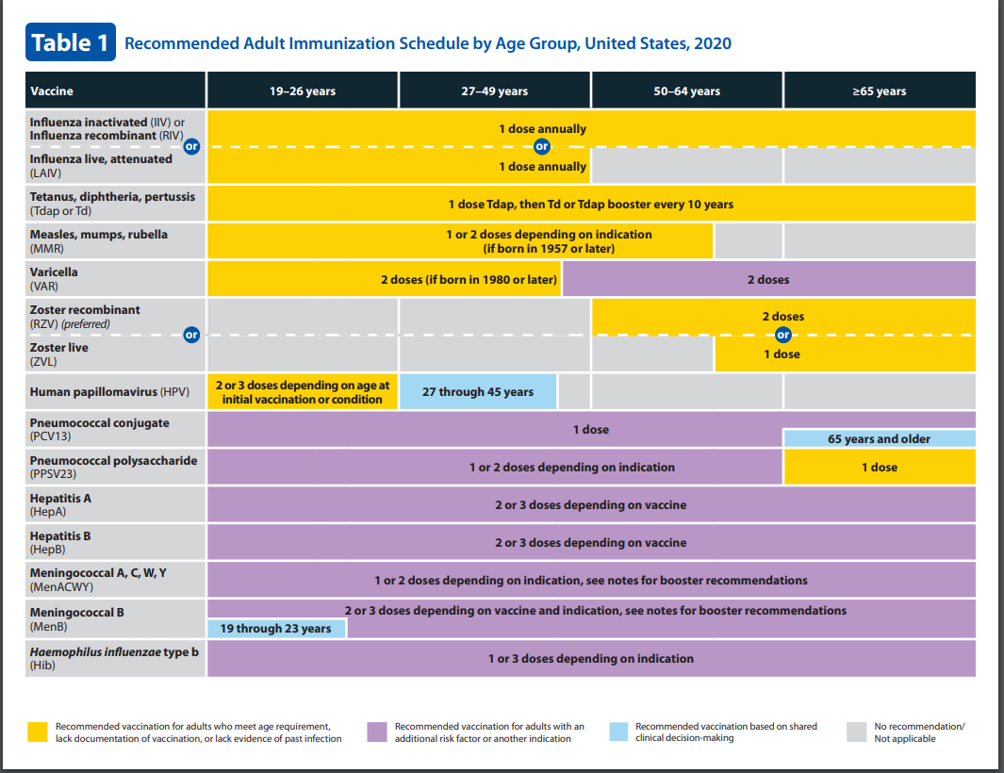

Slide 49
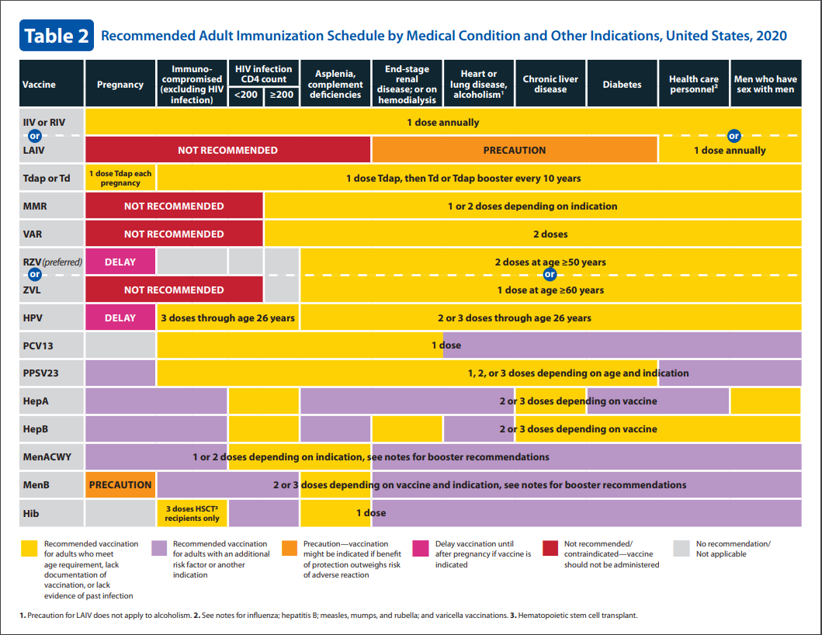

Slide 50
Pneumococcal Vaccination
Routine vaccination
Age 65 years or older (immunocompetent):
  1 dose PPSV23
  If PPSV23 was administered prior to age 65 years, adminster 1 dose PPSV23 at least 5 years after previous dose
Shared clinical decision-making
Age 65 years and older (immunocompetent):
  1 dose PCV13 based on shared clinical decision-making
  If both PCV13 and PPSV23 are to be administered, PCV13 should be administered first
  PCV13 and PPSV23 should be administered at least 1 year apart.
  PCV13 and PPSV23 should not be administered during the same visit
Special situations
Age 19 through 64 years with chronic medical conditions (chronic heart [excluding hypertension], lung, or liver disease, diabetes), alcoholism, or cigarette smoking:
  1 dose PPSV23
Age 19 years or older with immunocompromising conditions (congenital or acquired immunodeficiency [including B- and T-lymphocyte deficiency, complement deficiencies, phagocytic disorders, HIV infection], chronic renal failure, nephrotic syndrome, leukemia, lymphoma, Hodgkin disease, generalized malignancy, iatrogenic immunosuppression [e.g., drug or radiation therapy], solid organ transplant, multiple myeloma) or anatomical or functional asplenia (including sickle cell disease and other hemoglobinopathies):
  1 dose PCV13 followed by 1 dose PPSV23 at least 8 weeks later, then another dose PPSV23 at least 5 years after previous PPSV23; at age 65 years or older, administer 1 dose PPSV23 at least 5 years after most recent PPSV23 (note: only 1 dose PPSV23 recommended at age 65 years or older)
Age 19 years or older with cerebrospinal fluid leak or cochlear implant:
  1 dose PCV13 followed by 1 dose PPSV23 at least 8 weeks later; at age 65 years or older, administer another dose PPSV23 at least 5 years after PPSV23 (note: only 1 dose PPSV23 recommended at age 65 years or older)

Slide 51
CLINICAL SKILLS
nursing staff

Slide 52
Pediatric Vaccines
All pediatric vaccines are provided free of charge by the state to persons less than 19 years old.
The federal Vaccines for Children Program (VFC) requires providers to screen anyone less than 19 years of age for VFC eligibility at every immunization visit.
The outcome of this screening must be documented and dated. Documentation of VFC eligibility may be captured through our electronic health record (EHR).
Athena has a drop-down menu offering several options for VFC eligibility.
Below are the options that should be selected when documenting VFC eligibility in Massachusetts:
  VFC Eligible – Medicaid: a child eligible for MassHealth or Medicaid, including Medicaid HMOs. This category may be selected even if the child has MassHealth or Medicaid as their secondary insurance.
  VFC Eligible – Uninsured: a child with no insurance.
  VFC Eligible – American Indian/Alaskan Native: a child who (or whose parent/guardian) self identifies as American Indian (Native American) or Alaskan Native. Please note that no documentation/verification is required.
  Not VFC Eligible: Any child with private health insurance.
To assure safe administration of medications to our pediatric population

Slide 53
Pediatric Vaccines
Massachusetts Immunization Information System (MIIS)
The goal of the MIIS is to give health care providers and families a tool to help ensure that all individuals are immunized based on the latest recommendations.
The MIIS was designed to serve the needs of electronic health record (EHR) users through electronic data exchange, and can also support the needs of non-EHR users through direct data entry. The primary benefits of the MIIS are:
  Shared immunization records. Records will be available across multiple sites and locations to help identify under-immunized children and pockets of unmet need;
  Better decision making. Practices, schools, and electronic health record (EHR) systems will be able to increase on-time delivery and reduce inappropriate immunization by using advanced immunization forecasting decision support;
  Reduced waste and increased efficiency. Vaccine administration will be monitored and assessed on an ongoing basis to optimize distribution and use;
  Enhanced disease control. The MIIS will be integrated with the Massachusetts Department of Public Health infectious disease monitoring systems to allow the linkage of disease surveillance with the immunizations designed to prevent them;
  Improved disaster preparedness by providing an essential infrastructure for responding to natural disasters, bioterrorism events, influenza pandemics and other emergencies.
To assure safe administration of medications to our pediatric population

Slide 54
Vaccination Schedules
Pediatric Schedule

Slide 55
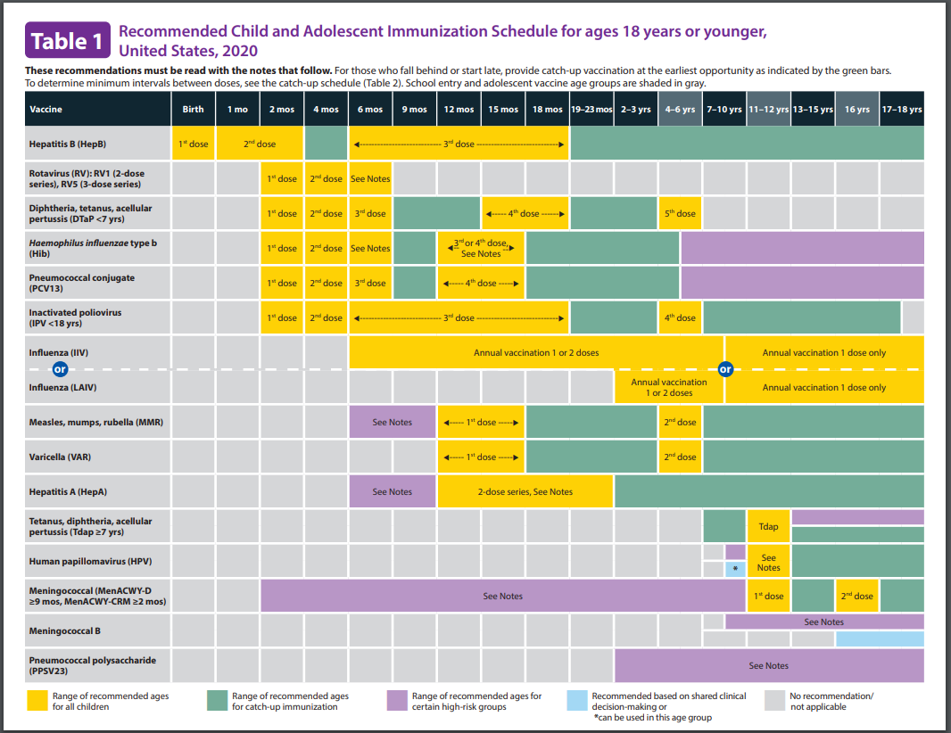

Slide 56
Personal Health Appraisal for Children and Adolescents
HEALTH MAINTENANCE GUIDELINES

Slide 57
Diabetes 101: Survival Skills
Bonnie P. Grenier, BSN, RN, CDE
Certified Diabetes Educator
Valley Medical Group

Slide 58
who is at risk…
1st degree relative
High risk ethnicity: African American, Latino, Native American, Asian, Pacific Islander
GDM or fetal weight over 9#
HTN (>140/90 or treated)
Hyperlipidemia
Polycystic ovarian syndrome
Pre-DM
Obesity
Acanthosis nigricans
Cardiovascular disease

Slide 59
 | Fasting Blood Sugar* | 2 Hr Post Prandial Blood Sugar** | Hemoglobin A1c***
No Diabetes | <100 | <140 | <5.7
Pre-Diabetes | 100-125 | 140-199 | 5.7-6.4
Diabetes | ≥126 | ≥200 | ≥6.5
For a diabetes diagnosis there MUST be TWO Fasting blood glucose levels >126 mg/dl, or positive OGTT or random blood glucose >200 mg/dl WITH symptoms. CANNOT use A1C for diagnosis.
*At least 8 hours without caloric intake
**Officially – oral glucose tolerance test – 2 hours after 75g glucose drink
***Measures the amount of glucose attached to red blood cells and gives average BG for past 2-3 months

Slide 60
characteristics
Type 2
Type 1
Insulin resistance and decrease in insulin output
Usually >40 years old
Often not ill at all, comes on slowly. Can be present for several years before diagnosed.
80-90% overweight
Non ketotic
Genetic predisposition
Treatment: meal plan and exercise, oral agents, injectables and insulin if needed
90% of diabetes population is Type 2
Autoimmune process– destruction of pancreatic beta cells
Absent or minimal production of insulin, insulin treatment mandatory
Common in youth but can happen at any age
Usually a quick onset and patient is ill.
Ketosis-prone
Genetic predisposition
Symptoms typically occur when 90% of beta cell mass has been destroyed
10% of diabetes population is Type 1

Slide 61
Common Myths
It's possible to have "just a touch" or "a little" diabetes.
Diabetes is caused by eating too much sugar.
People with diabetes can feel when their blood sugars go too low or too high.
You have to lose a lot of weight for your diabetes to improve.
You’ll know you have diabetes by your symptoms.
People with diabetes need to follow a special diet.
Taking insulin means you have “failed”.

Slide 62
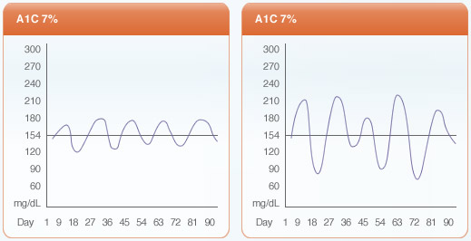
what is hemoglobin a1c
Measures the amount of sugar attached to red blood cells. RBCs live approx 3 months, so
Gives an average of blood sugar for the past 2-3 months
Does not take the place of SMBG (self monitored blood sugars)
Is not the be-all and end-all of evaluating glycemic control

Slide 63
a1c and estimated average glucose
A1c | Estimated glucose
4% | 50-80
5% | 80-115
6% | 115-150
7% | 150-180
8% | 180-210
9% | 210-245
10% | 245-280
11% | 280-310
12% | 310-345
13% | >345
Notes:
9% is 200
11% is 300

Slide 64
treatment: Care Team
Primary Care Provider- disease and health risks, complications, treatments including medications
RN, LPN, MA- basic teaching on acute complications, meters and injections
RN,CDE- survival skills education; insulin titration, life strategies, medications, specialized needs, insulin pump therapy, continuous glucose monitoring, personalized goal setting
RD, CDE- assessment of needs, nutrition education, coping skills , acute complications, personalized goal setting
Endocrinologist- blood glucose level management, chronic complications, comorbid conditions, Type 1 Diabetes, insulin pumps
Behavioral Health- coping, life skills, psychological issues and self care
Podiatry- foot care related to diabetes
Eye care- comprehensive eye exams to detect complications r/t diabetes

Slide 65
treatment: lifestyle: activity
Dietary changes are significant
150 minutes per week divided over as many days as possible (30 minutes/day)
  Some kind of activity most days
Start with whatever is possible
  2, 5, 10 minutes out the door and back again
  Chair exercises
  Get up and move around during commercials
  Ask :“What did you like to do when you were 12?”
Take into account other physical problems
Be safe
  Carry food, meter, medical ID, good footwear, stay hydrated, be alert for hypoglycemia
Consider supervised programs
  Exercise is Medicine (Greenfield Y)
  Northampton Athletic Club , Hampshire Fitness Northampton YMCA
Walking DVD’s

Slide 66
Why monitor?
The brain is a poor pancreas.
It needs all the information it can get!

Slide 67
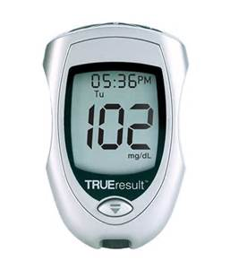
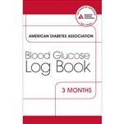
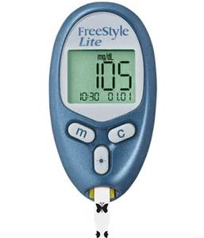
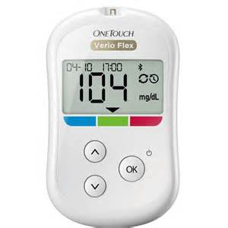
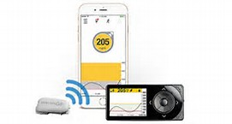

The needed tools
Notes:
METER
INFORMATION
LOG
MAP
BRAIN!!
WITH HCP AND ON OWN – PROBLEM SOLVING AND DECISION MAKING
UNDERSTANDING GUIDANCE FEEDBACK (meds, foods, activities…)
FOOD
INVOLVES PEOPLE IN THE PROCESS TOGETHER
MOTIVATION EMPOWERMENT
HYPO HYPER BG CONTROL COMPLICATIONS

Slide 68
How does it help? (1)
Gives people with diabetes and their health care providers information regarding:
  Effectiveness of treatments
  Guidance in changing treatments
  Underlying path/physiologic processes at play
  Recognition of patterns of BG
  Effects of lifestyle and medications
Gives immediate feedback regarding effects of activity, foods, medications, illness, etc
Alerts to changes in BG before they are out of control (before the high A1c, acute complication)

Slide 69
How does it help? (2)
Prevent, detect, improve recognition of hypo and hyperglycemia and guide treatment.
  Adds safety for people with hypoglycemia unawareness and people who easily develop DKA
Allows people on insulin and some medications to dose appropriately for the moment.
Helps to achieve and maintain target goals
Helps to prevent complications

Slide 70
When and how often to monitor BG?

Slide 71
Monitoring schedules:
Newly diagnosed Type 2:
-Fasting and alternate 2 hours after larger meals
Type 2 on insulin and Type 1:
-Before each meal and at bedtime
-Or discretion of provider.

Slide 72
Insulin Vials vs. Pens

Slide 73
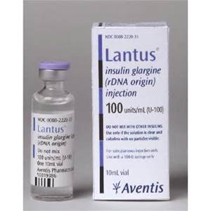
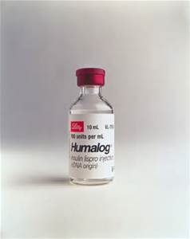
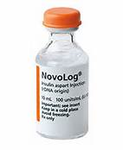
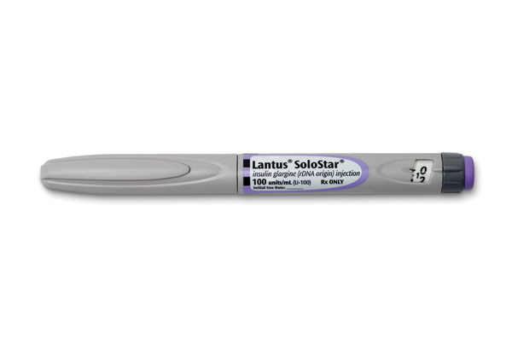
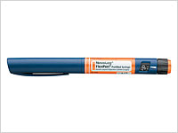
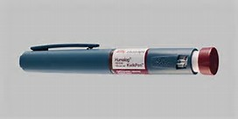
Commonly used insulins

Slide 74
Which one is best?
Cost is lower with vials and insurance companies prefer to cover vials.
Pens are much easier to use and are best for patients with the following problems: dexterity, vision, or memory trouble
PA is accepted for pens with one of the above explanations

Slide 75
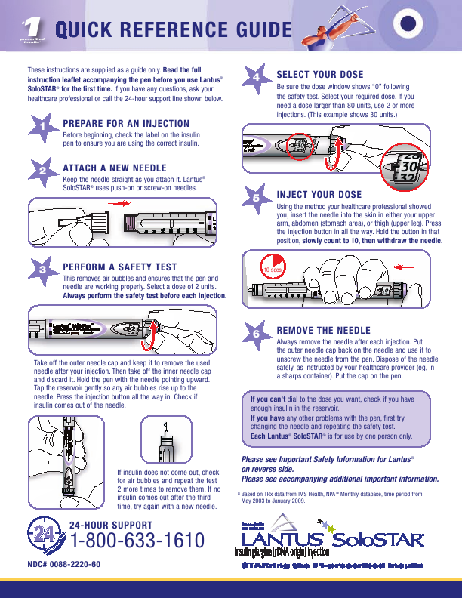

Slide 76
Pen Instructions:
Remind pts to prime the needle with 2 units before each injection to make sure it is working.
Once opening the pen, you can keep it at room temperature.
Avoid extreme temperature changes.
The other pens not being used can be stored in refrigerator.
After 28 days of opening pen, have pt discard it, even if there is insulin left in it.

Slide 77
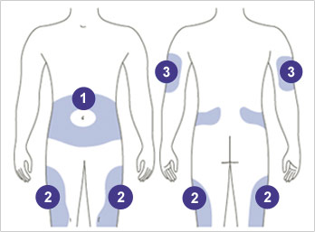
Injection Locations:

Slide 78
Acute complications
Basics on Hypoglycemia and Hyperglycemia

Slide 79
Causes of Hypoglycemia
Not enough food
Too much medication or too much insulin
Skipping or delaying a meal
Prolonged exercise
Being more active than usual
Anything below 70 mg/dl is considered hypoglycemic

Slide 80
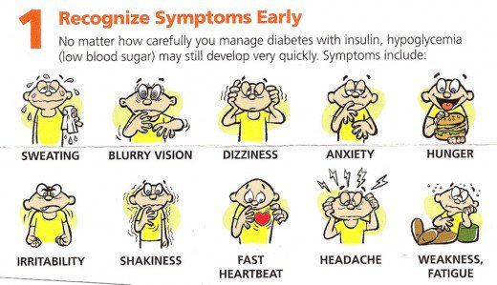
Symptoms of Hypoglycemia

Slide 81
Treatment of Hypoglycemia
1. Check your blood sugar to determine if you are below 70 mg/dl.
The “Rule of 15”
2. Treat it by eating or drinking 15 grams of carbohydrates (something high in sugar) such as:
  ½ cup of regular juice
  ½ cup of regular soda (not diet)
  3-4 glucose tablets
  1 tbsp of a concentrated sweet (honey, maple syurp)
  5-6 hard candies
3. Wait 15 minutes and recheck blood sugar. If still low, eat or drink another 15 grams of juice or candy. Once your blood sugar is normal, eat a meal or a snack.

Slide 82
Hyperglycemia- Causes
Too much food
Not taking enough insulin or missing a dose
Not taking your diabetes pills
Being less active than normal,
Stress
Illness or infection

Slide 83
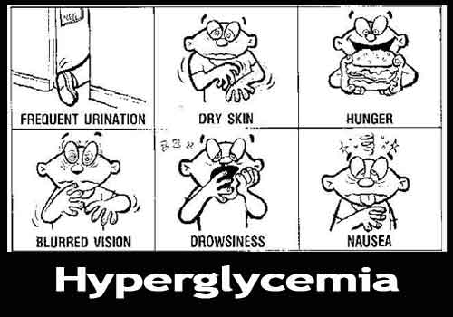
Symptoms of Hyperglycemia

Slide 84
Treatment of Hyperglycemia
  Drink lots of water
  Mild exercise if >250 (without ketones)
  Insulin correction doses (requires good knowledge) if pt on insulin
  Type 1 check ketones
  Glucagon kit if unresponsive
  Call if not coming down with treatment
  Call doctor or diabetes educator if blood sugars are elevated for more than 3 days in a row or sooner with vomiting/illness.

Slide 85
blood pressure and lipid goals different for diabetes
BP
  <140 systolic
  <90 diastolic
Treatment
  140-149/90-89
    Trial of lifestyle (DASH diet, increased activity)
  140/90 +
    Lifestyle PLUS Rx
    Often need more than one type of medication
    ACE/ARB can protect kidneys (contraindicated in pregnancy)
Studies still not completely clear what level is ideal for decreasing cardiovascular risk.
Lipids
  LDL first focus
    <100 if no overt CV disease
    <70 if high risk or CV disease
  Triglyceride <150
  HDL >40 men >50 women
Treatment
  Glycemic control
  Lifestyle – diet, activity, smoking
  Rx
    LDL – statins
    Other – niacin, fenofibrates, niacin, fish oil, bile acid sequestrants
Tips for Teaching: BG control helps; these issues just as important in reducing complications (cardiovascular) as BG control is; take meds as prescribed; be alert for side effects and discuss problems with provider.

Slide 86
Triage
The nurse helps direct the caller to the most appropriate healthcare setting or gives advice about home care treatment.
The clinical staff will decide whether the problem is:
  an emergency - call 911 or go to the nearest emergency department
  urgent - needing a same day appointment or within a specified time frame
  routine - requiring a later appointment
  advice - home care is advised. The patient is instructed to call back if no improvement or if the condition worsens
To standardize nursing advice guidelines to assist in the assessment of care a patient needs as well as prioritize their need.

Slide 87
Triage
Resources:
  5th edition of Telephone Triage for Nurses by Julie Briggs
  UP To Date
  Consultation with a provider.
To standardize nursing advice guidelines to assist in the assessment of care a patient needs as well as prioritize their need.

Slide 88
Triage
Documentation:
  Using a Patient Case in the EMR, the nurse will document the caller’s name, DOB, PCP, onset of symptoms, prior history, medications and questions appropriate to the complaint, such as frequency or severity of symptoms.
To standardize nursing advice guidelines to assist in the assessment of care a patient needs as well as prioritize their need.

Slide 89
Anticoagulation Therapy Management

Slide 90
What is an Anticoagulant?
There are three main types:
Anticoagulants, such as heparin or warfarin (Coumadin), work on chemical reactions in the body to lengthen the time it takes to form a blood clot.
Antiplatelet drugs, such as aspirin, prevent platelets from clumping together to form a clot.
Within the past three years, new anticoagulants (DOACs) have been introduced that are simpler to use and less risky than Coumadin because the risk for bleeding is lower. These medications do not require regular testing.

Slide 91
How is the effectiveness of Coumadin monitored?
It is necessary to perform regular blood tests to ensure the patient is receiving the correct dosing.
Too weak a dose increases the risk of stroke and heart attack.
Too strong a dose puts patients at risk for bleeding.
The test used to monitor the effects is called the International Normalized Ratio, or INR. It is a blood test that checks how long it takes for blood to clot.
The higher the INR, the longer it will take blood to clot (and the higher risk of bleeding).
The lower the INR, blood will clot quicker (and the higher risk of forming clots).

Slide 92
INR Range
A therapeutic range for the INR test will be decided based on diagnosis.
If the INR is higher than the range (risk for bleeding) – Coumadin is decreased
If the INR is lower than the range (risk for clotting) – Coumadin is increased

Slide 93
Factors that may contribute to a high or low INR
Other medications / supplements
Diet Changes
Alcohol
Being sick (vomiting, eating less)
Stress
Vacation
Missed doses
Wrong dose

Slide 94
Possible Side Effects
Slight Bleeding
Major Bleeding
Bleeding gums while brushing teeth
Occasional nosebleed
Easy Bruising
Heavier menstrual bleeding
Bleeding after a cut that stops within a few minutes
Red, dark, coffee or cola colored urine
Red or tar colored BM
Throwing up bright red or coffee colored substance
Severe pain
Excessive bleeding

Slide 95
Some Reasons to take Coumadin
A-fib
DVT
PE
Valve Replacement

Slide 96
Duration
Long Term
Short Term
A-Fib
DVT or PE with no precipitating event
Valve Replacement
DVT or PE with a precipitating event – we need to track these patients to ensure they are only being treated for the time frame proposed

Slide 97
Anticoagulation Therapy-
Coumadin Management Policy

Slide 98
Teaching
Nursing staff will provide education to patients
Emphasis on food and medicine interactions as well as signs of bleeding.

Slide 99
Dosing
ACCP Anticoagulation Guidelines

Slide 100
Goal Inr range 2.0-3.0
INR Range | Recommended dosage adjustment | Recommended Next INR
<1.5 | Mildly Subtherapuetic result, may consider repeating test. Assess for possible reason for low result. | Schedule INR test between 4 days to 1 week
1.5-1.9 | Minimally Subtherapuetic result, Assess for possible reason for low result. If patient has been stable with current dose, do not adjust if minimally subtheraputic. i.e. 1.8-1.9. Continue same dose. Repeat INR in 1 week | Schedule INR test between 4 days and 1 week Repeat INR in 1 week
2.0-3.0 | Therapeutic dose. Keep Same dose. | Repeat INR in 1 week. . If INR is within recommended range at next test visit, repeat again in 1 week. When INR is within recommended range after 2 consecutive weeks, you may extend testing interval an additional week each time thereafter, not to exceed an interval of 4 weeks. Patients who have had stable INR’s for 6 mos may extend their testing frequency to up to 12 weeks increasing by 2 weeks at each testing interval.
3.1-3.9 | Minimally supratheraputic result. Adjust dose 10-15% TWD. Do not adjust dose if minimally elevated and patient has been stable on current dose. i.e. 3.1 0r 3.2 Continue same dose Repeat test 1 week. If INR remains elevated for a second week, consider holding 1 dose (depending on the extent of elevation). | Schedule INR test 4 days to 1 week Repeat INR in 1weeks

Slide 101
Goal Inr range 2.0-3.0
4.0-4.9 | Mildly supratheraputic result. Always Consider repeating the test. Assess for possible reasons for elevation. With no significant bleeding, lower the warfarin dose no more than 15% or omit a dose and resume therapy at a lower calculated dose. | Schedule INR test 4 days to 1 week
5.0-5.9 | Mild/ Moderately supratheraputic result. Consider Repeating the test. Notify Practitioner. Hold next 1-2 doses of Coumadin, and reduce dose by 10-15%. Vitamin K is not recommended unless the patient is actively bleeding. | Schedule INR test between 4 days to 1 week
6.0>10.0 | Moderately supratherapeutic result. Consider repeating the test. Notify practitioner. Assess for possible reasons for elevation. Hold Coumadin x 3- 4 days Resume therapy at lower dose when INR reaches the therapeutic level. Vitamin K is not recommended unless the patient is actively bleeding. | Schedule INR test 2-4 days until INR is back in therapeutic range
10-20 | Consult provider. Hold coumadin and administer Vit K 2.5mg-5 Mg orally. Repeat if necessary Resume therapy at lower dose when the INR reaches the therapeutic level. | Repeat Q 1-2 days until INR reaches therapeutic level

Slide 102
Goal Inr range 2.5-3.5
INR Range | Recommended dosage adjustment | Recommended Next INR
<2.0 | Mildly Subtherapuetic dose, consider repeating test. | Schedule INR test 2-4 days until INR is in therapeutic range
2.0-2.4 | Minimally Subtherapuetic dose, Assess for possible reasons for low result, i.e. missed dose, etc. Do Not adjust dose if minimally subtheraputic and patient has been stable on current dose. i.e. 2.3-2.4 Continue current dose and retest in 1 week. | Schedule INR test 4 days to 1 week
2.5-3.5 | Therapeutic dose. Keep Same dose. | Repeat in one week. If INR is in recommended range at next test visit, repeat again at 1 week. When INR is within recommended range for 2 consecutive weeks, you may extend testing interval each time by another week thereafter not to exceed 4 weeks. Patients whose INR has been stable for 6 mos may have their testing frequency extended up to 12 weeks, increasing by 2 weeks each testing interval.
3.5-3.9 | Minimally Elevated result. Assess for possible reasons for elevation. If patient has been stable with current dose, do not adjust dose for readings 3.6-3.7. | Schedule INR test 4 days to 1 week
4.0-4.9 | Minimally/ Moderately elevated result. Always Consider repeating the test. Assess for possible reasons for elevation. May consider holding one dose coumadin . | Schedule INR test 4 days to 1 week
5.0-9.9 | Moderately supratherapeutic result. Consider repeating the test. Notify Practitioner. Hold next 1-2 doses of Coumadin. Calculate lower dose not to exceed 15%. Vitamin K is not recommended unless the patient is actively bleeding | Schedule INR 2-4 days until back into therapeutic range
>10.0-20 | Repeat the test. Notify practitioner. Hold coumadin. Give Vit. K 2.5 mg-5mg po. and repeat if necessary. Resume therapy at a lower dose when the INR reaches the therapeutic level | Repeat Q 1-2 days until INR reaches therapeutic level

Slide 103
Dosing
ACCP Anticoagulation Guidelines
Do thorough assessment
  Why INR may be high
  Why INR may be low

Slide 104
Assessing Why INR High
What dose is patient actually taking?
Did patient take an extra dose?
Any change in Medication?
Any new medications? i.e. ABX/OTC pain relievers
Any diet changes?
  Eating less greens
  Not taking supplements/vitamins anymore
Has patient been on vacation or traveling?
Has patient been sick recently?
  Vomiting-but not taking meds
  Not eating as much
Any alcohol or increase alcohol?
Have Coumadin pills changed in color/shape – different brand or manufacturer?
Assess for bleeding/bruising, dark stools.

Slide 105
Assessing Why INR Low
What dose is patient actually taking?
Any missed doses?
Any change in Medication?
Any new medications?
Any diet changes?
  Eating more greens
  New supplements/vitamins, health drinks (Boost/Ensure)
Has patient been on vacation or traveling?
Have Coumadin pills changed in color/shape – different brand or manufacturer?

Slide 106
Dosing
ACCP Anticoagulation Guidelines
Do thorough assessment
  Why INR may be high
  Why INR may be low
Look at INR history
Adjust based on all factors – not always black & white.

Slide 107
Documentation
All results and Coumadin adjustments are to be entered into the Athena flowsheet
Results from POC testing, VMG lab, Baystate and CDH will automatically populate in the Athena flowsheet.
Results coming in from other outside labs must be entered manually
INR goal to be entered in note section of diagnoses in problem list

Slide 108
Notification of INR
Provider
  Sent the first six weeks of therapy
  Results 0.5 above or below goal
Patient
  Printed report
  Phonecall

Slide 109
Non-compliance
The clinical department is responsible for test appointment management, and will follow the procedure for non-compliant patients as indicated:
Review overdue patient report weekly to determine which patients are overdue for blood work by one week or more then follow guidelines as listed:
  A) If INR is within range, or < 0.5 above range, or < 0.2 below range
    a. Attempt to remind patients by telephone for 3 consecutive days
    b. If there is no response to the telephone calls, mail out certified overdue letter
    c. Document in Coumadin flowsheet that letter has been sent
    d. If patient does not respond to the letter within 7 days, nursing will send a patient case to the provider, via Athena, to review and provide further instructions.
  B) If INR is ≥ 0.5 to 2 above range, or ≥ 0.2 to 0.5 below range
    a. Attempt to remind patients by telephone for 3 consecutive days
    b. If there is no response to the telephone calls, mail out certified overdue letter and send a patient case to the provider, via Athena, to review and provide further instructions.
    c. Document in Coumadin flowsheet that letter has been sent and provider notified.
  C) If INR is > 2 above range, or > 0.5 below range, or > 1.5 below range for Afib
    a. Attempt to remind patients by telephone at least 3 times in one day
    b. If there is no response to the telephone calls, notify provider via red flagged patient case, or in person, to review and provide further instructions.
    c. Consider reaching out to emergency contact
    d. If there is still no response, mail out certified overdue letter
    e. Document in Coumadin flowsheet all actions taken

Slide 110
Medication refills
Managed by treatment nurse if Coumadin managed by VMG
All other refills are sent to the PCP

Slide 111
Anticoagulation Therapy –
Bridging Policy - To Bridge or Not to Bridge

Slide 112
What is Bridging?
Transitioning from Coumadin to Lovenox for patients that are requiring surgical procedures that have an increased risk of bleeding who also have a high risk of clotting.

Slide 113
When to Bridge
First you must determine if the procedure is one that you need to stop Coumadin for.
If patients have a mechanical heart valve, recent stroke, DVT or PE within the last 3 months they will need to be bridged automatically with Lovenox.

Slide 114
Procedures that can be performed without discontinuing coumadin
Ophthalmic | Cataract surgery Trabeculectomy
Dental | Restorations Uncomplicated extractions Endodontics Prosthetics Periodontal therapy Dental hygiene
Dermatologic | Simple Excision
Gastrointestinal | Diagnostic esophagogastroduodenoscopy Colonoscopy without biopsy Diagnostic endoscopic retrograde Cholangiopancreatography Biliary stent without sphincterotomy Endoscopic ultrasonography without biopsy Push enteroscopy

Slide 115
When to Bridge
AFIB Patients
You need to verify the CHADS 2-VAS score on Atrial Fib patients.

Slide 116
Chads 2 – Vas Score
CHADS₂-VAS_{c} Scoring Table
Condition | Points
Congestive heart failure | 1
Hypertension | 1
Age >= 75 years | 2
Diabetes mellitus | 1
Stroke/TIA or thromboembolism (prior) | 2
Vascular disease (MI, PAD, or aortic plaque) | 1
Age 65-74 | 1
Sex Category (Female) | 1
You can also use website: www.anticoagulationtoolkit.org
Or you can use free smartphone app: MAQI2

Slide 117
When to Bridge
AFIB Patients
Score of 0-6 – will not need to bridge (unless other factors involved)
Score of ≥ 7 – patient will need to be bridged

Slide 118
When to Bridge
Other
Nursing verifies whether the patient is in the high moderate or low risk category.

Slide 119
Suggested risk stratification for perioperative thromboembolism
Indication for VKA Therapy
Risk Stratum | Mechanical Heart Valve | Atrial Fibrillation | VTE
High | Any mitral valve prosthesis Any caged-ball or tilting disc aortic valve prosthesis Recent (within 6 mos) stroke or TIA | Chads score ≥ 7 Recent (within 3 mos) stroke or TIA Rheumatic valvular heart disease | Recent (within 3 mos) VTE Severe thrombophilia (e.g. deficiency of protein C, protein S, or antithrombin; antiphospholipid antibodies; multiple abnormalities)
Moderate | Bileaflet aortic valve prosthesis and one or more of the following risk factors: Atrial fibrillation Prior stroke or TIA Hypertension Diabetes CHF Age > 75yrs | Chads score < 7 | VTE within the past 3-12 mos Nonsevere thrombophilia (e.g. heterozygous factor V Leiden or prothrombin gene mutation) Recurrent VTE Active cancer (treated within 6 mos or palliative
Low | Bileaflet aortic valve prosthesis without atrial fibrillation and no other risk factors for stroke |  | VTE > 12 mos previous and no other risk factors
Low Risk – No bridging required
Moderate – Bridging Plan may be required
High Risk – Bridging Plan required

Slide 120
Bridging Plan
Nursing sends plan to PCP for verification via patient case.
Prescription for Lovenox is sent to pharmacy.
Patient is notified of plan

Slide 121
Determining Bridging Plan
Determine when patient will take his/her last dose of Coumadin prior to procedure and when to restart it and what the dosage will be.
Determine the dosage of Lovenox
Determine when to begin Lovenox injections, if they will be self-administered, family administered or given at the center and when Lovenox will be resumed after the procedure
Determine when to have INR testing after restarting.

Slide 122
Bridging Plan
Coumadin will be stopped 5 days prior to procedure.
Begin Lovenox 1 day after stopping Coumadin and take full dose BID until day before procedure.
Take only one dose of Lovenox the day before the procedure. (Or half dose if taking daily)
Restart Coumadin (at previous dose) the night of the procedure or day after (to be determined by provider performing procedure).
Restart Lovenox (at full dose) 12-24 hours after procedure (determined by provider performing procedure).
INR will be retested 4-7 days after restarting the Coumadin. Patient will remain on Lovenox until INR is within range for 2 consecutive days.

Slide 123
Lovenox dosing
Therapeutic dose of Lovenox is:
  1mg/kg BID
  *If only once a day administration is needed then:
  1.5mg/kg daily
  (to convert lbs. to kg. divide by 2.2)

Slide 124
Example of plan based on October 1st procedure and weight of 80 kgs/176lbs with BID Lovenox dosing
9/25/17 | Last dose of COUMADIN
9/26/17 | No COUMADIN. Start 80mg of LOVENOX® BID (preferably at within a 2-hour period of the same time daily)
9/27/17 | No COUMADIN, LOVENOX® 80mg twice a day
9/28/17 | No COUMADIN, LOVENOX® 80mg twice a day
9/29/17 | No COUMADIN, LOVENOX® 80mg twice a day
9/30/17 | No COUMADIN, LOVENOX® 80mg ONCE daily (1/2 the dose)
10/1/17 | Procedure day. No LOVENOX®, restart COUMADIN the night of the procedure or the next day PER THE SURGEON (put the exact dose of COUMADIN to take according to patient's flowsheet)
10/2/17 | COUMADIN (give exact dose), LOVENOX® 80mg BID
10/3/17 | COUMADIN, LOVENOX® 80mg BID
10/4/17 | COUMADIN, LOVENOX® 80mg BID
10/5/17 | COUMADIN, LOVENOX® 80mg BID
10/6/17 | TEST INR

Slide 125
Anticoagulation Therapy -
Managing Patients who are taking Antibiotics/New Medications while on Coumadin Policy

Slide 126
Some medications that interact with Coumadin
Many Antibiotics
Some heart medicines
Birth Control Pills
Thyroid pills
Over the counter pain relievers/cold medicines
Vitamins
Herbal supplements

Slide 127
Procedure
Providers will inform nursing when prescribing new antibiotics or medications
Nursing will provide education to patients.
All patients will have INR testing 3 days after starting new medications.
All patients will then be tested weekly (or sooner if needed) until medication is discontinued and then be tested weekly until stable
Patients starting long term medications will be tested weekly until in range for 2 weeks.

Slide 128
Anticoagulation Therapy -
INR Home Monitoring Policy

Slide 129
Procedure
When patient requests a home monitor, a patient case will be sent to the nursing staff that manages home monitors.
Patient will call home monitor supplier with INR results, who will then send via Athena Fax
If INR is out of range, patient and supplier should call.
INR results will be sent to nursing – either directly through Athena fax or by PCP
Results will be documented into patients Athena flowsheet and Coagulink
If patients are out of range, they will be called with new dosing instructions
If patient is in range, they should be aware to continue at same dose and retest in 1 week
Nursing will document a count of each test on the Athena flow sheet (test#1, test#2, test#3, test#4)
Every 4th home test is billed by nursing using a blank billing form

Slide 130
Anticoagulation Therapy -
TTR (Total Time in Range) Management Policy

Slide 131
What is TTR (Total Time in Range)?
It is a calculation that evaluates compliance and efficacy of anticoagulation therapy with Coumadin
It is calculated by the Rosendaal method and gives you the percentage of time the patient’s INR was within range.

Slide 132
Procedure
TTR will be reviewed by nursing staff every 3 months using the report provided
Nursing will document this information, with date, in the Athena Coumadin flowsheet
If TTR is below 60%, nursing will review patient’s flowsheet and assess for possible reasoning
Nursing will create patient case with TTR and findings and send to PCP with recommendations.
Nursing will inform patient and provide teaching
Nursing will review TTR again in 3 months and if it remains under 60% will review flowsheet again
If the patient is on Coumadin for the treatment of a DVT or A-fib, the case will be reviewed with the PCP to determine if patient should be switched to a DOAC
If on Coumadin for any other conditions, findings will be reviewed and sent in patient case as previously done

Slide 133
Anticoagulation Therapy -
DOAC Management Policy and Patient teaching for DOACs

Slide 134
What is a DOAC?
Direct Oral Anti Coagulants are an alternative for Coumadin or vitamin K antagonists (VKAs) to prevent stroke in patients with non-valvular atrial fibrillation.
Some names of NOACs
  Pradaxa (Dabigatran)
  Xarelto (Rivaroxaban)
  Eliquis (Apixaban)
  Savaysa (Edoxaban)

Slide 135
Coumadin vs. DOACs
DOACS do not require routine blood testing and possess favorable pharmacological properties
DOACs are not affected by food – e.g. Vitamin K
DOACs have a lower bleeding risk
DOACs have less drug to drug interactions
DOAC’s are contraindicated for patients with prosthetic heart valves, severe renal insufficiency or who are pregnant.

Slide 136
Procedure
Providers will send a patient case to nursing when starting a patient on a DOAC
Nursing will provide education to patients regarding:
  How medication works
  How medication is taken
  How to handle a missed dose
  When to call the health center
  Possible side effects
  Phone call schedule
Nursing will schedule appointments in the NOAC schedule and call patients based on the schedule as follows:
  Once a week for the first 4 weeks
  Then once a month for the next 3 months
  Then once every three months until patient has been on NOAC for one year
  Then once a year
If nursing is unable to reach patient, a new appointment should be scheduled for the next day and repeated up to 14 days. After that a case is to be sent to the PCP
Nursing will check medication refill history at monthly, quarterly and yearly calls.
Nursing will document each call on the Coumadin flowsheet under the comments section.

Slide 137
Questions to ask on DOAC phone call
Is patient taking prescription as directed? Missing any doses?
Any bleeding events? i.e. bloody or dark stools, nose bleeds, pink urine, coughing up blood, blood in vomit.
Any dyspepsia. (If so take with food and full glass of water)
Any other side effects.
Medication review for potential drug interactions, including using ASA and NSAIDs.
Storing of medication properly

Slide 138
Patient Cases

Slide 139
Dosing – Case 1
Diagnoses – Afib
INR 1.7 (Range 2-3)
Week of Christmas to new years.
Patient had been being tested every 4-5 weeks and had been stable for past 5 months (2.3, 2.4, 2.2, 2.6, 2.2). Patient states diet has been different due to the holidays.
Do not change dose
Recheck in 1 week
If still low, adjust
If in range go back to 4 week checks.

Slide 140
Dosing – Case 2
Diagnoses – Afib
INR 3.2 (Range 2-3)
Patient states no change in diet or ETOH. Patient states they were at the Cardiologist and was started on Amiodarone last week.
Patients last few readings:
  1 week ago – 2.2
  2 weeks ago – 1.9
  3 weeks ago – 2.2
Amiodarone can increase effect of Coumadin
Decrease dose and re-check in one week

Slide 141
Dosing – Case 3
Patient has UTI and being started on Bactrim.
Antibiotics can increase effect of Coumadin
Decrease total weekly dose (TWD) by 30% and re-check in one week

Slide 142
Bridging– Case 1
Diagnoses:
  A-fib
  HTN
  CVA – 3 months ago
76yr old female
Hip replacement on 1/8/17
Renal function normal
Weight 165lbs
Does patient need bridging?
  Yes
What is patients CHADS score?
  6
Is patient in High, Moderate or Low Risk?
  High
What is Lovenox Dose?
  75mg BID
  To be rounded to whole number per provider

Slide 143
Bridging Plan– Case 1
Patient will stop Coumadin 5 days prior to procedure – last dose on 1/2/17
She will begin Lovenox 75mg BID the day after stopping her Coumadin
The day before the procedure (1/7/17) she will inject ½ the dose of Lovenox which would be 75mg Once daily
Procedure day – no Lovenox
She will restart Coumadin at previous dose day of or day after surgery (1/8/17 or 1/9/17 per the surgeon)
She will restart Lovenox 75mg BID the day after surgery (1/9/17)
INR to be tested 4 days after restarting Coumadin (1/12 or 1/13)
She will remain on Coumadin and Lovenox until INR is within range for 2 consecutive days

Slide 144
Plan given to patient
1/2/17 | Last dose of COUMADIN
1/3/17 | No COUMADIN. Start 75mg of LOVENOX® twice a day (preferably at within a 2-hour period of the same time daily)
1/4/17 | No COUMADIN, LOVENOX® 75mg twice a day
1/5/17 | No COUMADIN, LOVENOX® 75mg twice a day
1/6/17 | No COUMADIN, LOVENOX® 75mg twice a day
1/7/17 | No COUMADIN, LOVENOX® 75mg ONCE (1/2 the dose)
1/8/17 | Procedure day. No LOVENOX®, restart COUMADIN the night of the procedure or the next day PER THE SURGEON (put the exact dose of COUMADIN to take according to patient's flowsheet)
1/9/17 | COUMADIN (give exact dose), LOVENOX® 75mg twice a day
1/10/17 | COUMADIN, LOVENOX® 75mg twice a day
1/11/17 | COUMADIN, LOVENOX® 75mg twice a day
1/12/17 | COUMADIN, LOVENOX® 75mg twice a day
1/13/17 | TEST INR

Slide 145
Anticoagulation Therapy -
Patient Teaching

Slide 146
Teaching Topics
What is an Anticoagulant
How is Coumadin monitored and understanding INR Testing
Diet and Coumadin
Taking other medications with Coumadin
Side Effects & Bleeding precautions

Slide 147
Teaching Handouts/Resources
Coumadin Policy & Procedure
Coumadin Therapy Blue Book
Anticoagulation Toolkit (pg. 27)
  www.anticoagulationtoolkit.org

Slide 148
Questions & Discussion

