Slide 1
Advance Care Planning
Primary Care Lunch
Spring 2019

Slide 2
Agenda
Introduction
Some stats
Serious Illness Conversation Guide
Group discussion

Slide 3
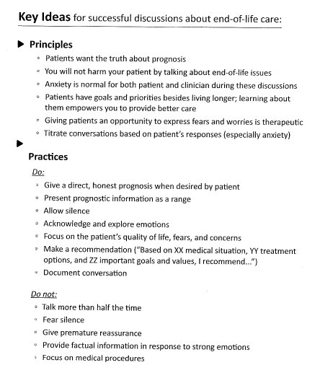

Slide 4
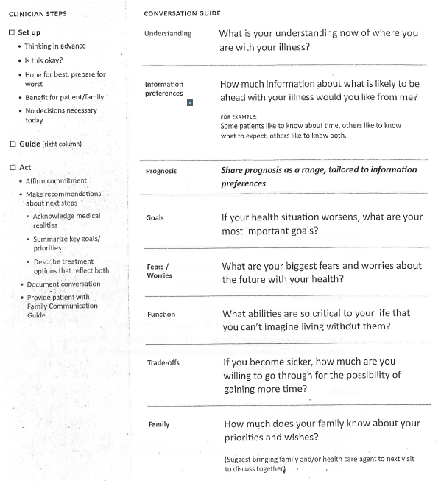

Slide 5
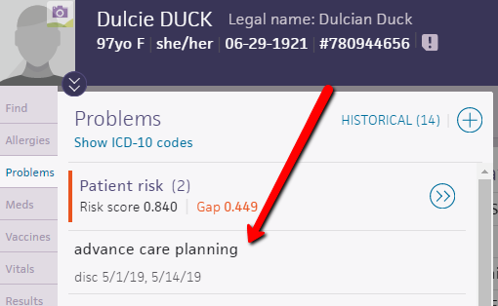
Documenting discussions

Slide 6
References
Ariadne Labs: A Joint Center for Health Systems Innovation between Brigham and Women’s Hospital and the Harvard T.H. Chan School of Public Health https://www.ariadnelabs.org/areas-of-work/serious-illness-care/
Ariadne Labs Videos
video of ACP discussion, 20 minutes: https://youtu.be/xLl1HlCcNYM
same video annotated by the MD, 34 minutes: https://youtu.be/RPQBukpyKAY
alternate video of ACP discussion, 12 minutes: https://youtu.be/fhwa9f5O_U4
Video shown during presentation, 3 minutes: https://youtu.be/45b2QZxDd_o
Honoring Choices Massachusetts https://www.honoringchoicesmass.com/
The Conversation Project https://theconversationproject.org/
Mass Coalition for Serious Illness Care http://www.maseriouscare.org/

