Slide 1
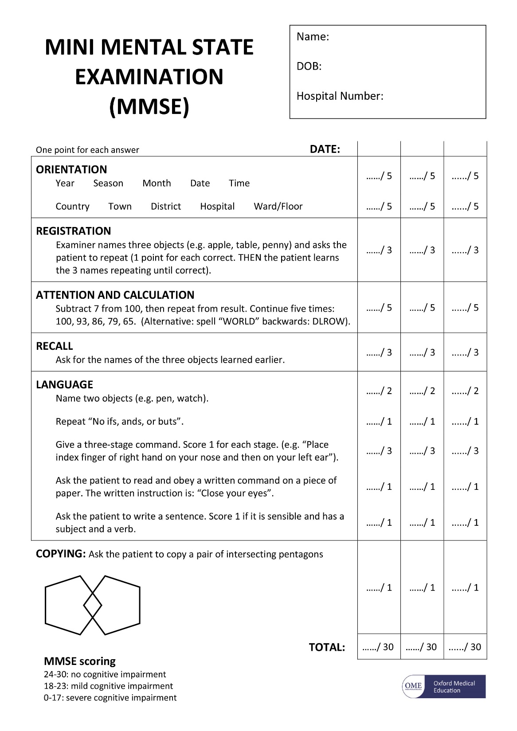
Mini-Mental Status Exam
May fluctuate slightly from day to day (can help over time)
Affected by education level
Total score can be limited by physical impairment (ex: vision)

Slide 2
Neuropsychological testing
NEUROPSYCH TESTING PROVIDERS
Provider | City
Dr. Bradley Brummet | Hadley
Dr. Kate Carlson | Northampton
Dr. Nahid Markosian | Northampton
Neuropsychological Evaluations of Northampton, Dr. Michael Fearing | Northampton
Dr. Terese Hodel-Malinofsky | Easthampton
Berkshire Memory Services | Pittsfield MA
Pioneer Valley Psychological Assessment Inc. | South Deerfield
Baystate Behavioral Health and Neuropsychology, Dr. Zachary Marowitz, Dr. Jessica Jaworksi | Springfield
Clionsky Neuro Systems | Springfield
Umass Memorial Worcester | Worcester
Cornerstone Behavioral Health | Worcester
Help to quantify degree of functional impairment and which areas of the brain are most affected (speech, etc)
Identify mood disorders
Repeating over time helps to gauge change

Slide 3
Geri-psych
GERI-PSYCH PROVIDERS
Provider | City
Connecticut General & Geriatric Psychiatry | Simsbury, CT
West Central Family & Counseling | West Springfield MA
Advanced Psychiatry Services | Worcester, MA
Required to determine capacity in patients with coexisting psychiatric disorder
Psychiatrists also must be involved in assessing capacity for patients with developmental delay
Dr. Starr is an excellent geriatrician and is extremely helpful with patients with dementia and behavioral issues, but does not do specialized psychiatric management (ex: an elderly patient with schizophrenia or bipolar) or determine capacity in those cases.

