Slide 1
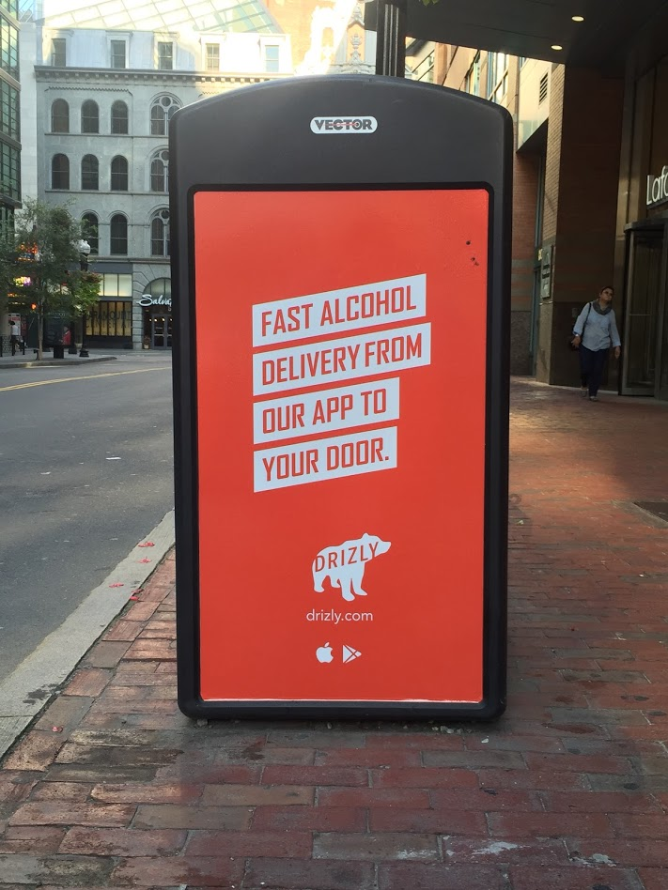
Notes:
https://www.pinterest.com/pin/124763852151315568/

Slide 2
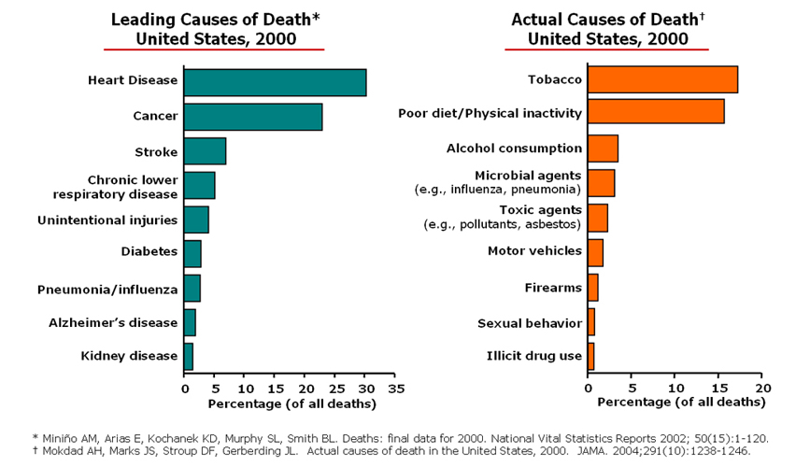

Slide 3
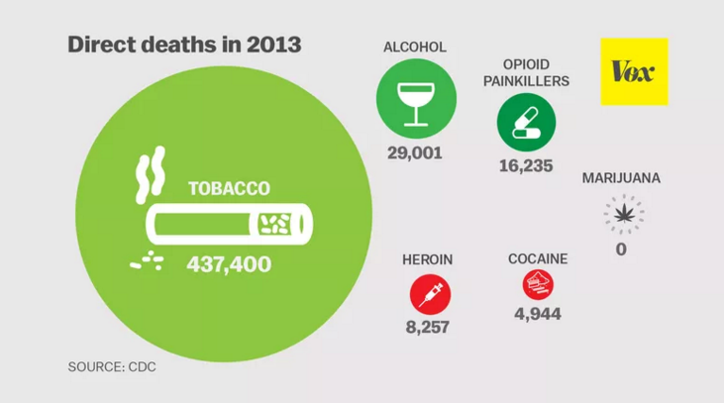

Slide 4
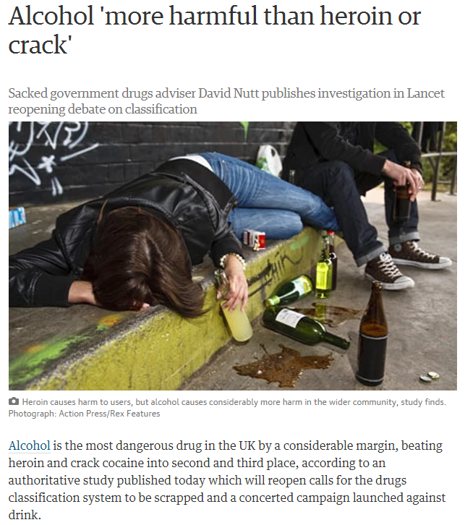

Slide 5
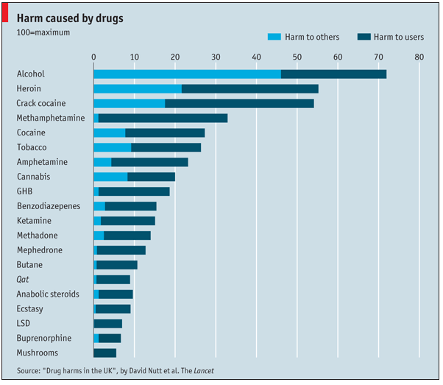

Slide 6
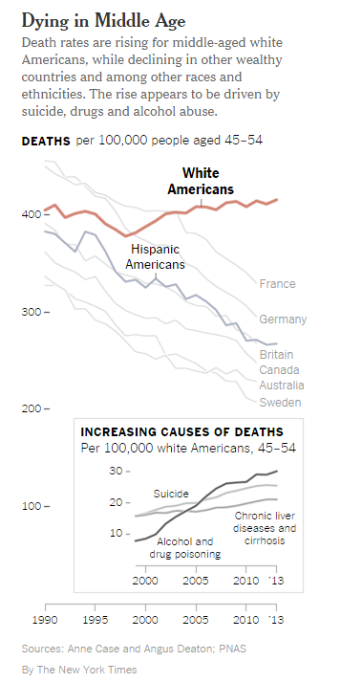

Slide 8
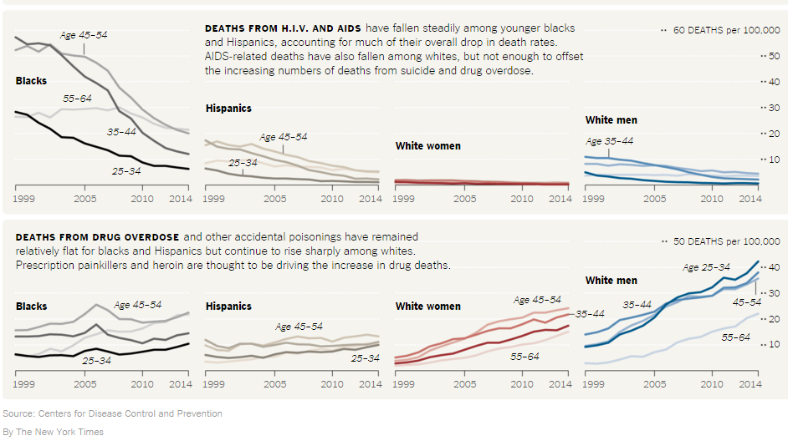

Slide 10
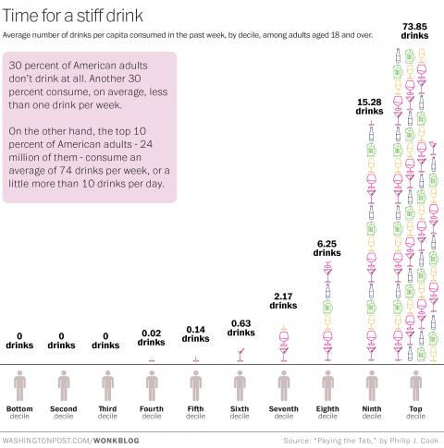
Think you drink a lot? This chart will tell you…

Slide 11
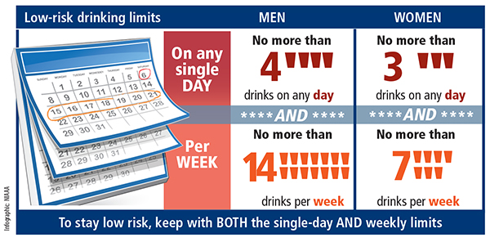
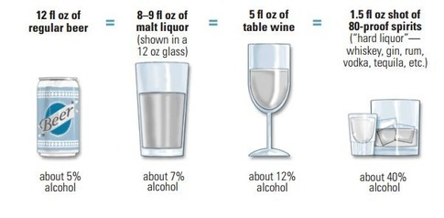

Slide 12
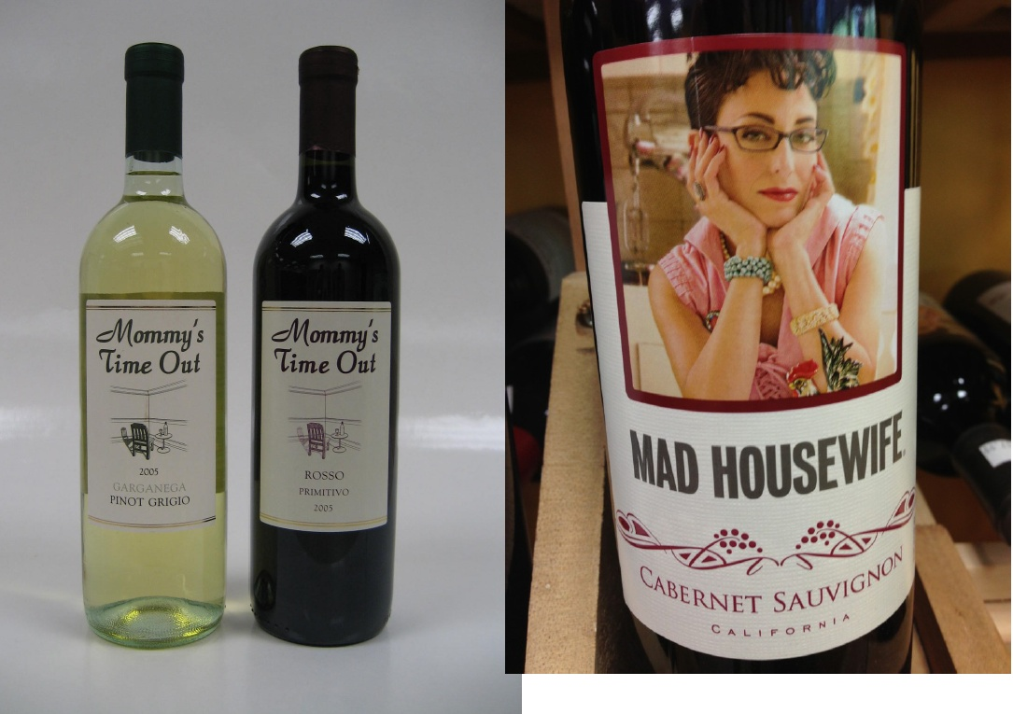

Slide 14
DSM V describes a problematic pattern of use of an intoxicating substance leading to clinically significant impairment or distress, as manifested by at least two of the following, occurring within a 12-month period:
The substance is often taken in larger amounts or over a longer period than was intended.
There is a persistent desire or unsuccessful effort to cut down or control use of the substance.
A great deal of time is spent in activities necessary to obtain the substance, use the substance, or recover from its effects.
Craving, or a strong desire or urge to use the substance.
Recurrent use of the substance resulting in a failure to fulfill major role obligations at work, school, or home.
Continued use of the substance despite having persistent or recurrent social or interpersonal problems caused or exacerbated by the effects of its use.
Important social, occupational, or recreational activities are given up or reduced because of use of the substance.
Recurrent use of the substance in situations in which it is physically hazardous.
Use of the substance is continued despite knowledge of having a persistent or recurrent physical or psychological problem that is likely to have been caused or exacerbated by the substance.
Tolerance, as defined by either of the following:
A need for markedly increased amounts of the substance to achieve intoxication or desired effect.
A markedly diminished effect with continued use of the same amount of the substance.
Withdrawal, as manifested by either of the following:
The characteristic withdrawal syndrome for that substance (as specified in the DSM- 5 for each substance).
The substance (or a closely related substance) is taken to relieve or avoid withdrawal symptoms.

Slide 17
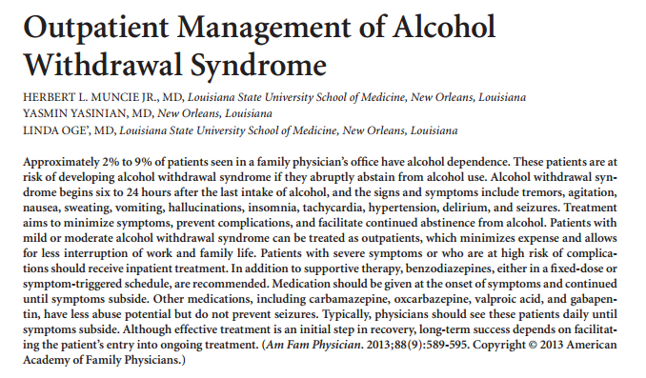
Am Fam Physician. 2013;88(9):
589-595.

Slide 18
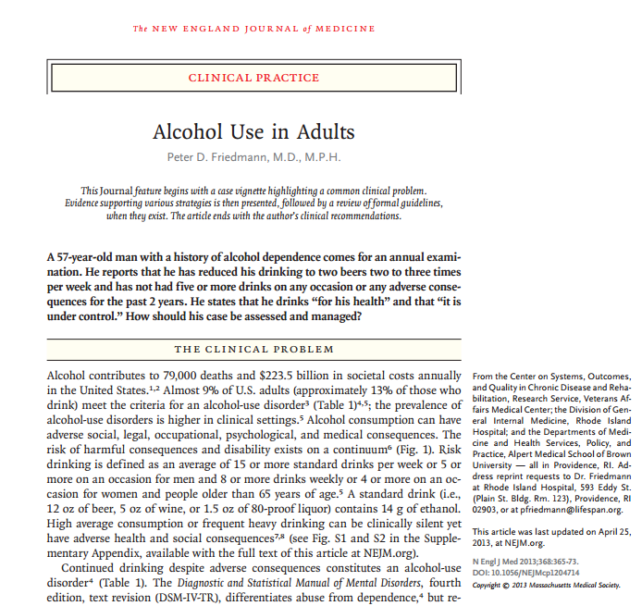

Slide 19
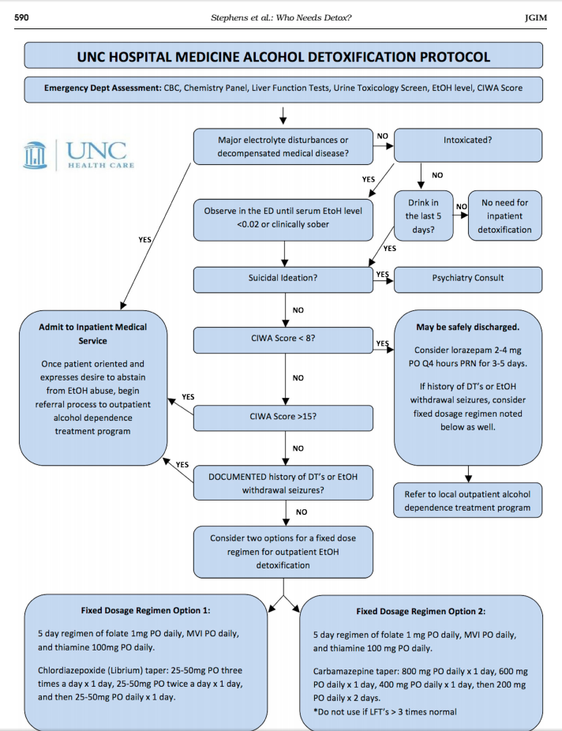

Slide 20
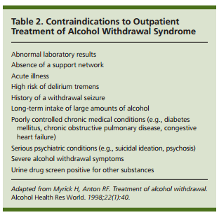

Slide 21
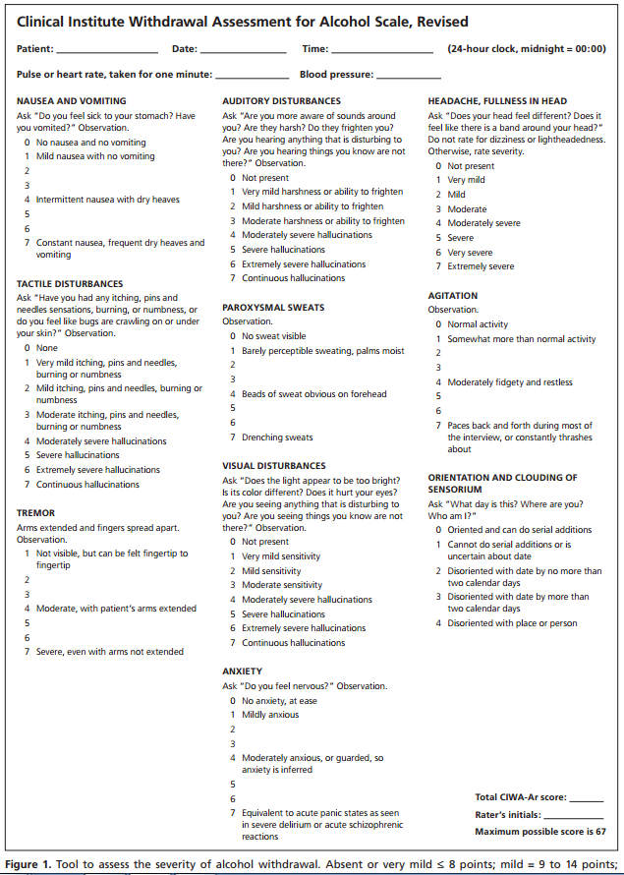

Slide 22
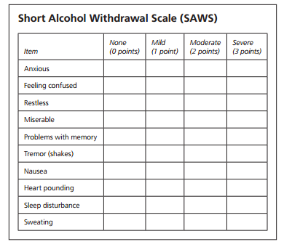
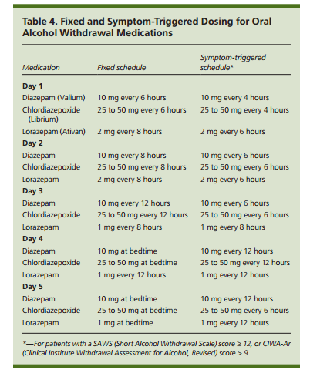

Slide 23
Newer and Safer Options?
Gabapentin
Librium
400 mg 400 mg 400 mg = 3
300 mg 300 mg 300 mg = 1
200 mg 200 mg 200 mg = 1
100 mg 100 mg 100 mg = 1
Total = 6 days
100 mg = 3 days
75 mg = 1 day
50 mg = 1 day
25 mg = 1 day
Total = 6 days
Notes:
withdrawal. First, benzodiazepines have abuse
liability (Ciraulo et al., 1998). This is problematic in an outpatient setting. Second,
benzodiazepines do blunt cognition which might hamper early attempts at rehabilitation
counseling. Third, benzodiazepines have significant interactions with alcohol and opioids. If
taken together, there can be additive respiratory depression and cognitive impairment.
Lastly, there are some pre-clinical and clinical studies that suggest benzodiazepine use may
increase craving and early relapse to alcohol use

Slide 26
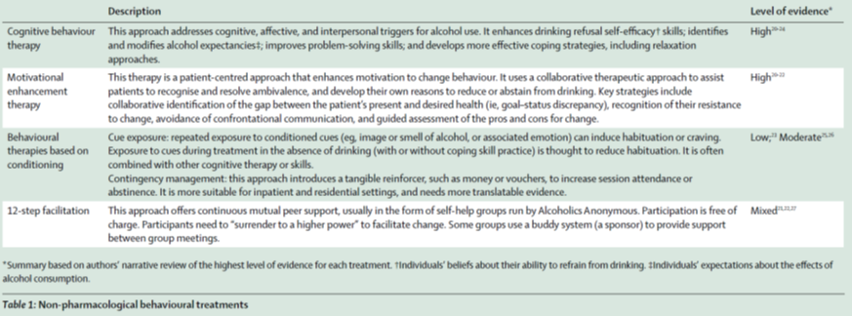

Slide 27
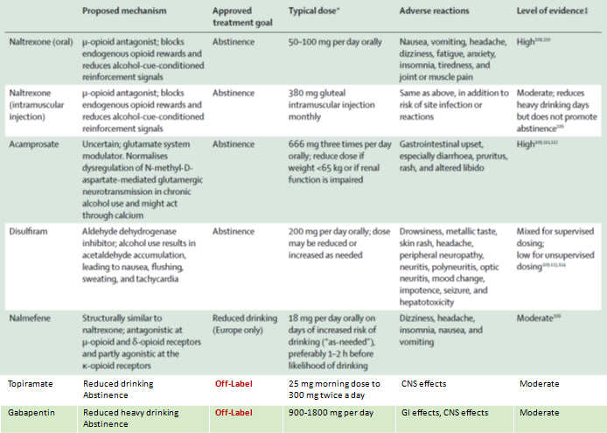

Slide 28
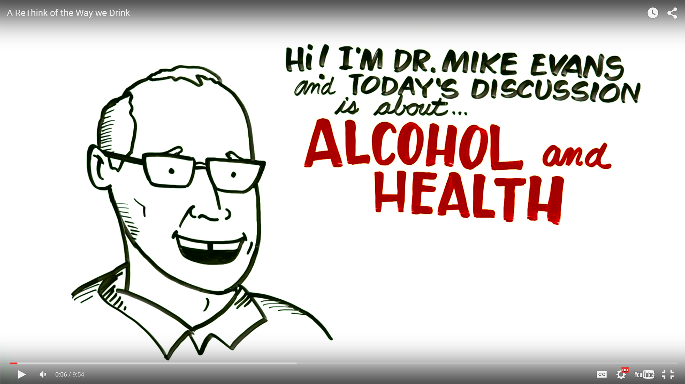
Notes:
https://www.youtube.com/watch?v=tbKbq2IytC4

