Slide 1
PrEP
Sara Utzschneider NP-C WHNP-BC
VMG LGBTQ+ Committee
November 11, 2021

Slide 2
HIV Pre Exposure Prophylaxis (PrEP)
Continuous daily antiretroviral medication to prevent HIV acquisition in people with ongoing risk of HIV exposure
Two medications (F-TDF, F-TAF) FDA approved for adults and adolescents weighing at least 77 lbs
Efficacy: 99% risk reduction with daily oral use
Recommended by USPSTF (Grade A), CDC, WHO
(Ard, 2019; CDC, 2021; USPSTF, 2019)
Notes:
F-TDF 2012, F-TAF 2019
Both used in combo with other medications for HIV treatment
Emtricitabine (F) 200 mg in combination with tenofovir disoproxil fumarate (TDF) 300 mg
Emtricitabine (F) 200 mg in combination with tenofovir alafenamide (TAF) 25 mg

Slide 3
Steps for Prescribing PrEP
Assess Risk for HIV Infection
Determine Medical Eligibility
Prescribe PrEP
Monitor

Slide 4
Assess Risk for HIV Infection
Considerations: High risk populations, transactional sex, patient asks for PrEP, potential future condom-less sex with high risk partner(s)
(Ard, 2019; CDC 2021; Poteat, 2021)

Slide 5
Determine Medical Eligibility
HIV status
Document negative HIV test (4th gen ag/ab) within the past week
Symptomatic in past 4 weeks? → HIV ag/ab + HIV RNA
Exposure in past 72 hours? → nPEP
Renal function
Other Considerations
Hepatitis B
Pregnancy
STI testing (Treat per 2021 CDC STI treatment guidelines)
Bone health
(Ard, 2019; CDC, 2021; CDC, 2018; Landovitz et al., 2021; Poteat, 2021; USPSTF, 2019)

Slide 6
Non-occupational Post Exposure Prophylaxis (nPEP)
28 days of antiretrovirals treatment taken after discrete HIV exposure
Initiate within 72 hours of exposure (eg, condomless receptive or insertive vaginal or anal intercourse and/or a percutaneous exposure to blood, or body fluids contaminated with blood)
Initial labs: HIV ag/ab 4th gen, CMP, Hep B serologies, Hep C, STI testing, pregnancy if patient could become pregnant
Test source person if possible
TDF-FTD + raltegravir 400 mg bid or dolutegravir 50 mg daily
Avoid dolutegravir in early pregnancy or people who could become pregnant
If eGFR <60, dose adjust TDF or consider zidovudine-lamivudine
Follow up testing:
4-6 weeks: HIV, STIs, CMP
12 weeks: HIV test
*If Hep C contracted due to this exposure, at 24 weeks test HIV, HBV, HCV
National Clinician's Post-Exposure Prophylaxis Hotline at 888-448-4911
(Ard, 2019; Aberg and Daskalakis, 2021)

Slide 7
Transitioning nPEP → PrEP
After 28 days, drop third drug and continue Truvada provided HIV testing at 4-6 weeks is negative. No pause in antiretroviral advised
(Ard, 2019)

Slide 8
Prescribe PrEP
ICD-10 Code | Description
Z79.899 | Long-term drug therapy
Z20.82 | Contact with and (suspected) exposure to other viral communicable diseases
Z72.5 | High risk sexual behavior
W46 | Contact with hypodermic needle
Emtricitabine 200mg – tenofovir disoproxil fumarate 300mg tablet
Take 1 tablet every day by oral route. 30 tablets 2 refills
OR
Descovy 200mg – 25 mg tablet
Take 1 tablet every day by oral route. 30 tablets 2 refills
(CDC, 2021)

Slide 9
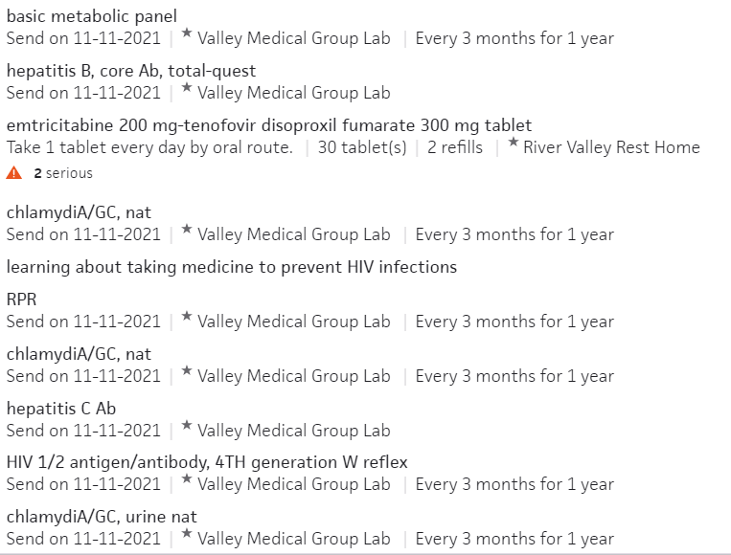
Order Set: PrEP Initiation F-TDF

Slide 10
Paying for PrEP
Covered by insurance. If no insurance or difficulty paying copays see below resources
Patient assistance program: https://readysetprep.hiv.gov/
Co-pay assistance program: https://www.gileadadvancingaccess.com/
MA PrEP drug assistance program: https://crine.org/prepdap
(CDC, 2021)

Slide 11
Monitoring
Follow up appointments and labs every 3 months (can consider 1 month follow up pending concern for side effects / adherence)
Adherence, screen for side effects
Risk reduction support
PWID: assess access to sterile needles/syringes and drug treatment services
Labs q 3 months
HIV, BMP*, STI testing, pregnancy testing if appropriate
(Ard, 2019; CDC, 2021; CDC, 2018; Poteat, 2021)
Notes:
Discuss gatekeeping

Slide 12
Counseling Points
Adherence!
Maximum protection reached for receptive anal sex at 7 days of daily use, and about 21 days daily use for receptive vaginal sex and injection drug use
Common side effects: nausea, flatulence, diarrhea, fatigue, headache. Usually resolves in 2-4 weeks.
On demand dosing not approved in the US
Data only on cis MSM for 2-1-1 dosing. 2 tabs 24-2 hours prior to sex, 1 tab 24 hours later, 1 tab additional 24 hours later.
(Ard, 2019; CDC, 2021; CDC, 2018; Poteat, 2021)
Notes:
Minimum use 4 pills per week

Slide 13
Pregnancy
Not contraindicated in pregnancy
Pregnancy is associated with an increased risk for HIV acquisition
Data directly related to the safety of PrEP use for a developing fetus are limited
Serodifferent couples considerations, U=U
(Ard, 2019; CDC, 2018; Poteat, 2021)

Slide 14
PrEP considerations for Transgender people
Does not impact gender affirming hormones.
Lower levels of TDF noted in people on estradiol. No clinically significant impact if taken daily. More research needed.
eGFR → consider monitoring with both sex markers
(Poteat, 2021)
Notes:
Discover trial for Descovy (F=TAF) of 5387, 74 trans women (none aquired HIV), no cis women, no trans men, no data on neovaginal or vaginal sex
iPrex – 339 trans women (N=2499) → HR 1.1, adherence low 18%, no seroconversions if TDF level consistent w 4 week, TFV levels lower if on hormones (regimen not standard)
iFACT 2019 20 trans women for 6 months no hx orchiectomy. 2mg estradiol + cyproterone 25 mg wks 1-5, then 8-15, PrEP started week 3. estradiol levels not affected by PrEP, 13-17% lower TFV levels on hormones
Finding the Right Dose 8 trans women on any HRT, DOT prep x 7 days, no impact on estradiol, 24-32% reduction in TFV levels transwomen vs cis men
iBreathe 24 tw and 23 tm 6 months stable on e or t, 4 weeks daily F/TDF compared to 17 CW 15 CM
TW and TM lower levels but not statistically significant, no change in T or E levels

Slide 15
Discontinuing PrEP
Protection wanes 7-10 after discontinuation
Discuss other ways to reduce HIV risk. Discuss PEP
Hep B?
Document :
HIV status at time of discontinuation,
Reason for PrEP discontinuation
Recent medication adherence
Reported sexual risk behavior.
(Ard, 2019; CDC, 2021; Poteat, 2021)

Slide 16
On the Horizon
Long acting injectable medications CAB LA (cabotegravir)
3mL injections q 8 weeks after 5 weeks oral lead phase
N=4570, cis men and trans women (12.5%)
HIV infection 13 in cab la group (0.41 per 100 person-years) and 39 in F-TDF group (1.22 per 100 person-years)
FDA approval expected this year
Concern about the “tail”. INSTI resistance and delays of detection in CAB LA group
Vaginal rings, implants, injections, infusions, monthly tablet
Lenacapavir, q6 mo injection, currently in animal studies
Additional studies in transgender populations
(Landovitz et al., 2021; Poteat, 2021)

Slide 17
Questions?
PrEP National Clinician Consultation Service
(855) 448-7737 or (855) HIV-PrEP
Monday – Friday, 9 a.m. – 8 p.m. ET

Slide 18
References
Aberg, J. A. and Daskalakis, D. C. (2021). Management of nonoccupational exposures to HIV and hepatitis B and C in adults. In J. Mitty (Ed.), UpToDate. Retrieved November 11, 2021, from https://www.uptodate.com/contents/management-of-nonoccupational-exposures-to-hiv-and-hepatitis-b-and-c-in-adults?search=npep&source=search_result&selectedTitle=1~22&usage_type=default&display_rank=1
Ard, K. L. (2019, April 30). Basic PrEP Management. National LGBTQIA+ Health Education. https://www.lgbtqiahealtheducation.org/courses/pre-and-post-exposure-prophylaxis/lessons/basic-prep-management/
Ard, K. L. (2019, April 30). PrEP and PEP. National LGBTQIA+ Health Education. https://www.lgbtqiahealtheducation.org/courses/pre-and-post-exposure-prophylaxis/lessons/prep-and-pep/
Ard, K. L. (2019, April 30). PrEP for Serodifferent Couples. National LGBTQIA+ Health Education. https://www.lgbtqiahealtheducation.org/courses/pre-and-post-exposure-prophylaxis/lessons/prep-for-serodifferent-couples/
Centers for Disease Control and Prevention (CDC), US Public Health Service. Preexposure Prophylaxis for the Prevention of HIV Infection in the United States—2017 Update: A Clinical Practice Guideline. CDC website. https://www.cdc.gov/hiv/pdf/risk/prep/cdc-hiv-prep-guidelines-2017.pdf. Published March 2018.
Centers for Disease Control and Prevention (CDC). (2021, June 11). Pre-Exposure Prophylaxis (PrEP). https://www.cdc.gov/hiv/clinicians/prevention/prep.html
Landovitz, R. J., Donnell, D., Clement, M. E., Hanscom, B., Cottle, L., Coelho, L., Cabello, R., Chariyalertsak, S., Dunne, E. F., Frank, I., & Gaur, A. H. (2021). Cabotegravir for HIV Prevention in Cisgender Men and Transgender Women. New England Journal of Medicine, 385:595-608. DOI: 10.1056/NEJMoa2101016
Poteat, T. (2021). PrEP and Transgender Communities: Evidence-Informed Practices. 2021 Advancing Excellence in Transgender Health conference. https://www.lgbtqiahealtheducation.org/courses/prep-and-transgender-communities-evidence-informed-practices-2021/
US Preventive Services Task Force. Preexposure Prophylaxis for the Prevention of HIV Infection: US Preventive Services Task Force Recommendation Statement. JAMA.2019;321(22):2203–2213.

Slide 19
(CDC, 2018)

Slide 20
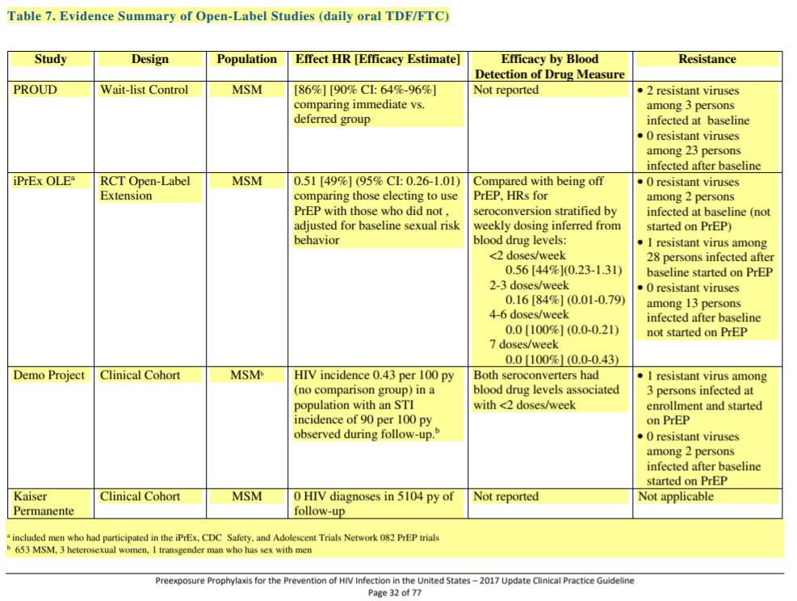
CDC, 2018)

