Slide 1
Alzheimer’s Disease & Related Dementias
Laura Iglesias Lino, MD
Erin Leahy, MD
December 19, 2018
Special thanks to Alzheimer’s Association and HRSA.

Slide 2
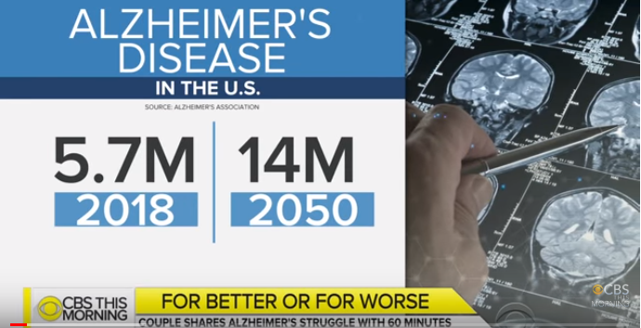
Notes:
Ave life expectancy in US is ~78 years
1 in 3 seniors dies with AD or a different dementia
It kills more than prostate and breast cancer combined
Every 60 seconds someone in the US develops AD

Slide 3
Learning Objectives
Describe the prevalence and impact of dementia
Describe the diagnostic evaluation and management of Alzheimer’s disease and related dementias
Discuss prognosis and end of life care
Review new innovations

Slide 4
Disclosures
None

Slide 5
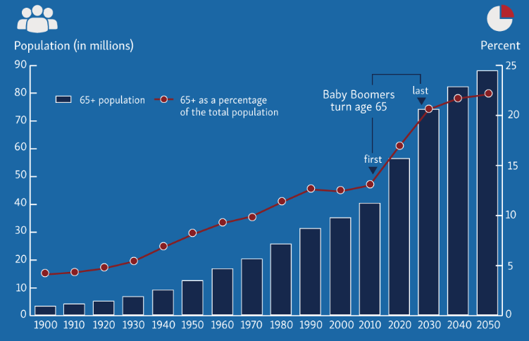
An Aging Population
Sources: U.S. Census Bureau, International Data Base, decennial censuses, and 2014 National Population Projections.
Notes:
The number of Americans ages 65 and older is projected to more than double from 46 million today to over 98 million by 2060
The 65-and-older age group’s share of the total population will rise to nearly 24 percent from 15 percent.
In 2010, slightly more than 14 percent of the older population will be 85 and older. By 2050, that proportion is expected to increase to more than 21 percent. The aging of the older population is noteworthy, as those in the oldest ages often require additional care giving and support
The older population is becoming more racially and ethnically diverse. Between 2014 and 2060 the share of the older population that is non-Hispanic white is projected to drop by 24 percentage points, from 78.3 percent to 54.6 percent.

Slide 6
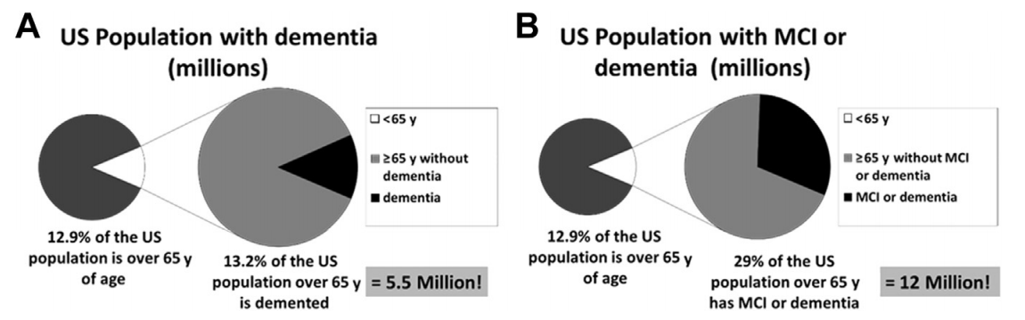
Scope of the Problem
42 million
42 million
Moga et al. (2017) 439-456
Notes:
If we add in the 6-7 million with MCI (mild memory, attention or visuospatial), we have 12 million out of the 42 million people > 65 … Which means, we have another 30 million that are “completely normal” and yet our data shows that 1 out of every 3 actually has the early biological features of AD or another degenerative disorder in their brain.
Brings total to 22 million out of 42 million → that’s over 50% of the people of those > 65 have biologic evidence for some kind of problem that we need to be able to recognize so that we can provide support or treatment

Slide 7
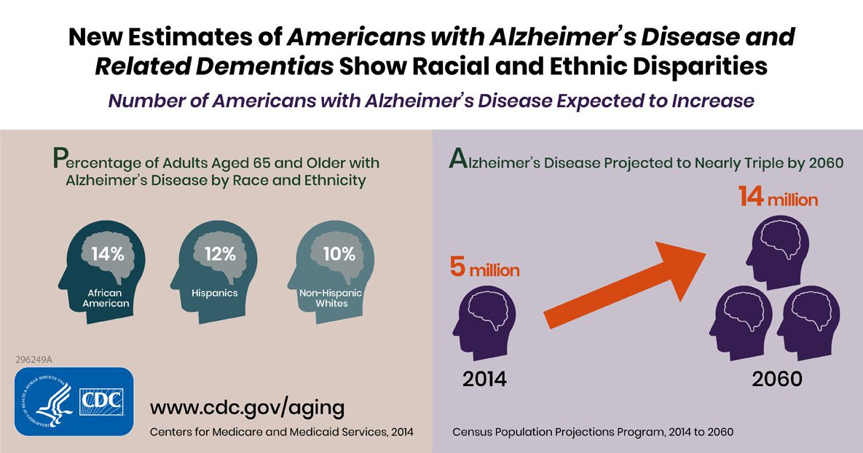
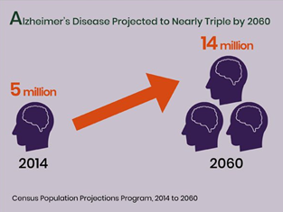
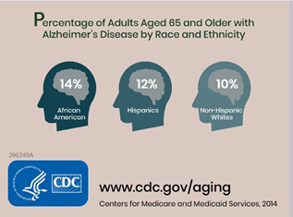
Racial and Ethnic Disparities
Notes:
Alzheimer’s Disease Projected to Nearly Triple by 2060. In 2014 – 5 million cases by 2060 – 14 million cases
Disproportionate increase in racial and ethnic minorities
The burden of Alzheimer’s disease and related dementias in 2014 was 5 million people, which is 1.6 percent of the U.S. population in 2014—319 million
This burden is projected to grow to 13.9 million, nearly 3.3 percent of the population in 2060–417 million people.
** Increases are a result of fewer people dying from other chronic diseases and surviving into older adulthood when the risk for Alzheimer’s disease and related dementias increases.

Slide 8
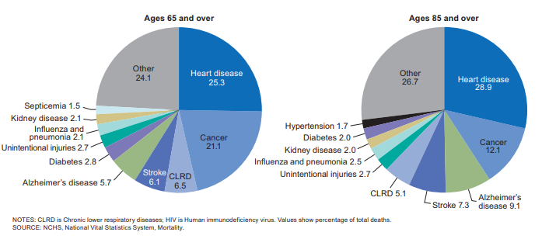
Leading Cause of Death
National Vital Statistics Reports Volume 65, Number 5 June 30, 2016 Deaths: Leading Causes for 2014
Notes:
Alzheimer’s disease is the 6th leading cause of death in the nation
It is the ONLY disease in the top-10 leading causes of death that cannot be prevented, slowed or cured
From 2000-2015, deaths from heart disease decreased by 11% while deaths due to alzheimers increased by 123%
CLRD = chronic lower respiratory diseases
https://www.cdc.gov/nchs/fastats/leading-causes-of-death.htm
National Vital Statistics Reports Volume 65, Number 5 June 30, 2016 Deaths: Leading Causes for 2014

Slide 9
Diseases Causing Dementia
Vascular Dementia
Dementia with Lewy Bodies
Parkinson’s Disease
Frontotemporal Dementia
Huntington’s Disease
Creutzfeldt-Jakob Disease
Normal Pressure Hydrocephalus (NPH)
Traumatic Brain Injury
Down Syndrome Dementia
Korsakoff Syndrome
Notes:
Alzheimer’s Disease is not the only disease that cases cognitive impairment and dementia. There is a broad array of conditions that can affect cognition
Alzheimers Disease is one of the most common, accounting for 60-70% of cases.
Increasingly we see mixed AD and vascular over the age of 65
Bottom line is that you have to take the full context of a person’s medical background into consideration when you think concerns about progressive MCI might be due to a medical cause as opposed to primary brain process

Slide 10
The Facts on Early Diagnosis and Disclosure
Only about half of people with Alzheimer’s are diagnosed.
Of those diagnosed, only 45% of them or their caregivers are aware of the diagnosis.
Among just those with the disease, only 33% are aware of their diagnosis.
33%
45%
Notes:
Millions of Americans have Alzheimer’s disease, but many of them do not know.
Over 5 million Americans are currently living with Alzheimer’s and as many as half of them have never been diagnosed.
Of those who have been diagnosed (that is, a doctor has determined this person has Alzheimer’s disease) only 45 percent of them or their caregiver are aware of the diagnosis.
That’s not the case with other diseases. For example:
93 percent of people diagnosed with the four most common cancers (breast, colorectal, lung, and prostate) or their caregivers are informed of their diagnosis. And yet, AD kills more people than breast and prostate cancer combined.
90 percent of people with diagnosed heart disease or their caregivers know of the diagnosis.

Slide 11

The Importance of Early Diagnosis and Disclosure
Access Available Treatments
Build Care Team
Participate in Clinical Trials
Access Support Services
Better Manage Medications
Receive Counseling
Address Driving and Safety Issues
Manage Co-Occurring Conditions
Advance Planning
Leads to
BETTER
OUTCOMES
for Individuals and
Caregivers
Notes:
Despite the belief of some health care providers, early detection and diagnosis are important because they provide the best opportunity for better medical care and health outcomes for both individuals with the disease and caregivers.
Even without a way to cure or slow the progression of Alzheimer’s, early diagnosis provides individuals and their caregivers with access to available treatments, support services, and the opportunity to enroll in clinical trials. The care team can better manage co-occurring conditions and reduce the risk for falls and injuries.
Early diagnosis also allows the individual with the disease to be involved in his or her own care when cognition is least affected. They can help build their care team and set advanced care and financial plans.
Patients can still have many years of decent quality of life if they adapt with the appropriate supports

Slide 12
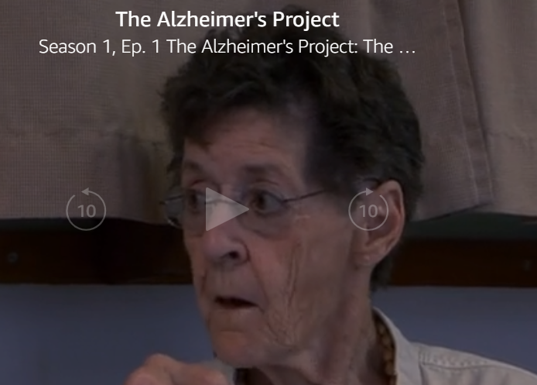
Diagnosing AD
The Alzheimer’s Project. 2009.
Notes:
7:30-9:56
The Alzheimer’s Project. HBO. 2009.

Slide 13

Introduction
Normal
Cognitive Impairment
Dementia
Notes:
Framework of diagnosis
“normal” cognition and “dementia” are not separate entities
A person does not decline from normal to dementia, but rather …

Slide 14
Dementia – Major Neurocognitive Disorder (DSM 5)
Evidence of significant cognitive decline from a previous level of performance in one or more cognitive domains:
  Learning and memory - Complex attention
  Language - Perceptual motor
  Executive function - Social cognition
Deficits interfere with independence in daily activities
Deficits do not occur exclusively in context of delirium
Deficits are not better explain by another mental disorder (eg. major depression, schizophrenia)
Notes:
Key points:
Collateral information very important
Decline can occur in ANY domain and does NOT have to include memory
Deficits have to interfere with dependence and daily activities – instrumental ADLS – including bill paying, appointments, etc.

Slide 15

Know The 10 Signs
Memory changes that
disrupt daily life
New problems with words in speaking or writing
1
6
Challenges in planning or
solving problems
Misplacing things and losing
the ability to retrace steps
2
7
Difficulty completing
familiar tasks
Decreased or
poor judgment
3
8
Confusion with time
or place
Withdrawal from work or
social activities
4
9
Trouble understanding images
and spatial relationships
Changes in mood
or personality
5
10
Notes:
Here are the 10 warning signs of Alzheimer’s disease.
Some people may recognize changes in their thinking before anyone else. For others, friends and family may be the first to notice changes in their loved one’s memory, behavior, or abilities. Because of this, Know the 10 Signs is designed for the entire community to help build awareness.
[Highlight 1-2 warning signs to emphasize; use those for which you have a personal anecdote, if possible. Example: “We have one man who comes to our caregiver support group who noticed his wife – a lifelong baker – was having trouble making cupcakes, something she has done a million times in her life. Looking back, he now understands that her difficulty following a recipe was a warning sign that something was wrong with her thinking pattern.”]

Slide 16
Detecting Cognitive Impairment in Clinic
Inappropriate interactions with staff
Inability to maintain conversation
Inappropriate clothing and personal hygiene
Changes in gait or mood over time
Frequently missed appointments
Unsafe driving behaviors
New alcohol or drug use
Notes:
(Cooper & Greene, 2005; Galasko, 2013; Galvin & Sadowsky, 2012; Parmar et al., 2014)

Slide 17
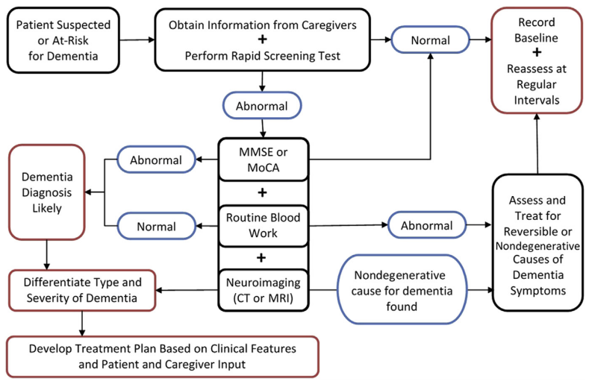
Suggested Algorithm for Diagnosis
Notes:
Primary care often first point of contact for PLwD (Robinson et al., 2015)
Adults who manifest subjective signs and/or symptoms of cognitive impairment or dementia should undergo evaluation.
Initial evaluation typically involves administration of a brief objective standardized instrument to detect dementia and determine if additional evaluation is warranted (Borson et al., 2006; Rabins & Blass, 2014).
Screening alone cannot diagnose dementia.
Specialized screening necessary when presented by adult with Down syndrome or other intellectual disability (Moran et al., 2013)

Slide 18
In Practice
Ask 3 questions about memory, language and personality
  Have you noticed changes in your learning/memory, language, personality?
If yes, follow with:
  Do you think changes are worse than your peers?
  Have you stopped doing anything because of these changes?
  Has anybody commented to you about these changes in your memory?
Notes:
When suspicious for cognitive impairment, consider asking the following …
Assessment of Cognitive Complaints Toolkit
for Alzheimer’s Disease
PRODUCED BY THE CALIFORNIA ALZHEIMER’S DISEASE CENTERS

Slide 19
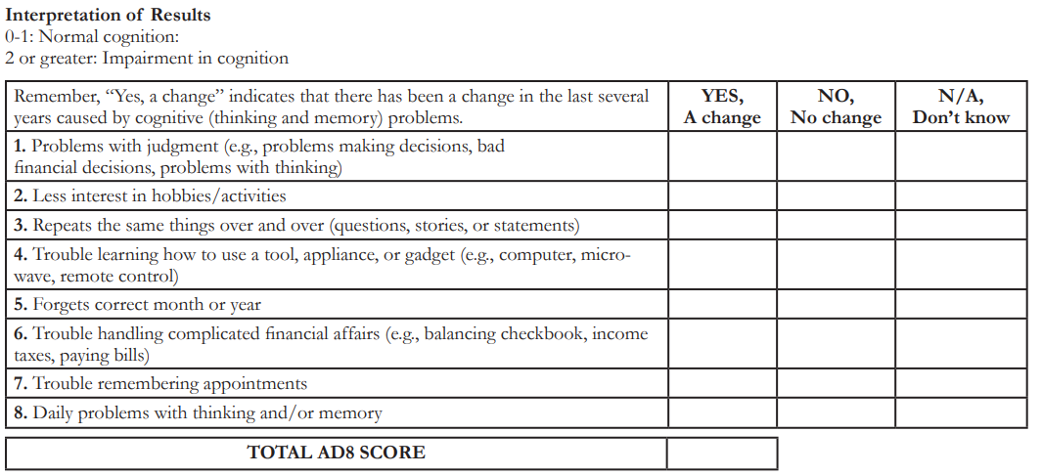
AD8
Notes:
8 questions for the caregiver pertaining to the patients ability to perform daily activities and issues in other cognitive domains
2 or more answered positive should prompt further work up

Slide 20

MoCA vs MMSE
 | MoCA | MMSE
Sensitivity | 100% | 78%
Orientation | Y | Y
Registration | Y (not for scoring) | Y
Short term memory | 5 items | 3 items
Language | Y (repetition + nomination) | Y (repetition)
Attention and working memory | Y | Y
Executive Function | Y | NO
Visuospatial skills | Y | Y
Notes:
Moca is more sensitive, as it assess more cognitive domains, AND different languages, low literacy (moca basic) and visual impairment (moca blind)

Slide 21
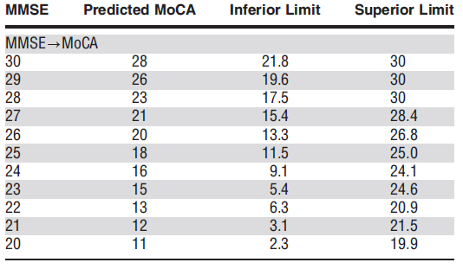
MMSE and MoCA Comparison
MoCA Interpretation
26-30 = normal
18-25 = mild cognitive impairment
10-17= moderate cognitive impairment
less than 10= severe cognitive impairment
MMSE Interpretation
24-30 = normal
19-23 = cognitive impairment
10-18 = moderate cognitive impairment
0-9 = severe cognitive impairment
Notes:
Not 1:1
Test doesn’t make the diagnosis – MUST meet other clinical criteria

Slide 22
Reversible Causes of Cognitive Impairment
Depression
  Independent risk factor for Alzheimer’s disease
  Distinguish depression from apathy
Medication Side Effects
  Opioids
  Anticholinergics
  Sedative hypnotics
Hypothyroidism
Sleep disorders
Vitamin Deficiencies: B12
Excessive alcohol use or substance abuse
Notes:
To illustrate the importance, Memory disorders clinic requires:
patient’s with OSA be compliant with therapy for 6 months before assessment
requires adequate treatment for underlying depression / anxiety
Will nott assess someone with ACTIVE alcohol or substance abuse
Must be 6 months out from chemotherapy
Depression: Late-life depression (LLD) can be a reversible cause of cognitive impairment, distinct from dementia
Depression, anxiety and apathy are also common neuropsychiatric symptoms (NPS) that occur over the course of MCI and dementia.

Slide 23
Suggested Algorithm for Diagnosis
Notes:
Primary care often first point of contact for PLwD (Robinson et al., 2015)
Adults who manifest subjective signs and/or symptoms of cognitive impairment or dementia should undergo evaluation.
Initial evaluation typically involves administration of a brief objective standardized instrument to detect dementia and determine if additional evaluation is warranted (Borson et al., 2006; Rabins & Blass, 2014).
Screening alone cannot diagnose dementia.
Specialized screening necessary when presented by adult with Down syndrome or other intellectual disability (Moran et al., 2013)

Slide 24
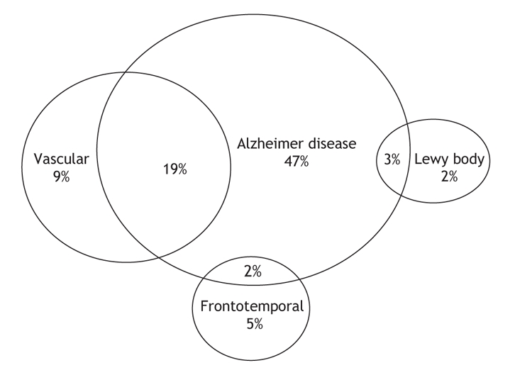
Dementia Subtypes
12%
Notes:
These are most common but other types and often overlap

Slide 25
Dementia Subtypes
Etiology | Diagnostic Criteria
Alzheimer’s Disease | Gradual onset over months-years Most prominent feature is memory Impaired learning and recall of recently learned information
Vascular Dementia | Stepwise decline History of clinically apparent stroke that is temporally related to cognitive decline
Dementia with Lewy Bodies | 2 of 3 required: Fluctuating cognition Recurrent visual hallucinations Parkinsonism (bradykinesia, muscular rigidity, tremor, postural instability)
Frontotemporal Dementia | 3 of 6 required: Disinhibition • Compulsive behaviors Apathy • Hyperorality Loss of empathy • Impaired decision making
Notes:
Psychiatric symptoms can be overlooked and are often the presenting feature of certain subtypes
AD - Memory first, also visuospatial dysfunction, Early preservation of social skills, executive function impaired late
VaD – Variable presentation depending on where vascular lesions are … includes large and small vessel. executive dysfunction is common early
DLB - Hallucinations and delusions, parkinsonism, fluctuating cognition; Falls, autonomic dysfunction; REM sleep disorder
Attention and visuospatial impaired early; Relative milder memory difficulties
FTD –
BV: Apathy, disinhibition, compulsive, repetitive
Memory and orientation intact early
Semantic: Impaired naming and word comprehension
Loss of meaning for words, objects
PNFA (progressive non-fluent aphasia): Stuttering. Early preservation of word meaning. Late mutism.
Early preservation of social skills
ALZHEIMERS DISEASE (AD) - Most common subtype > 65 yr; Incidence doubles every 5y
VASCULAR DEMENTIA (VaD) – includes large and small vessel; Incidence doubles every 5 years after 65 yr; 15-30% have dementia after CVA
LEWY BODY DEMENTIA (DLB) – often earlier onset (50-90), increased risk with FHx
FRONTOTEMPORAL DEMENTIA(FTD) – multiple variants – behavioral, semantic, progressive non fluent aphasia
More common than AD in younger than 60 (onset as young as 30), increased risk with FHx

Slide 26
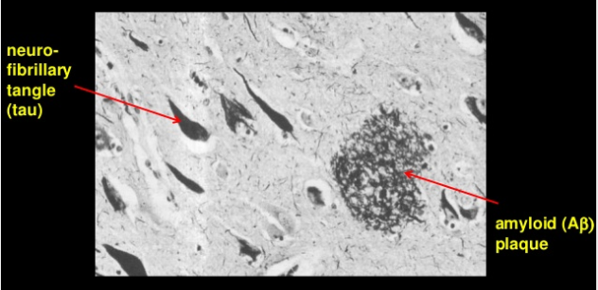
AD Neuropathology
Notes:
Defining neuropathological mechanisms in AD brains:
Extracellular AB plaques
Intraneuronal tau containing neurofibrillary tangles (NFT)

Slide 27
AD Biomarkers
Core CSF biomarkers
  Amyloid β42
  Total tau (t-tau)
  Phosphorylated tau (p-tau)
  --------------------------------------------------------------------
Novel CSF biomarkers
  Aβ oligomers
  Neurogranin
  SNAP25
  α synuclein
  Etc.
J.L. Molinuevo et al. (2018)
Notes:
Dementia is currently a clinical diagnosis
Validated, widely used biomarkers exist that are proxies for AD neuropathologic changes
Biomarkers of neuropathological change, B-amyloid deposition, pathologic tau and neurodegeneration have been and are being developed
Amyloid Beta42 – principal peptide in plalques; reflects cortical amyloid deposition; levels correlate inversely with plaque load
Total tau (t-tau) -- reflects intensity of neurodegeneration
Phosphorylated tau (p-tau) – correlates with NF pathologic changes; abnormal phosphorylation of tau in AD has been hypothesized to be driven by AB pathology; High sensitivity and specificity of 85-90% to identify prodromal AD in the MCI stage
Older adults with AD often show several pathological changes – alpha synuclein, TDP43 and vascular changes precluding any biomarker from having 100% diagnostic accuracy
AB oligomers – toxic form of AB that cause synaptic dysfunction; first biomarkers to become abnormal
B-amyloidosis can cause downstream pathologic change (e.g. tauopathy and neurodegeneration)
Synaptic biomarkers are neurogranin – high CSF concentrations predict progression to AD in those with MCI
Presynaptic protein SNAP 25 increases substantially during prodromal stage

Slide 28
AD Biomarkers
Core Imaging
  Structural MRI of brain
    If unable to obtain MRI, high resolution CT
  FDG-PET
  Amyloid PET
  --------------------------------------------------------------------
Novel Imaging
  SPECT
  Dopaminergic SPECT
  Tau PET
Sheikh-Bahaei et al. (2017)
Notes:
MRI or high resolution CT – excludes other potential pathologies
When, how, which biomarkers should be used?
CSF – amyloid and tau
FDG PET – determines glucose hypometabolism when brain structure is normal; approved by medicare for differentiating AD from FTD
Amyloid PET – approved by FDA
SPECT – shows hypoperfusion in areas of low glucose metabolism shown on FDG PET, less sensitive and specific than FDG PET, but a possible alternative
May help differentiate AD from vascular dementia
Dopaminergic SPECT – high sensitivity and specificity for diagnosing DLB
MR Spectroscopy – non invasive way to measure concentration of certain chemicals in the brainopy – non invasive way to measure concentration of certain chemicals in the brain

Slide 29
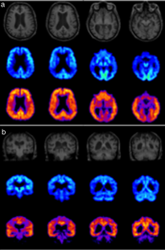
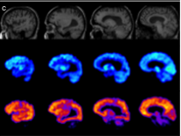
Typical AD Case
MRI (top)
FDG-PET (middle)
Amyloid-PET (bottom)
Sheikh-Bahaei et al. (2017)
Notes:
MRI –
preferred to CT due to higher resolution and ability to assess vascular burden
characteristic pattern of atrophy MTL (involving hippocami, entorhinal cortex, parhippocampal gyrus, amygdala, cingulate cortex; sparing motor cortex)
helpful for differentiating other patterns of atrophy in atypical cases and excluding other mimickers of dementia – tumors, CNS inflammatory conditions, etc.
Contrast to FTD – frontal and anterior temporal, anterior cingulate gyrus
Contrast to DLB – primary visual cortext, posterior occipital
Minimum sequences – High res 3D/volumetric T1 weighted images, T2 weighted images, FLAIR
Different ways to assess hippocampal and MTL atrophy – visual assesment, linear planimetric (2D) and volumetric (3D) → no significant difference in accuracy
FDG-PET --
cerebral hypometabolism is one of the main features of AD (correlates with neurodegeneration, neuronal dysfunction and synaptic disease)
predictive value in identifying healthy progressing to MCI and MCI converting to AD
allows to discriminate AD from FTD (85% sensitivity and specificity) and AD from DLB (>90% sensitivity; 70% specificity)
Amyloid PET – best amyloid binding tracer (Pib), several derivatives in clinical practice, greater accuracy in differentiating AD from healthy controls than FDG PET but recommended only in dementia expert centers. Amyloid PET most sensitive and specific biomarker for AD but only use at this point is confirming dx of AD if atypical presentation or differentiating amyloid vs non amyloid pathology. Cant differentiate between various forms of AD.

Slide 30
Biomarker Changes Begin Years before Symptoms Emerge (reflecting neuropathology)
Figure adapted from Jack et a. 2010; Sperling et al Alzheimer’s & Dementia 2011
Notes:
Biomarkers are thought to be very helpful in understanding this at the early stage. This is an estimate of the sequence of biomarker related changes in people’s brains as they move from the preclinical to the mci to the dementia stage.
On left is curve showing accumulation of amyloid plaques in the brain and those gradually build up during the preclinical stage and then start to lead to synaptic dysfunction and tau deposition so it’s when the amyloid itself can make the transmission between the synapses inefficient but then the tau starts to build up and the two synergize and cause neurons not to function as well. Then the shrinkage occurs when the neurons are lost.
.
It’s worth noting, however, that 30-40% of cognitively unimpaired older adults have AD neuropath changes at autopsy and a similar proportion has abnormal amyloid biomarkers. And so you can’t predict WHEN someone may have clinical symptoms in the setting of biomarker abnormalities but we think amyloid plaques occur in the brain 10-20 years before memory loss occurs.
What we have in our biomarkers is tests that can measure amyloid which can be done with PET imaging and spinal fluid. PET imaging has been FDA approved for 3 years but only last year has there been Medicare sponsored study that helps us get it in Medicare patients over 65 who have symptoms concerning for Alzheimer’s and where the diagnosis is not certain.
We also have tau which we can measure in the spinal fluid as well. In young people (under 65) with symptoms which can’t get PET, spinal fluid from lumbar puncture shows amyloid and tau consistent with AD
Basically we have amyloid PET scans, or amyloid measurements in spinal fluid
Tau measurements in spinal fluid, and tau PET scans (used only in research settings)
We’ve got FDG glucose pet scans that you typically think of when monitoring cancer but that can be done in the brain dedicated systems that can tell you if the brain synaptic function is abnormal in a way suggestive of the brain no longer functioning properly
And then we’ve got structural MRI which can show patterns of atrophy patters of brain shrinkage which can be relatively specific to AD or related disorder

Slide 31
Communicate the diagnosis
Following a dementia diagnosis, a family meeting should be arranged
Ideally the meeting is multidisciplinary including social worker, care manager
During the meeting
  Communicate the diagnosis and expected progression of disease
  Discuss potential interventions

Slide 32
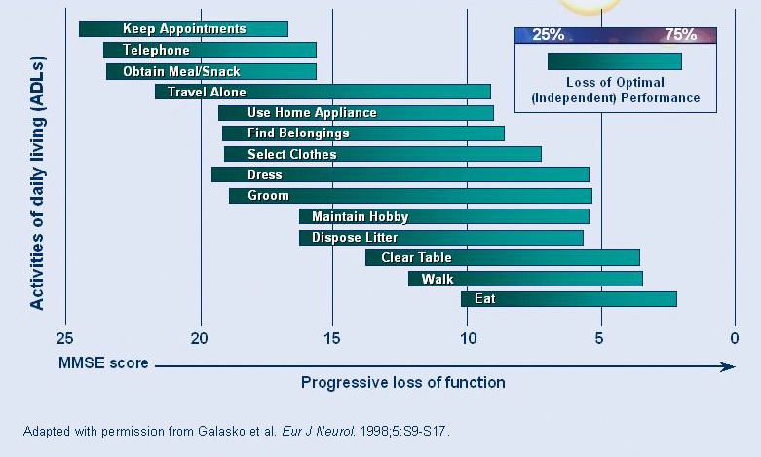
AD Progression
Notes:
3 stages …
Early or Mild – minor BUT increasingly noticeable, pt can often compensate
Moderate – memory losses more obvious, can’t be hidden from family, increased need for support, may need repeated reminders for ADLs
Severe – less verbal / difficulty communicating, increasingly dependent and often fully dependent
FAST scale

Slide 33

management

Slide 34
Introduction
There are no curative treatments for cognitive and functional impairments of dementia.
Non-pharmacologic interventions are first-line.
Notes:
Management is NOT the physicians role only. It takes a team.

Slide 35
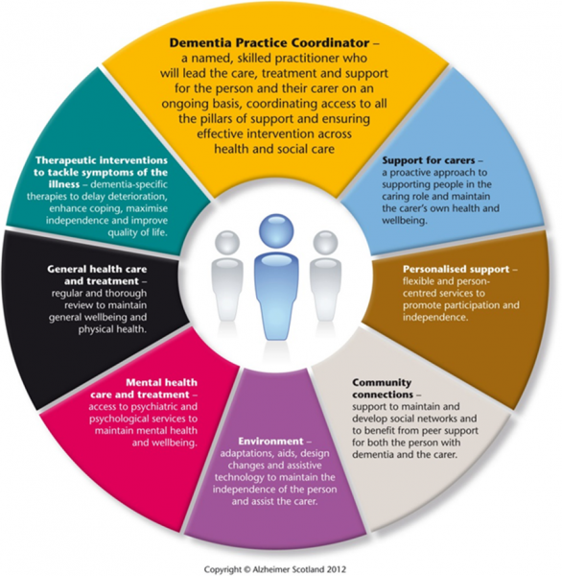

Slide 36
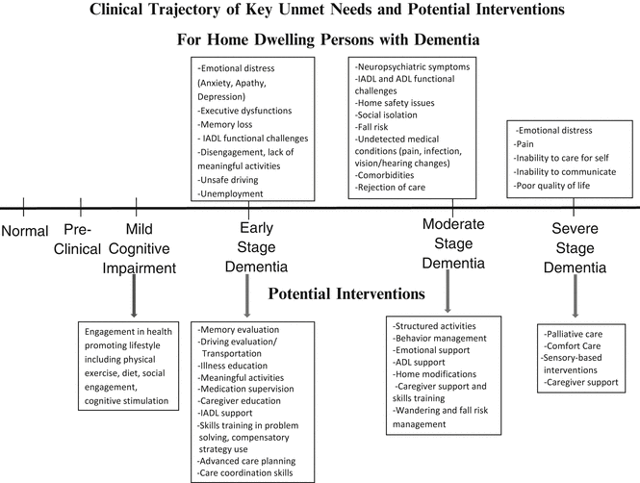
Notes:
Comanagement needs are going to change as dementia progresses.
For instance …
At early stages, adjusting to dx, caregiver support, education and planning are most important
At moderate stages, we tend to see behaviors and neuropsych symptoms appear … making structured activities, home modifications, education on behavioral mgmt important
At later states, caregiver support and palliation become more important
**Advanced care planning, caregiver support and education are important at EVERY stage

Slide 37
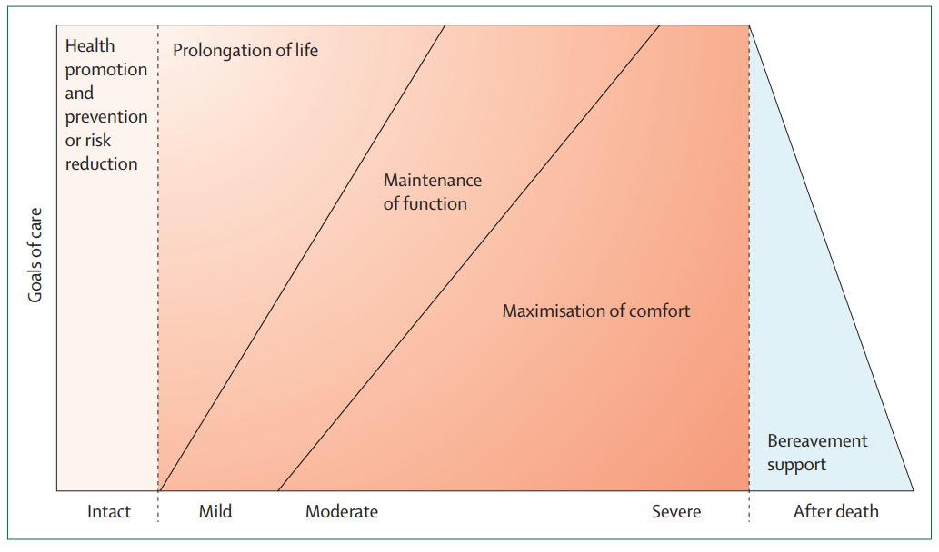
Model of Goals of Care in Dementia
Notes:
Individualize care plan
: Model of palliative care in dementia Reproduced from van der Steen and colleagues,571 by creative commons licence (CC BY-NC 3.0).
Management changes based on goals of care → reflects the importance of providing anticipatory guidance

Slide 38
Medications in Dementia
Primary goal: delay progression of cognitive and functional impairment
  Medications do NOT stop or reverse the disease
Secondary goals:
  Manage behavioral and psychiatric symptoms (BPSD)
  Improve quality of life
Notes:
Prescribing any medication for PLwD must follow a risk-benefit assessment.
The majority of PLwD are over age 65 and have comorbid conditions (Clodomiro et al., 2013).
Physiologic changes of aging affect the pharmacokinetics and pharmacodynamics of drugs (Bishara & Harwood, 2014; Pasqualetti et al., 2015).
PLwD may be taking other medications or products that have no demonstrated benefit for dementia but can interfere with the effectiveness of dementia medications.
PLwD are at elevated risk of pharmacologic adverse events (AEs) and
drug–drug interactions that can limit the use of dementia medications (Clodomiro et al., 2013).
Practice guidelines are available, but not necessarily current
(Rabins et al., 2014; Doody et al., 2001; O’Brien & Burns, 2011).

Slide 39
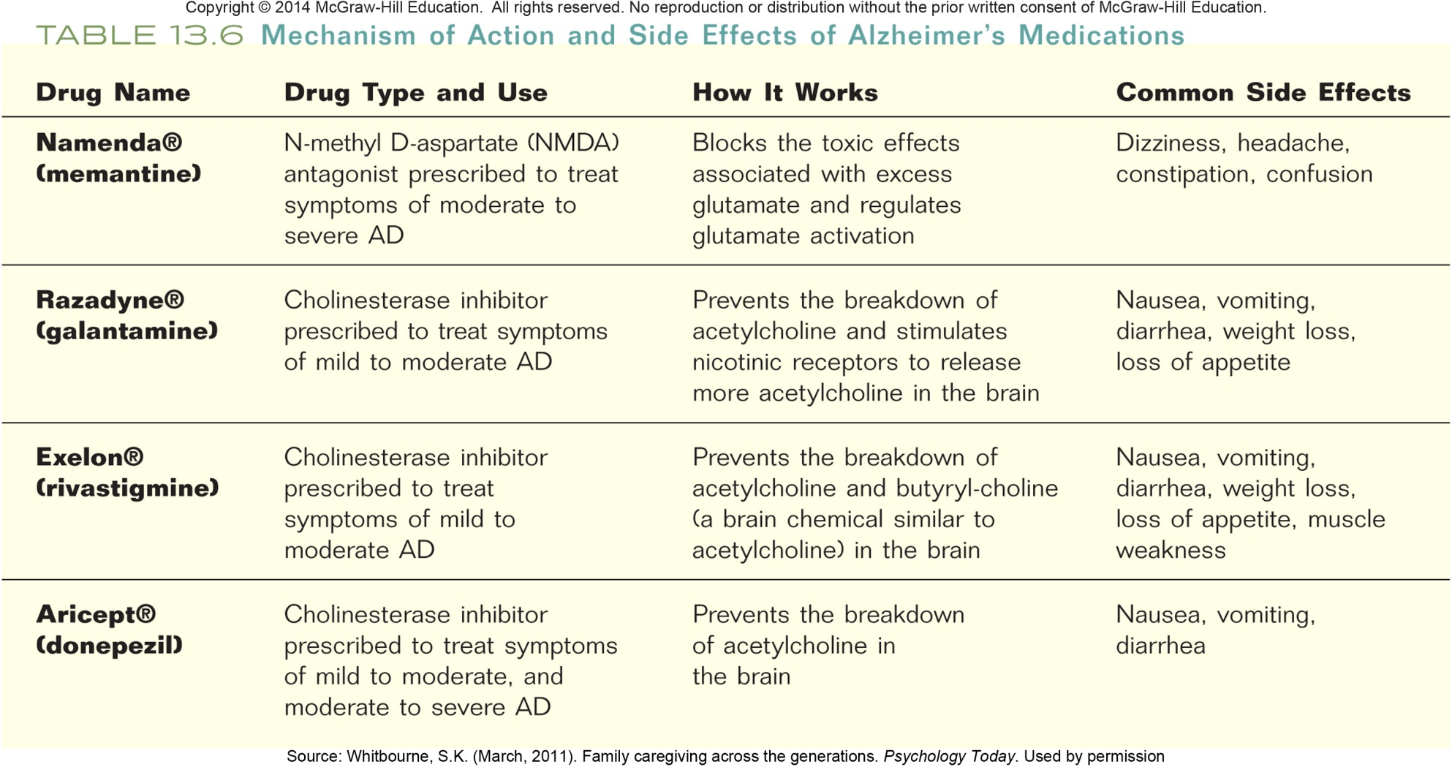
Mechanism of Action and Side Effects of Alzheimer’s Medications
Notes:
Memantine is a potent NMDA receptor antagonist (Dominguez et al., 2011) that is believed to work by regulating glutamate.
It is indicated for the treatment of moderate to severe dementia associated with Alzheimer’s disease (Rive et al., 2013).
It can be administered as monotherapy or as an add-on to cholinesterase inhibitors.
It is available as tablets, an oral solution, and extended-release capsules (Uriri-Glover et al., 2012; Wilkinson et al., 2014).
Memantine has been proven to be more effective than other channel blockers (Dominguez et al., 2011).
Memantine appears to provide benefit in both moderate-to-severe Alzheimer’s disease and vascular dementia, but not in mild Alzheimer’s disease (Buckley & Saltpeter, 2015). Memantine is associated with improvement by clinical impression in DLB; secondary analyses showed preliminary benefit for cognition and neuropsychiatric features (Aasland et el., 2009; Stubendorff et al., 2014; Wesnes et al., 2014).
Memantine has a better adverse effect profile than ChEIs (Buckley et al., 2015; Borisovskaya et al., 2014, Clodomiro et al., 2013).
There are minimal differences between the ChEIs in effectiveness but some differences in the adverse effects (AE) profiles (Massoud et al., 2011).
The most common side effects are gastrointestinal (GI) complaints (Borisovskaya et al., 2014; Sheffrin et al., 2015; Uriri-Glover et al., 2012).
The increased risk of weight loss should be considered when prescribing for elderly PLwD (Sheffrin et al., 2015).
GI complaints are more common than cardiovascular concerns (Howes, 2014; Nordström et al., 2013).
Risk of AEs increases in PLwD who are over age 85 (Buckley & Saltpeter, 2015).
Rare but serious AEs include bradycardia, QT prolongations, seizures and syncope (Borisovskaya et al., 2014; Howes, 2014; Uriri-Glover et al., 2012).
Unique side effect profiles with each of the agents should be considered (Uriri-Glover et al., 2012; Igeta et al., 2014; Lai et al., 2015; Kröger et al., 2015).
PLwD should discontinue the ChEI if the AEs are intolerable
(Borisovskaya et al., 2014).
Switching to another agent must wait until complete resolution of the AEs (Massoud et al., 2011).

Slide 40
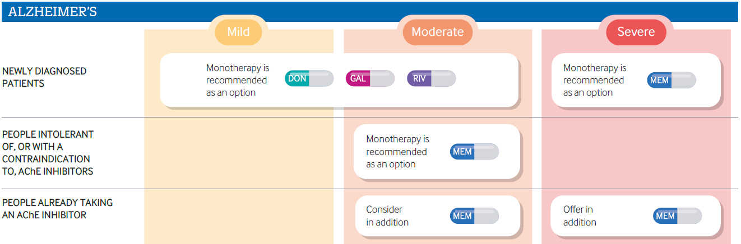
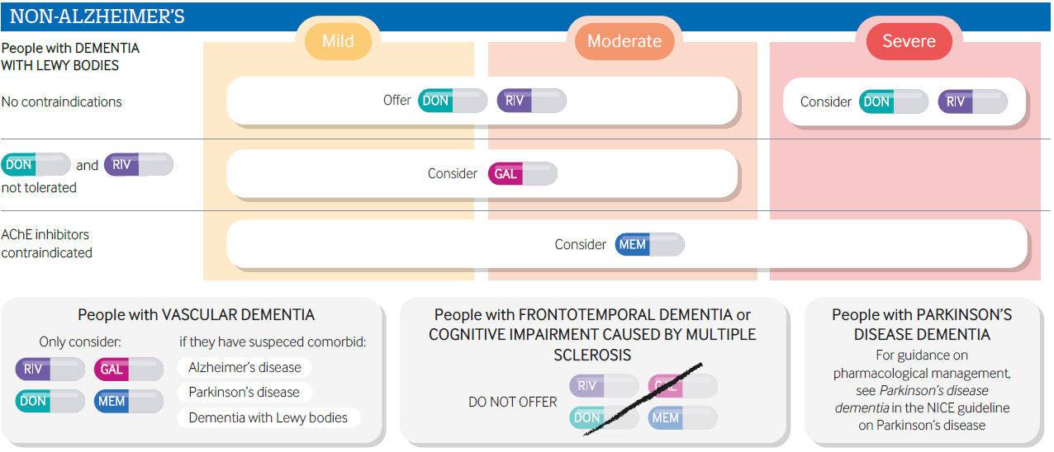

Slide 41
The New Generation of Treatment for Alzheimer’s Disease
Aimed at underlying pathology
Primarily amyloid based approaches
  Decrease production of toxic form of amyloid
      Secretase inhibitors
  Decrease amyloid aggregation
  Increase amyloid clearance – Immunotherapy
      Vaccines
      Antibodies
Notes:
28
In the future, a biomarker-based diagnosis of Alzheimer’s will impact the estimates of incidence and prevalence. It will add individuals who are currently not included in estimated (people with AD biomarkers, but no dementia) and remove those with dementia but no AD biomarker

Slide 42
Safety Assessment
1. Is the patient still driving?
2. Is the patient taking medications as prescribed?
3. Are there concerns about safety in the home?
4. Has patient gotten lost or wandered?
5. Are firearms present in the home?
6. Has patient experienced unsteadiness or falls?
7. Does the patient live alone?
Notes:
Leaving stove on … iron on … doors open …

Slide 43
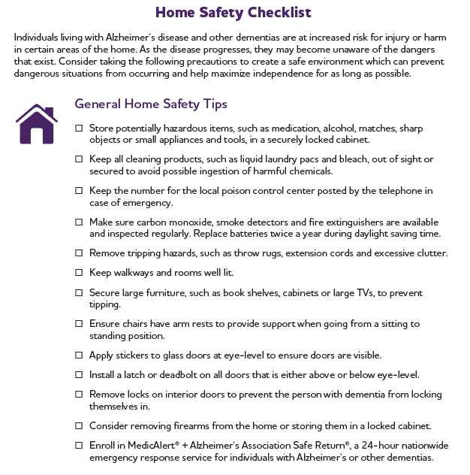
Notes:
Alzheimers’ association handout for home safety

Slide 44
In Practice
Referral to Aging Service Access Points (ASAPs)
  LifePath, Inc. (413) 773-5555
Referral to Alzheimer’s Association.
  Dementia Care Coordination Program
  617-393-2080
  Helpline number: 800-272-3900
Notes:
Older Americans Act of 1965
The Older Americans Act establishes an effective interrelationship between the federal government, State aging units and local service coordinators called Area Agencies on Aging. All three centers of service, the Federal, the state and the local engage in detailed future planning in order to accomplish their jobs. Input at the local level is received from diversified advisory boards representing stakeholders in the elder community.
Local agencies on aging represent geographic areas in a state that can be serviced effectively by that local unit.

Slide 45
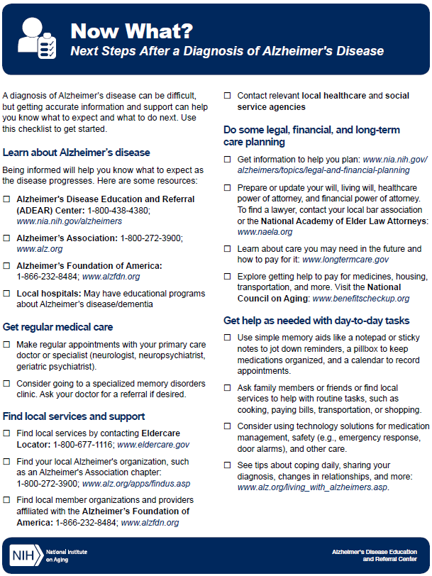
Notes:
NIH handout

Slide 46
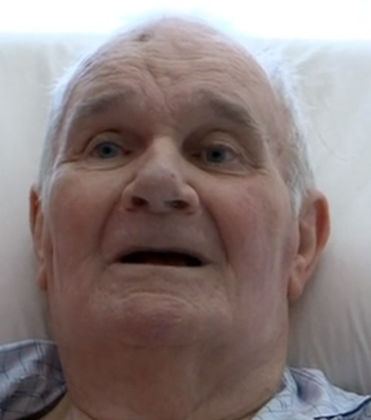
Prognosis and End of Life
The Alzheimer’s Project. 2009.

Slide 47
Prognosis
Dementia is a terminal illness
Estimated length of survival from diagnosis of dementia to death ranges from 3 to 12 years
Survival rates depend upon type of dementia
Family members, caregivers and patients may have contradicting sets of goals for end-of-life care
Notes:
We begin with a brief discussion of end-stage, or advanced, dementia. We note that the literature uses the terms “late-stage,” “end-stage,” and “advanced” dementia interchangeably to describe the final phase of dementia characterized by profound cognitive and physical disability.
(Sekerak & Stewart, 2014; Todd et al., 2013; Wolf-Klein et al., 2007).

Slide 48
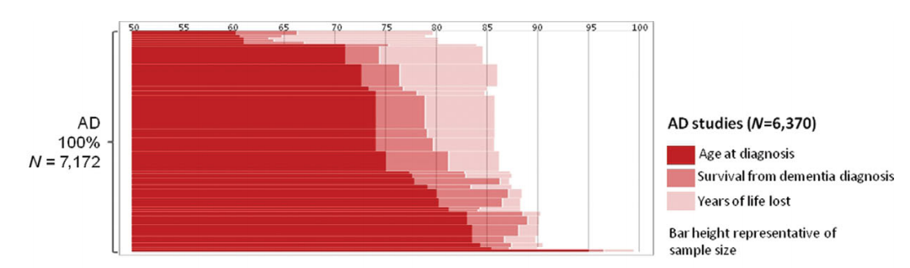
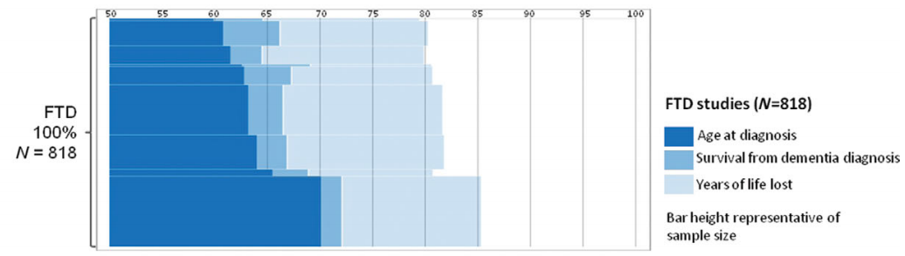
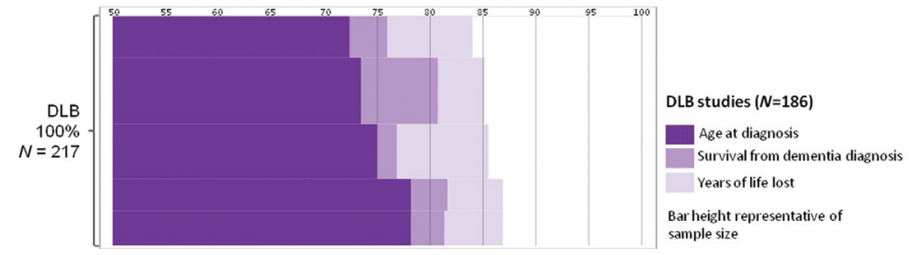
Notes:
Brodaty H, Seeher K, Gibson L. Dementia time to death: a systematic literature review on survival time and years of life lost in people with dementia. Int Psychogeriatr. 2012 Jul;24(7):1034-45
Qualifying type of dementia can help families anticipate rate of decline

Slide 49
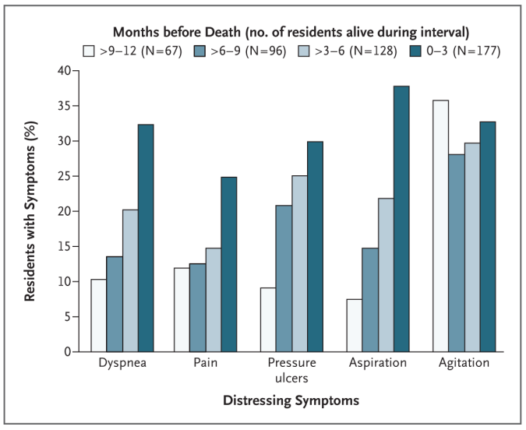
Manifestations of End-Stage Dementia
Notes:
(Mitchell et al., 2009).
(Schafirovits-Morillo et al., 2010).
Dementias are progressive, incurable illnesses. • Persons living with end-stage dementia typically have profound memory deficits, minimal verbal abilities, difficulties ambulating independently, inability to independently perform any activities of daily living, and urinary and/or fecal incontinence. This is true of persons diagnosed with most types of dementia—including Alzheimer’s disease, Lewy body dementias, and vascular dementias. • As with Alzheimer’s disease and other dementias, persons with end-stage frontotemporal degeneration (FTD)—which is also known as frontotemporal disorder, frontotemporal dementia, or frontotemporal lobar degeneration—may have trouble with ambulation and require a wheelchair. The person with end-stage FTD may have difficulty swallowing, chewing, and moving, along with bowel and/or bladder incontinence. The time from diagnosis to death is typically about 5 years, although it can vary widely depending upon the type of FTD.
) (Mitchell et al., 2009).
These manifestations of end-stage dementia are similar for persons diagnosed with Alzheimer’s disease, Lewy body dementias, or vascular dementias.
Persons living with some forms of end-stage frontotemporal degeneration (FTD) have similar signs and symptoms but a faster progression to death (UCSF Memory and Aging Clinic, 2016).

Slide 50
Feeding Tubes in Advanced Dementia
Little evidence supporting use of feeding tubes
American Geriatrics Society (AGS) does not recommend PEG feeding tubes for older adults with advanced dementia (AGS, 2014)
Providing objective information can reduce conflicts about these decisions
Notes:
Care partners require sufficient objective information to make informed decisions regarding feeding tubes.
Providers need to understand risks and benefits of tube feeding before recommending it (Friedrich, 2013).
(Peck et al., 2014).

Slide 51
Hospice Criteria for Dementia
Functional Assessment Staging Tool (FAST) Scale – Stage 7c:
Unable to ambulate without assistance
Unable to dress and bathe without assistance
Urinary & fecal incontinence
No consistently meaningful verbal communication; stereotypical phrases only or the ability to speak is limited to six or fewer intelligible words
Should have had one of the following within the past 12 months:
Aspiration pneumonia
Other infections: upper urinary tract infection, septicemia
Pressure ulcers, stage 3-4
Fever, recurrent after antibiotics
Inability to maintain sufficient fluid and caloric intake with 10% weight loss during the previous six months or serum albumin < 2.5 gm/dL
Notes:
Hospice care is a type of palliative care that is instituted at the end of life
Despite many benefits of enrollment in hospice in 2013 only 16% of enrollees in hospice had a primary diagnosis of dementia (NHPCO, 2014)

Slide 52

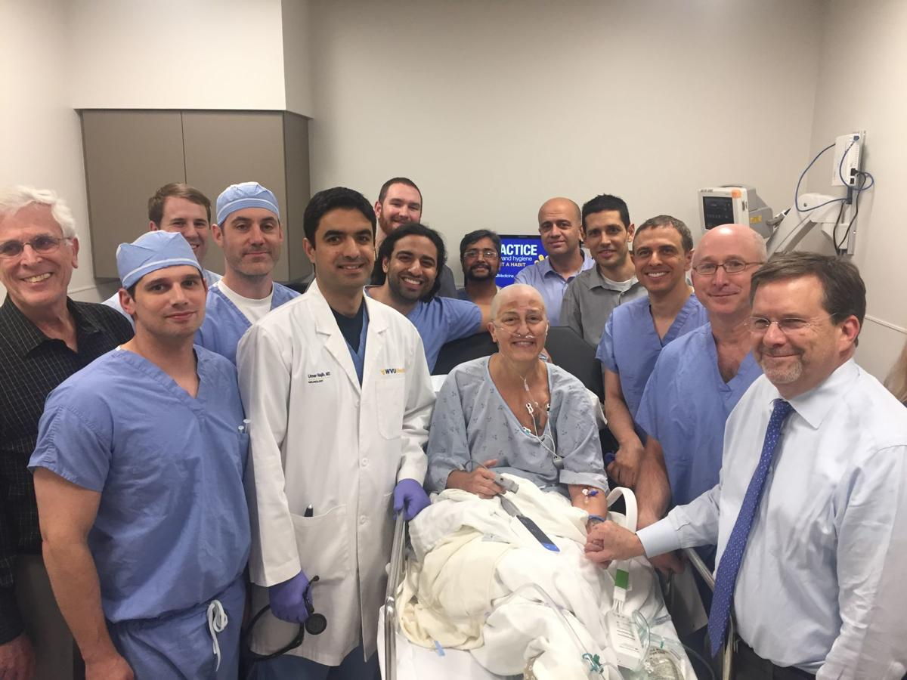
Notes:
Premise: focused ultrasound (use of ultrasound waves focused through a specialized helmet with more than 1,000 probes targeting a precise spot in the brain); opens the blood brain barrier, targeting areas of high amyloid concentration and allowing amyloid to be cross BBB
Phase 1 trial out of Toronto showed that ultrasound could open up BBB
In animal studies, plaques could be cleared with ultrasound technology
Phase 2 studies look for side effects and effectiveness (usually last ~2 years)

Slide 53

Thank you!!

Slide 54
References
Moga DC, Roberts M, Jicha G. Dementia for the Primary Care Provider. Prim Care. 2017 Sep; 44(3):439-456.
McKhann GM, Knopman DS, Chertkow H, Hyman BT, Jack CR Jr, Kawas CH, Klunk WE, Koroshetz WJ, Manly JJ, Mayeux R, Mohs RC, Morris JC, Rossor MN, Scheltens P, Carrillo MC, Thies B, Weintraub S, Phelps CH. The diagnosis of dementia due to Alzheimer's disease: recommendations from the National Institute on Aging-Alzheimer's Association workgroups on diagnostic guidelines for Alzheimer's disease. Alzheimers Dement. 2011 May;7(3):263-9.
Alzheimer’s Association. 2018 Alzheimer’s Disease Facts and Figures. Alzheimers Dementia 2018; 14(3):367-429.
The Assessment of Cognitive Complaints Toolkit for Alzheimer's Disease (ACCT-AD). California Department of Public Health. https://www.cdph.ca.gov/Programs/CCDPHP/DCDIC/CDCB/Pages/AlzheimersDiseaseResources.aspx
Larner AJ. AD8 Informant Questionnaire for Cognitive Impairment: Pragmatic Diagnostic Test Accuracy Study. J Geriatr Psychiatry Neurol. 2015 Sep;28(3):198-202.
Brodaty H, Seeher K, Gibson L. Dementia time to death: a systematic literature review on survival time and years of life lost in people with dementia. Int Psychogeriatr. 2012 Jul;24(7):1034-45.
Dementia: assessment, management and support: summary of updated NICE guidance. BMJ 2018;361:k2438 ​
Onyike CU. Psychiatric Aspects of Dementia. Continuum (Minneap Minn). 2016 Apr 22 (2 Dementia): 600-614.
Molinuevo JL et al. Current State of Alzheimer’s Fluid Biomarkers. Acta Neuropathologica. 2018. 136:821-853.
Sheikh-Bahaei et al. Imaging Biomarkers in Alzheimer’s Disease: A Practical Guide for Clinicians. Journal of Alzheimer’s Disease Reports 1 (2017) 71-88.

Slide 55
References
Intermountain Healthcare Care Process Model. Diagnosis and Management of Mild Cognitive Impairment and Dementia. February 2017: 1-20.
C.R. Jack Jr. et al. NIA-AA Research Framework: Toward a Biological Definition of Alzheimer’s Disease. Alzheimer’s & Dementia 14 (2018): 535-562.
Scheltens P. et al. Alzheimer’s Disease. Lancet 2016; 388: 505-517.
Fazio S. et al. Alzheimer’s Association Dementia Care Practice Recommendations. Gerontologist, 2018, Vol. 58, No. S1, S1-S9.
Femminella GD et al. Imaging and Molecular Mechanisms of Alzheimer’s Disease: A Review. Int. J. Mol. Sci. 2018, 19, 3702
New Strategies in Diagnosing, Preventing and Treating Dementia: A Course for Primary Care Physicians. Alzheimer’s Association 2018.
U.S. Census Bureau, International Data Base, decennial censuses, and 2014 National Population Projections.
Moga et al. Dementia for the Primary Care Provider. Prim Care Clin Office Pract 44 (2017) 439-456
National Vital Statistics Reports Volume 65, Number 5 June 30, 2016 Deaths: Leading Causes for 2014
Training Curriculum: Alzheimer’s Disease and Related Dementias. Bureau of Health Workforce. U.S. Department of Health and Human Services. 2018. https://bhw.hrsa.gov/grants/geriatrics/alzheimers-curriculum
The Alzheimer’s Project. Home Box Office (HBO). 2009. Season 1. Episode 1.

