Slide 1
Dementia: Diagnosis, Treatment and Other Considerations
Rebecca Starr, MD, AGSF
Medical Director, Geriatrics
Cooley Dickinson Healthcare
March 22nd, 2023
Month, year

Slide 2
Objectives:
Discuss how to assess and diagnose cognitive impairment
Review current treatments for dementia
Educate on when to do driving assessments
No disclosures

Slide 3
COGNITIVE DISORDERS: PREVALENT AND COMMONLY UNDIAGNOSED AT EARLY STAGES
Be on the look out for memory concerns
Sources: patient or their family, or clinical staff(missed appts, meds, etc)
Studies:
22% of caregivers didn’t recognize dementia (Greiner et al. JAMA 1997;277:1757)
64% missed by caregivers and physicians (Sternberg et al. J Am Geriatr Soc 2000;48:1430-4)

Slide 4
Steps To Help Diagnose and Treat Dementia
Take the patient’s history
Interview a caregiver or family member
Physical exam
Cognitive testing
Laboratory Testing
Structural imaging if necessary
Neuropsych assessment if necessary
Develop assessment and plan inclu. treatment
Care Planning
Close follow up

Slide 5
Ask about the ABC’s:
Activities – ADLs, IADLs, new incontinence, driving, financial scams, tremor, gait changes - shuffling, falls,
Behaviors – Change from prior, VH/AH/delusions/paranoia
Cognition – Memory loss? Executive dysfunction? Decreased attention? Language difficulties?
* Important to get family/friend input – but they may miss signs (or don’t want to see them)

Slide 6
Review PMH and Psychosocial history
Note cardiovascular history and risk factors
Note if depression/anxiety/insomnia and sleep apnea risk factors
Ask about possible childhood or adult trauma
Ask about military experience
Alcohol use, drugs (incl THC, CBD) and tobacco
Ask about h/o surgeries, delirium, etc
Family history

Slide 7
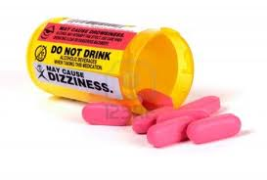
Review Medications – Including OTC!
Know about Beers Criteria Medications
Meds to avoid in older adults:
Anti-cholinergics
Includes oxybutynin, amitriptyline, hydroxyzine, meclizine, amantadine
Avoid the “PM”s –Tylenol PM, Advil PM, diphenhydramine
Muscle relaxers
Certain meds uses for anxiety and/or insomnia
alprazolam, diazepam, chlorazapam
zolpidem, zaleplon
Pain medications – indomethacin
Neuroleptics – high doses of gabapentin
He Health In Aging.org, American Geriatric Society – Beers Criteria

Slide 8
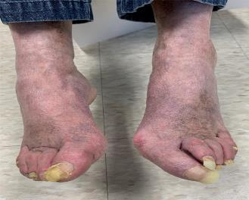
Exam
Overall appearance including hair
Hearing and vision
Smell
Mouth, Teeth
Extremities – “long toenail sign”, swelling, arthritis
Is there tremor?
Speech - ? Word finding difficulties, dysarthria? Word salad?
Gait assessment is crucial! Is there shuffling? Decreased tandem gait?

Slide 9
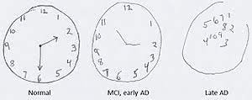
Cognitive Assessment - The Mini Cog
3 Word Recall
Clock Draw Test
High sensitivity and specificity for dementia screening
Not influenced by education or language
Quick - takes on average 3 minutes to administer!

Slide 10

Assessments
MOCA
The recommendation is to get officially trained - $150
May be free for some institutions
Available in many languages, for low education, hard of hearing.
Please include details of the assessment, not just the score
Note which version you use – 8.1, 8.2, 8.3 – and try not to use the same one twice in a row.
GPCOG Screening Test
Informant tools: AD8, CPCOG, IQCODE

Slide 11
Structural Imaging
Send for initial imaging – unless very confident of dx, older age, increased frailty
Used to identify potentially treatable conditions that affect the structure of the brain, such as tumors, hydrocephalus, or hematomas.
Can also detect atrophy and macro or micro- vascular changes.
CT/Head:
  Rapid
  Provides reasonably good resolution (1mm)
  Relatively inexpensive
    Limited by GFR if contrast needed, not as good as MRI
MRI Brain:
  Greater tissues contrast and better able to visualize small regions of brain injury, white matter lesions, microbleeds
  Gadolinium can identify where the permeability of the BBB is increased
    Limited by metallic implants, CKD
    Ask for coronal views to look at hippocampus
Amyloid PET Scan: very expensive, not being done regularly

Slide 12
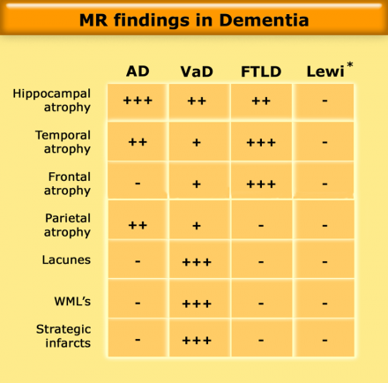
Use of MRI in Dementia
Specific signs of dementias such as:
Alzheimer's disease (AD): medial temporal lobe atrophy (MTA) and parietal atrophy
Frontotemporal Lobar Degeneration (FTLD): (asymmetric) frontal lobe atrophy and atrophy of the temporal pole
Vascular Dementia (VaD): global atrophy, diffuse white matter lesions, lacunes and 'strategic infarcts' (infarcts in regions that are involved in cognitive function)
Dementia with Lewy bodies (DLB): in contrast to other forms of dementia usually no specific abnormalities

Slide 13
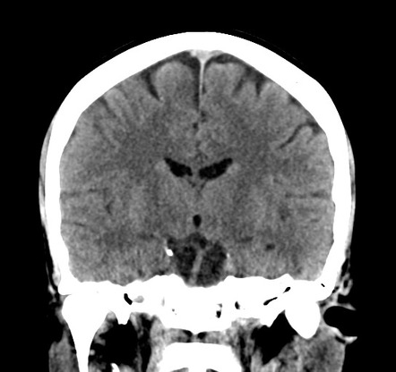
CT Head

Slide 14
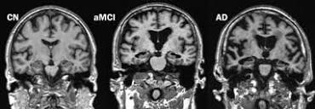
MRI Brain – Coronal Views

Slide 15
Next Steps: How to put it together
Say what you know: Cognitive Impairment and to what degree
Say what you think it might be (or what it is not) :
Sometimes the diagnosis takes time, further evaluation, stopping medications, treating depression/anxiety, decreasing ETOH
Note contributing factors (cardiovascular history, sleep apnea, depression, meds, alcohol, etc.)
Next steps:
More frequently, we are seeing a mix of both Neurodegenerative and Vascular Dementias.
If you feel confident in your diagnosis, ensure you have time and a method of breaking bad news.
  Remember, this may be a terminal diagnosis
Focus on what is preserved, not lost.
Dx is not a one time event, plan to review dx and plans.
Include caregiver supports/concern for caregiver stress/strain in plan
Setting
Perception
Invitation
Knowledge
Empathy
Summary

Slide 16
When to refer to Geriatrics:
Help with diagnosis
Behavioral issues – though note we have a wait list
Caregiver stress and supports
Treatment options
Review of medications
* Recommended for referral:
Please have reason for referral – the more detailed the better.
Note labs (difficult for us to see them), imaging and Neuropsych if done
Include any work up & assessments – again, detail is better
  For ex, if MOCA – please don’t just write score – detail out deficits
Note h/o delirium, and any pertinent medical history
Start discussion of care planning and possible driving retirement

Slide 17
Referrals: Neurology and Neuropsychology
Help with diagnosis
If there seems to be a neurological component – tremor, change in gait, change in speech patterns, and things do not to seem to add up – then send to Neurology
Results of imaging – NPH, ? CAA
I send to MGH Neurology or Umass specialists if concerns about a rarer type of dementia (ie. Progressive Supranuclear Palsy, Corticobasal Degeneration) or desire for clinical study
Neuropsych assessment: possibly if MOCA score > 15 AND if depression/anxiety are not severe
To establish a baseline or help with diagnosis, if helps with planning, driving, if c/w goals of care
Consider PT/OT/ST referrals

Slide 18
Memory changes: Normal Aging
Some occasional word or name finding difficulties but you may remember later in the day - “tip of the tongue”
Misplacing things like glasses
The need to make lists or write things down more than you did in the past
Harder to multi-task
May take longer to recall information
May take longer to learn new information

Slide 19
Memory changes: Mild Cognitive Impairment
Corroborated complaint of memory loss
Normal overall cognition and ADLs – functional status is preserved
Memory impaired for age and education
(>1.5 SD below cohort)
About 12% (vs 1-2% nls) progress yearly to AD though can be reversible

Slide 20
Memory Changes: Dementia
The development of multiple cognitive deficits manifested by both:
Memory impairment
Impaired ability to learn new information
Difficulty recalling previously learned information
One or more of the following cognitive disturbances:
  Aphasia: language disturbance
  Apraxia: impaired skilled or symbolic movement despite intact motor function
  Agnosia: failure to recognize or identify entities despite intact sensory function
  Executive functioning: planning, organizing, sequencing, abstracting

Slide 21
The major dementia syndromes include:
Alzheimer’s Disease (AD)
Vascular dementia (VaD)
Dementia with Lewy bodies (DLB)
Frontotemporal dementia (FTD)
Parkinson’s disease with dementia (PDD)
Normal Pressure Hydrocephalus
Also:
“Reversible” (possibly) dementias
Alcoholic dementia
AIDS dementia
Note – there are over 120 different types!

Slide 22
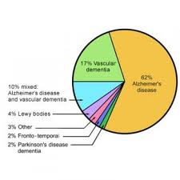
Dementia Types: Frequency
AD: 60% - 70%
Vascular: 17-20%
Mixed: 10%
Other progressive disorders: 10% (e.g. Lewy body, frontotemporal)
Reversible dementia (e.g., drug toxicity, metabolic changes, thyroid disease, subdural hematoma, normal-pressure hydrocephalus): 2% - 5%

Slide 23
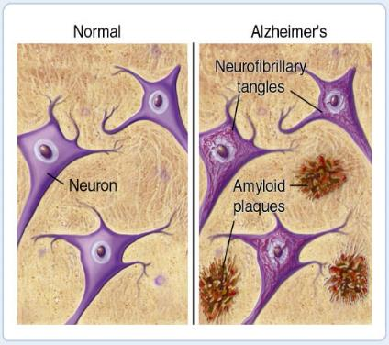
Alzheimer’s Disease (AD):
B Amyloid protein deposits
    in extracellular parenchymal plaques
Tau, the microtubule‐associated protein, forms insoluble filaments that accumulate as neurofibrillary tangles

Slide 24
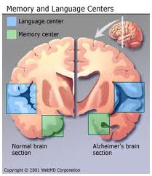
Alzheimer’s Disease (AD):
Early degeneration of mesial temporal lobes – most likely causes the prominent impairment of recent memory (seen in both MCI and AD)
Early degeneration of the basal forebrain – the rationale behind cholinergic augmentation
Subcortical and primary sensory and motor cortex structures are spared.

Slide 25
Stages: Mild
Year 1-3 from onset of symptoms
MOCA 18-25; MMSE 21-25; CDR 1; FAST 4*
Disoriented to date
Naming difficulties (anomia)
Mild difficulty copying figures
Problems managing finances
Recent recall problems
Decreased insight
Irritability, mood change
Social withdrawal

Slide 26
Stages: Moderate
Year 2-8
MOCA 10-17; MMSE 11- 20; CDR 2; FAST 5-6*
Disordered to date, place
Comprehension difficulties (aphasia)
Impaired language and calculating skills
Impaired new learning
Getting lost in familiar places; ; driving difficulties
Problems with dressing, grooming
Not cooking, shopping, banking
Restless, anxious, depressed
Delusions, agitation, aggression
New incontinence – bladder and bowel

Slide 27
Stages: Severe
Year 6-12
MOCA < 10; MMSE: 0-10; CDR 3; FAST 7*
Remote memory gone
Nearly unintelligible verbal output
Unable to copy or write
No longer grooming or dressing
Incontinent all the time
Motor or verbal agitation
Distressing conditions: pressure ulcers, constipation, pain, weight loss, contractures, and shortness of breath
Hospice eligible at FAST 7C

Slide 28
Vascular dementia (VaD)
Causally related to cerebrovascular disease
Multiple or strategically placed large-vessel occlusions
Multiple small-vessel occlusions
Often seen as “chronic microvascular changes”
Approximately 25% of patients who have a stroke meet criteria for dementia on follow-up at 3 months
Relative risk in 4 years post stroke is 5.5% or 8.4% per year, compared with 1.3% for the general population.

Slide 29
Vascular dementia (VaD)
Diagnosis:
History and ROS
Imaging studies and neurologic signs on exam
Said to follow a classic stroke-like disease course (abrupt onset or stepwise deterioration)
In practice, ~ 1/3 of patients experience an insidious disease onset and gradual decline
Also, there is often no history of CVA or focal neurologic signs
MMSE is not sensitive for vascular dementia
Associated with cognitive slowing, apathy, and poor problem solving

Slide 30
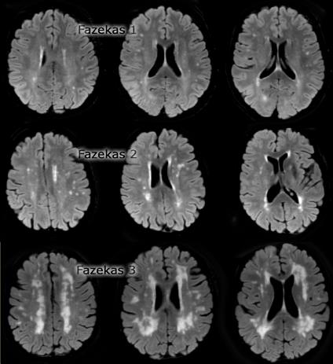
MRI – Vascular Dementia
Fazekas scale for WM lesions
On MR, white matter hyperintensities (WMH) and lacunes - both of which are frequently observed in the elderly - are generally viewed as evidence of small vessel disease.
It is best scored on transverse FLAIR or T2-weighted images.
Score:
Fazekas 0: None or a single punctate WMH lesion
Fazekas 1: Multiple punctate lesions
Fazekas 2: Beginning confluency of lesions (bridging)
Fazekas 3: Large confluent lesions

Slide 31
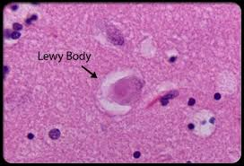
Dementia with Lewy bodies (DLB):
Characterized by intraneuronal Lewy body inclusions in the cerebral cortex

Slide 32
Dementia with Lewy bodies (DLB):
Criteria:
Deficits of attention, frontal-subcortical skills, and visuospatial ability may be particularly prominent
Persistent memory impairment may not occur early but is usually evident with progression.
Two of the following core features:
  1. Fluctuating cognition with pronounced variation in attention and alertness
  2. Recurrent visual hallucinations that are typically well formed and detailed
  3. Spontaneous motor features of parkinsonism

Slide 33
Dementia with Lewy bodies (DLB):
Supportive features include:
  Repeated falls
  Syncope
  Neuroleptic sensitivity
  Delusions
  Hallucinations in other modalities
  REM behavior disorder
  LBD Screening tool can help
Parkinsonism occurs because of involvement of classic subcortical nuclei
Fluctuating sensorium and visual hallucinations may be partially caused by a central cholinergic deficit.
Sensitivity to neuroleptics

Slide 34
Frontotemporal dementia (FTD):
Occurs between the ages of 35-75 years; rarely after age 75
Early insidiously progressive impairment of personality and executive functioning, including decision making, prioritizing, and planning
Early progressive language dysfunction
Often includes failure to initiate appropriate behavior or to inhibit or cease inappropriate behavior
Present with poor social decisions, inappropriate behavior, and apathy, poor insight
Memory impairment may be mild compared with degree of executive functioning impairment

Slide 35
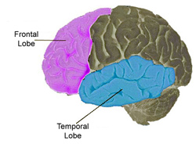
Frontotemporal dementia (FTD):

Slide 36
Normal Pressure Hydrocephalus
Clinical Features:
Triad: Gait disturbance, incontinence, dementia
Gait ataxia – usually first sign – ~ 90% - difficulty initiating gait or hesitant (magnetic), slow, shuffle, hesitant
Dementia – in up to 80% - often mild cognitive deficit – sub-cortical type, resembles frontal disorder: forgetful, inattentive, inertia, psychomotor and thought retardation, apathy, flat affect.
Urinary incontinence – 25 – 50% - early or late sign

Slide 37
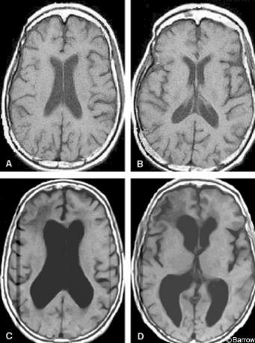
Normal Pressure Hydrocephalus

Slide 38

Dementia: Treatment
What works
What doesn’t work
What may work
New medication

Slide 39
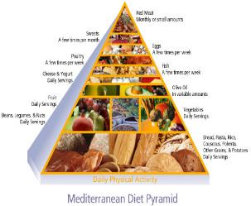
Treatment: Nonpharmacologic Approaches
  Diet
    ? Mediterranean
  Physical exercise (what is good for the heart
  is good for the brain)
  Mental exercise – particularly learning a new skill
  Social stimulation & connectedness
  Leisure activities (not watching TV!)
  Meditation and/or Tai Chi

Slide 40

Treatment: What doesn’t work
Supplements:
Prevagen - FTC charged the makers of Prevagen with false and deceptive advertising, as the company study itself found that Prevagen was no more effective than placebo at improving any of the nine cognitive skills, including memory, that the company was measuring.

Slide 41
Treatment: What May Work – Cholinesterase Inhibitors
For early to moderate stages of Alzheimer’s Dementia
Prevent the breakdown of acetylcholine, a chemical messenger important for learning and memory
Delay or slow worsening of symptoms.
Effectiveness varies from person to person
No evidence that higher doses are more effective
Please – do not have anti-cholinergic + cholinesterase inhibitors!
Ex: should NOT be on oxybutynin AND donepezil.

Slide 42
Treatment: What May Work – Cholinesterase Inhibitors
Generic | Brand | Approved For: | Side Effects
Donepezil 5-10 mg/day | Aricept | All stages | Nausea, vomiting, loss of appetite, muscle cramps, increased BM, incr urinary incontinence, vivid dreams, bradycardia
Galantamine 8-14 mg/day | Razadyne | Mild to Moderate | Same
Rivastigmine 1.5 – 6 mg/BID Patch: 4.6-13.3 mg/24 hr | Exelon | Mild to Moderate | Same – comes in a patch which may have less GI side effects.

Slide 43
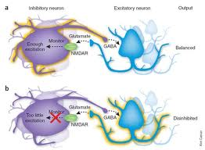
Memantine (Namenda)
For moderate to severe dementia
Works differently than cholinesterase inhibitors
It blocks the actions of the neurotransmitter, glutamate.
Glutamate is needed for memory,
but too much of it is toxic to nerve
cells, and it appears that in people
with Alzheimer’s, there is too
much of it (for unknown reasons).
Final dose – 10 mg twice daily
Side effects: headache, constipation, confusion and dizziness, sometimes increased agitation, sometimes less

Slide 44
Treatment: New Medication - Lecanemab (Leqembi)
FDA granted accelerated approval after results of a Phase III clinical trial
Shown to moderately slow cognitive and functional decline in MCI or early-stage cases of Alzheimer’s Dementia
Developed by Eisai, cost $26,500 per year
Medicare has not yet decided to cover – will review again in July 2023
Works to remove amyloid plaques from the brain – believed to cause Alzheimer’s Disease to advance
Slowed decline by 27% after 18 months compared to those who received a placebo
Requires:
CSF biomarkers (lumbar puncture)
Serial PET scans and MRI to monitor for ARIA prior to the 5th, 7th, 14th infusions
Bi weekly infusions for 18 months.
Alz.Net registry

Slide 45
Treatment: New Medication - Lecanemab (Leqembi)
Side effects:
Infusion related - flushing, chills, fever, rash – reaction: 26.4% vs 7.4% placebo
ARIA:
Amyloid-related imaging abnormalities with edema
12.6% vs 1.7% in placebo group
Amyloid-related imaging abnormalities with brain bleeding
17.3% vs 9% in placebo group
  Mostly microhemorrhages

Slide 46
Dementia and Driving:
Ask pt and family about driving and any concerns.
Would they allow their children or grandchildren to drive with the pt?
Start the conversation early; MyMobilityPlan from the CDC
Safety concerns:
Lack of insight
Decreased executive function & visuospatial abilities - more of a concern than short term memory loss (why MOCA results matter)
Vision changes: The parts of the brain that handle visual information have been affected.
Decreased peripheral range, color and contrast decline, depth perception difficulties.
Frontal lobe – difficulty ensuring mental focus remains on the correct object.

Slide 47
Dementia and Driving
Greatest risk factor for unsafe driving.
Drivers with dementia ~ 2.5 to 4.7 times more likely than healthy, age-matched controls to be involved in motor vehicle collisions.
Consensus among national guidelines is that those with moderate or severe dementia should not drive
A MOCA score of 18 or less was associated with greater likelihood of failing an on-road driving assessment
** Note that the use of this alone was NOT strong enough to recommend its use as the sole instrument to assess driving.
Two great resources and tools:
Clinician’s Guide to Assessing and Counseling Older Drivers
Clinical Assessment of Driver-Related Skills - CADReS Evaluation
Hollis et all. Validity of the mini mental status examination and the montreal cognitive assessment in the prediction of driving test outcome, JAGS, 63(5), 988-992.

Slide 48

Other Considerations
The Dementia Road Map from Washington State
Overall well-being and social connections
Planning for the future
Estate Planning – Remember the 5 year look back for SNF placement
Planning for Current and Anticipated Care Needs
Planning for one can no longer drive
Home Safety
Advanced Care Planning
Assessing Capacity
Caregiver support is crucial!!
  Caregiver stress and strain are very high in families taking care of dementia patients.

Slide 49
CAREGIVER ISSUES AND RESOURCES
Maintaining the health and well-being of caregivers is essential for effective treatment of dementia patients
Over 50% of caregivers develop depression
Physical illness, isolation, anxiety, and burnout are common
Intensive education and support of caregivers may delay institutionalization of patients with dementia
Adult day services for patients and respite services for caregivers may help
Alzheimer's Association (www.alz.org / 800-272-3900) offers education and support services (e.g., Safe Return); chapters are located in major cities throughout US
Family Caregiver Alliance (www.caregiver.org / 800-445-8106) offers support, education, and information for caregivers

Slide 50
Resources
CDMG Geriatric Website – Geriatric Resources
Helpful videos on dementia
Family caregiver resources
Driving information
Beers Criteria
Alzheimer’s Association
Teepa Snow – videos
CADReS Score sheet to further assess www.safemobilityfl.com/pdfs/CliniciansGuide/CADReS
ww.nhtsa.gov/sites/nhtsa.gov/files/812228_cliniciansguidetoolderdrivers.pdf

Slide 51
Thank you!!

Slide 53
RISK FACTORS FOR DEMENTIA
Possible Risks
Delirium
Head trauma
Heavy smoking
Hypercholesterolemia
Hypertension
Lower educational level
Other genes
Postmenopausal hormone therapy
Definite Risks
Age
APOE4
Atrial fibrillation
Depression
Down syndrome
Family history of dementia
H/o delirium

Slide 54
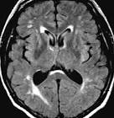
MRI Brain – Cerebral Amyloid Angiopathy

Slide 55
Basic Laboratory Testing:
Goal: to look for reversible causes and for factors that can be altered that can slow decline
Basic Labs:
CBC
CMP
TSH, reflex FT4
B12 and MMA
Folate
? Homocysteine
Indication Dependent:
Labs
VDRL
HIV
Lyme Titer
ESR – non-specific
EEG

