Slide 1
Billing Updates
March 2023
Julianne Tauscher, FNP
Billing Advisory Champion
EHC Co-Team Leader

Slide 2
Goals
Review: What is an RVU?
How is it calculated?
Reminder to review snapshots
High value visits
Increasing RVUs
Reminder to use Counseling/ E/M codes w/ wellness visits

Slide 3
What is an RVU and how do I increase them?
RVU = RELATIVE VALUE UNITS
Reflects effort and volume of work
More RVUs= more income for the practice
work more efficiently
bill in a way that reflects the work you do
measure of productivity
High value services are transition care (TCMS) and procedures
(Kantner, 2023)

Slide 4
Calculations- (for those who like math)
Resource – Based Relative Value Scale, used by Medicare and payers to determine provider payment for services
3 Components: RVU (relative Value unit) , Geographic practice cost indices (GPCIs)adjusts the RVU for regional differences, a conversion factor (CF) to determine payment in dollars
Total RVUs= work RVUs (patient risk/ time spent in clinical decision making) + practice RVUs(practice expenses) +malpractice RVUs (liability insurance costs)
(Kantner, 2023)

Slide 5
WORK RVUs
This data is available in the Tableau Provider Snapshots on the intranet
Review and compare you RVU/ encounter to peers
Total RVU’s, basically all the work you did added together.
(Kantner, 2023)

Slide 6
How to increase work RVU?
Patient volume and fill rates
Review % of 99214 and 99215
Review counseling code usage (Team leader dashboard- see your Team Leaders!)
(Kantner, 2023)

Slide 7
Add Codes to Wellness Visits: E/M, Counseling
**Add E/M codes to Wellness visits, Medicare Wellness, and PEPs if appropriate
Separate identifiable visit at a time of a preventative care visit should be billed for.
Who is doing this(review snapshots):
EHC, 19.8%
GHC, 39.41%
AMC, 30.75%
NHC, 34.385%
Bill for counseling if performed:
EHC, 6.5%
GHC, 9.24%
AMC, 7.35%
NHC, 4.86%
(Kantner, 2023)

Slide 8
Reminders: High Value Visits
New patient visits having higher RVU’s than established patients
Skin procedures
Joint injections
Transitional care management services (TCMS)
Medicare Wellness
Paps add RVU
Track time for billing, face to face and prep, charting time
Work smarter not harder
Medicare reimbursement rates (2021)
99213 95.76
99214 135.79
99215 189.34
Mod TCMS 215.95
High TCMS 292.38
(Kantner, 2023)

Slide 9
(Kantner, 2023)

Slide 10
Coding Wellness Visits + A problem Visit You just finished a wellness visit and “Oh by the way…”
Difference between health promotion vs. addressing a medical problem (new/ acute, or chronic)
2021 E/M changes make it easier to bill for both services if you address an issue at a wellness visit
Explain to patients: a separate service is performed and may result in a charge
At VMG all patients receive a letter explaining this
“Comprehensive preventive medicine evaluation and management services of an individual including an age and gender appropriate history, examination, counseling/anticipatory guidance/risk factor reduction interventions, and the ordering of laboratory/diagnostic procedures.” – CPT description of preventative visits
CPT specifies that if you assess and manage new/chronic problems, you should bill an E/M code
(Nicoletti, B. & Magoon, V., 2022)

Slide 11
Wellness + 9921x
Do not bill E/M:
Insignificant problems w/o work should not be billed
If problems are not managed or evaluated, do not bill separate code
Problems listed, but no significant info provided, refills provided, no changes
When to Bill E/M:
New problems, with supporting documentation, MDM and a plan is documented
Chronic problems are evaluated, labs are ordered, meds are refilled
Chronic problems exacerbated, changes in treatment plan, short follow up recommended
Ex. Evaluate a rash, Address uncontrolled blood pressure/cholesterol. Deciding on a plan( med/ no med/ lifestyle adjustment) = a separate service was completed
Modifier 25 is used to add the E/M code (99213, 99214) to the Prevention Code
(Nicoletti, B. & Magoon, V., 2022)

Slide 12
Medicare wellness visits + E/M codes
“Welcome to Medicare” G0402
Initial Medicare Visit G0438
Subsequent Medicare Visit G0439
Medicare Wellness Requirements: See Templates
Update PMH, FHX, SH, Vitals, Depression Screening, ADLs, Safety, Prevention Screening, personal prevention plan, substance/ opioid use. Advanced care planning.
Not required: a physical exam, reviewing A&P of acute or chronic problems
Can bill for if medical necessary and performed w/ modifier 25
MDM billing is easier here, time is more difficult to track
(Nicoletti, B. & Magoon, V., 2022)

Slide 13
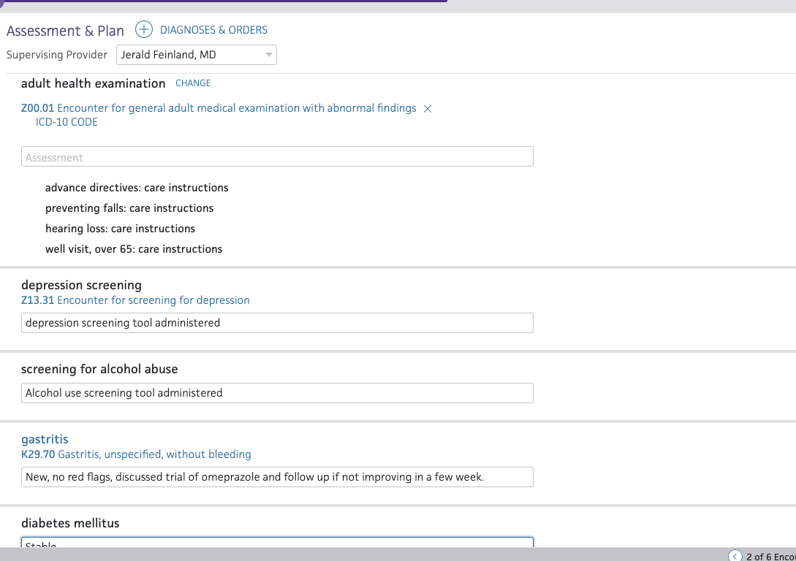
A & P Minnie Mouse Medicare Wellness
Minnie was seen for her Medicare wellness, but also has gastritis that is new. She has diabetes that is reviewed and assessed.

Slide 14
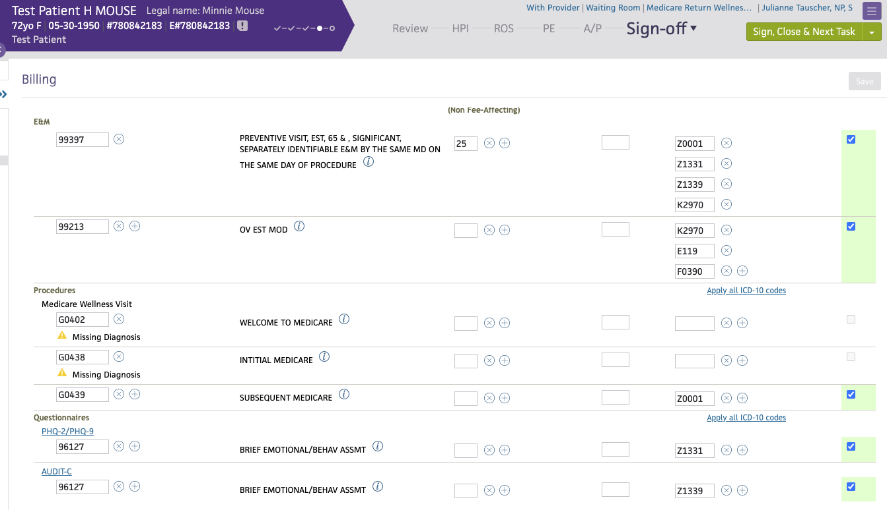
Notes:
Physicals:
If you perform them on a Medicare patient specifically GIC, HNE, Masshealth, Tufts-document them and bill 99397 for them.

Slide 15
References
CMS.gov. Search the Physician Fee Schedule. https://www.cms.gov/medicare/physician-fee-schedule/search
Kantner, A. C. (2023). Understanding and improving your work RVUs. Family Practice Management, 30(2), 4-8.
Nicoletti, B. & Magoon, V. (2022). Combining a Wellness visit with a problem-oriented visit: a Coding Guide. Family Practice Management. 29(1) 15-20.

