Slide 1
First Do No Harm The Healing Relationship in Women’s Health: A Trauma Sensitive Approach
Julie Stanitis Thompson
DO, FACOG
Cindy Marty Hadge

Slide 2
What is Trauma? What does trauma feel like?
Basic needs not being met
Sexual, physical violence
Oppression
Poverty, Disaster displacement
Witnessing violence
Cumulative
Emotional abuse, neglect, bullying
Accident, Illness, Medical Procedures
Grief, separation, loss
Generational, historical
Notes:
A Physical and Emotional response
Categorized by a sense of powerlessness, and impending doom, frequently accompanied by feelings of guilt and shame, as well as betrayal.
Personal
Impact and responses vary
Cumulative

Slide 3
Life Experiences
Family History
Society and Gender
Cultural History

Slide 4
Trauma Responses
Fight
Flight
Freeze
Capitulation

Slide 5
Trauma Reactions
Shaking
Disassociation
Loss of situational awareness
Heightened sensory awareness
Altered Sensory perceptions – seeing, hearing, feeling, despite the apparent absence of external stimuli

Slide 6
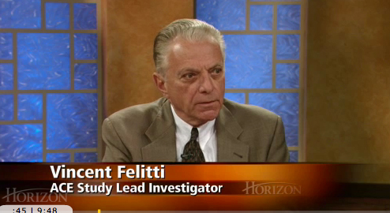
The Adverse Childhood Experience (ACE ) Study
Dr Vincent Felitti – Chief of Preventative Medicine at Kaiser Permanente , in partnership with The Center for Disease Control (CDC).
Health records of over 17,000 patients were reviewed
World Health Organization (WHO) reports consistent findings with research conducted around the world.

Slide 7
Impact of Trauma
ACE scores have been correlated to difficulties with fertility, menstruation, birth weight, sexual behavior, and other aspects of women’s health.
After being raped a person is four times more likely to contemplate suicide.
https://mainweb- v.musc.edu/vawprevention/research/mentalimpact.shtml
Health outcomes of sexual assault:
Increased reported symptoms
Chronic pelvic pain
Dysmenorrhea
Sexual dysfunction
Decreased quality of life
Alterations in perceptions of health
(Plichta SB et al, Dickenson LM et al, Golding JM et al)

Slide 8
Prevalence of Sexual Assault
1 in 4 girls are sexually abused before age 18.
1 in 5 female high school students abused by a dating partner.
- US Department of Justice
According to the National Sexual Violence Resource Center, one in five women will be raped at some point in their lives.

Slide 9
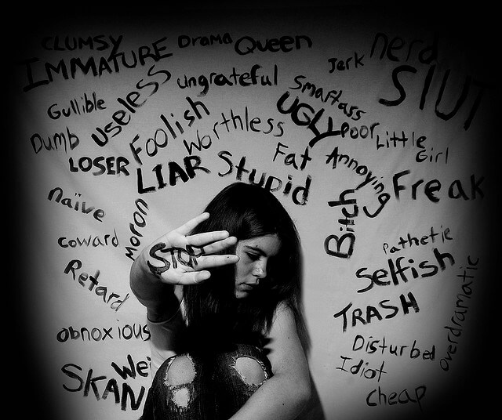
Messages that can come with Trauma
It is your fault.
Don’t tell or someone will get hurt.
They won’t believe you anyway.
Comply or it will get worse.
You are lying.
You wanted it. You deserve this.
Suck it up/get over it.
I am doing this for your own good.
You should be grateful, you have it this good.
There is nothing you can do.

Slide 10
The Result: Seeing the world through a trauma lens
My experiences have taught me that the world is dangerous place where my basic needs will not be met, so I adapt in order to survive.
Fear – impending doom
Victimhood
Distrust
Shame
Anger

Slide 11
Re-traumatizing Potentials in Our Practices
Invasive exams and procedures
Lack of information
Not knowing what is going to happen
Being undressed
Being touched
Being asked intrusive questions
Being immobilized
Physical invasion
Conscious sedation
Institute for Health and Recovery

Slide 12
Traumatizing Potentials in Our Practices
Traumatic Birth
20-30% of women experience birth as traumatic
10% initial severe traumatic stress response
1-7% develop PTSD from birth
(Ayers S, 2004, Olde E, et al, 2006, Soet JE, et al, 2003)

Slide 13
Factors that Mitigate Trauma
Addressing shame and guilt.
Being seen, heard, and validated.
Playing a role in one’s own healing/rescue.
Human connection.
Self esteem and empowerment (information is empowering).

Slide 14
Trauma Sensitive
Listening: Demonstrating that you are hearing and addressing the concerns.
Providing information verbally and in writing.
Letting people know what to expect next.
Addressing both the physical and emotional.
Human contact – eye contact, caring consensual touch, conversation.
Choice and respecting preferences when possible.
Being transparent about rules, rights, and protocols, especially in regards to potential loss of liberty.
Inviting someone to engage in their recovery.
Informed consent.
Non – judgmental approach.

Slide 15
Failure to Provide Trauma Informed Care
Failure to engage (Farley, 2004)
Difficult interactions
Less optimal outcomes (Easton, 2000; Ouimette, 1999)
Inadvertent re-traumatization (Harris and Fallot, 2001)

Slide 16
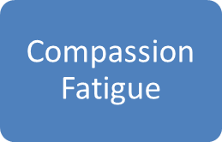
How does it impact us
Growth
Resilience
Secondary
Trauma
Burn Out

Slide 17
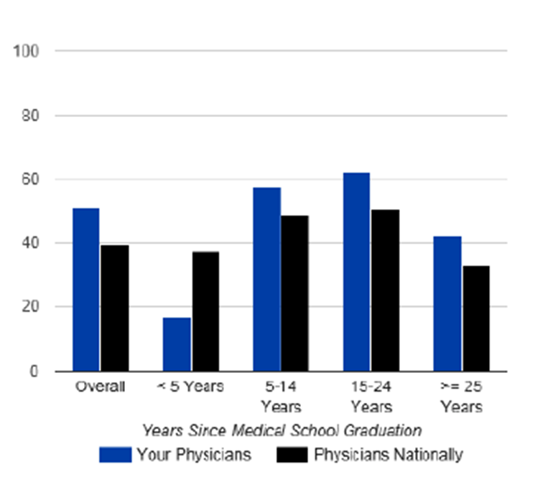
Burnout at Baystate
Numbers out of 457 with score > 3
2 fold higher reporting of medical error
5 fold higher burnout
4 fold severe fatigue
2 fold risk suicidal ideation
3 fold poor overall quality of life

Slide 18
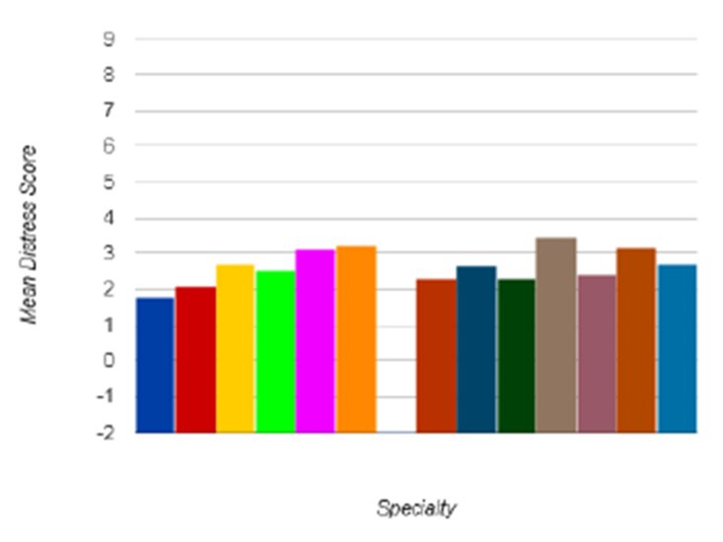
Mean by Provider Specialty

Slide 19
Pillars of Trauma Informed Care
Trauma is Central and Pervasive
Central to the development of mental and physical health problems and addiction
Impacts many aspects of a person’s life
Universal Precautions
A person should not have to disclose trauma to receive trauma-informed services
Treat everyone as a potential trauma survivor.
Understanding Symptoms and Behaviors
Attempts to cope with the trauma
Survival mechanisms
Align Goals of Service
to return a sense of autonomy and control to the person being served
Institute for Health and Recovery

Slide 20
Creating a Trauma Sensitive Organizational Culture
Contact Us:
Julie Thompson: Julie.Thompson@baystathealth.org
Cindy Marty Hadge: cindy@westernmassrlc.org

Slide 21
Resources/Supports
SAMHSA (Substance Abuse and Mental Health Services Administration)
https://www.samhsa.gov/
CHCS (Center for Health Care Strategies, Inc:
Healthrecovery.org – Intro to Psychological Trauma
When Survivors Give Birth: Understanding and Healing the Effects of Early Sexual Abuse on Childbearing Women 1st Edition
by Penny Simkin
Trauma Informed Care in the Perinatal Period (Protecting Children and Young People) First Edition,New edition Edition
by Julia Seng and Julie Taylor
The Body Keeps the Score: Brain, Mind, and Body in the Healing of Trauma Paperback – September 8, 2015
by Bessel van der Kolk M.D.
Trauma Stewardship: An Everyday Guide to Caring for Self While Caring for Others Paperback – May 4, 2009
by Laura van Dernoot Lipsky and Connie Burk

